Slide 1
Practical information about the vf²TDC
Document link
Overview of the board
Variations (current status)
Latest order

Slide 2
1. Document link
/group/da/distribution/coda/HardwareManual/vfTDC/
vfTDC.docx, vfTDC.pdf: vf²TDC user manual
vfTDC.pptx: a short presentation about the vf²TDC, resolution etc.

Slide 3
Practical information about the vf²TDC
Document link
Overview of the board
Variations (current status)
Latest order

Slide 4
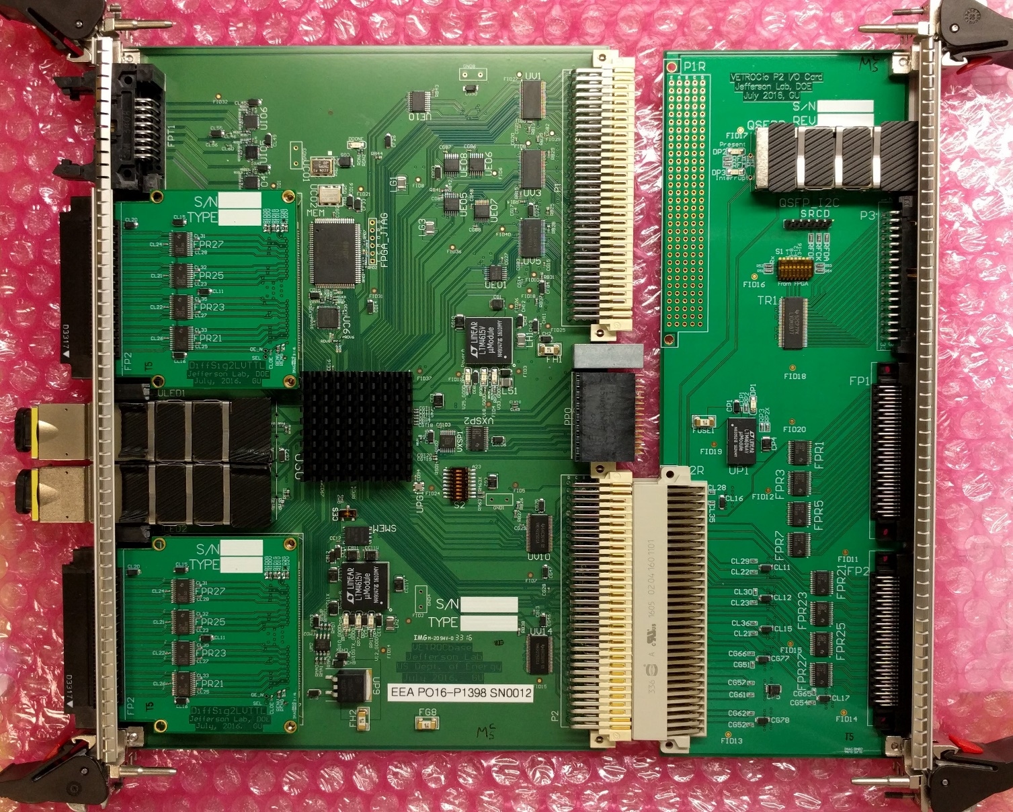
2. Overview of the board
The SET:
VETROCbase, 6U VME64x, 64 differential channels plus 8 differential inputs and 8 ECL outputs
2x VETROCmezz, 32-ch differential receiver (to LVTTL)
VETROCio, 6U VME64x, P2 IO card, 64-ch differential receiver (to LVTTL)

Slide 5
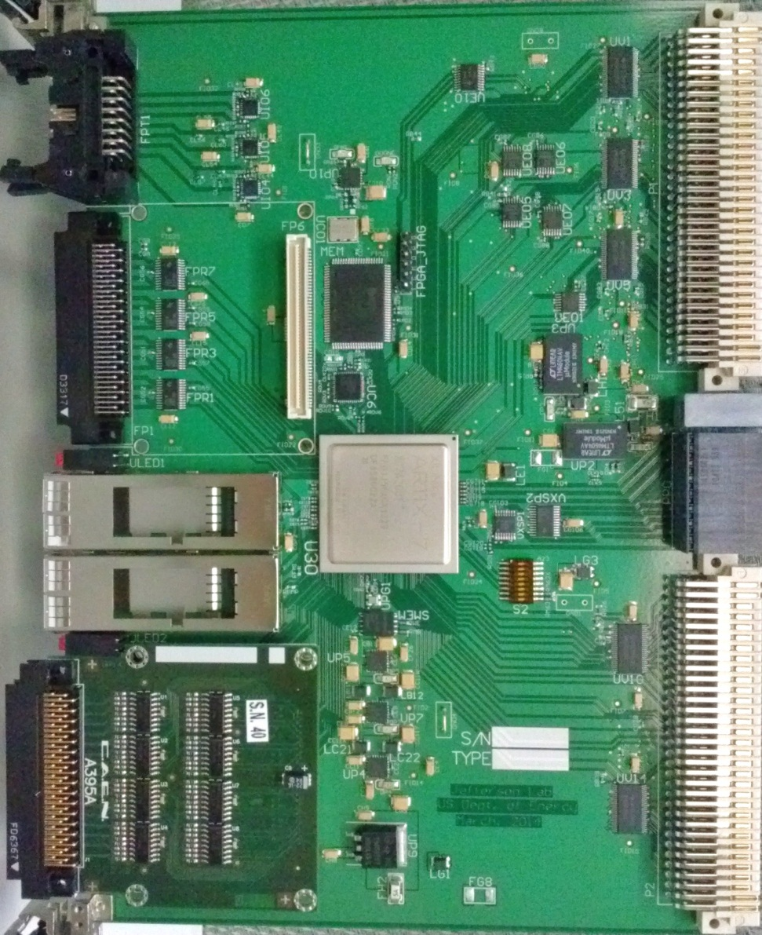
2. Overview of the board, details about the 6U VME base board
18Mbit RAM
Generic
8 differential In
8 ECL out
VME64x:
Register,
Data Readout
32 differential in
32 LVTTL in
Trigger Interface (fiber)
Trg/Clk/Reset/Busy
VXS P0:
Trg/Clk/Reset/Busy (SD)
4x Rx/Tx (to SW#A)
4x Rx/Tx (QSFP)
28 LVTTL on row A
4 + 4 LVTTL on row D
28 LVTTL on row C
2x Rx/Tx on row A & C
32 differential in
32 LVTTL in (with mezz. for differential IN)
FPGA, XC7A200T-2FF1156C

Slide 6
3. Variations (firmware)
3.1: 192-ch version (hardware: the SET)
There is a 4 µs ring buffer for every channel waiting for the readout trigger’s arrival. The data buffer is implemented in FPGA’s BRAM (~100 Kbyte). This data buffer can be expanded to the external 2 Mbyte ram. The TDC resolution (rms) ~ 30 ps.
This firmware is used in HallA.
3.2: 64-ch version (hardware: The 6U vme base board only)
There is a 8 µs ring buffer for every channel waiting for the readout trigger’s arrival. The edges are measured (at least) twice for better timing resolution and large delay cell mitigation. The data buffer is implemented in FPGA’s BRAM (~100 Kbyte). This data buffer can be expanded to the external 2 Mbyte ram. The TDC resolution (rms) ~ 20 ps.
This firmware is used in HallB.

Slide 7
4. Lastest order (the cost)
FY2024
PCB orders: PR# 430581, 424127
Front panels: PR#432423, 423948, I1, I2,
Costs:
VETROCbase: ~$1700 each at the quantity of 60
VETROCio: ~$450 each at the quantity of 40
VETROCmezz: ~$110 each at the quantity of 80
The 192-channel version: ~$2350 each
The 64-channel version: ~$1700 each
* But, (much) higher price for small quantity orders

