Slide 1
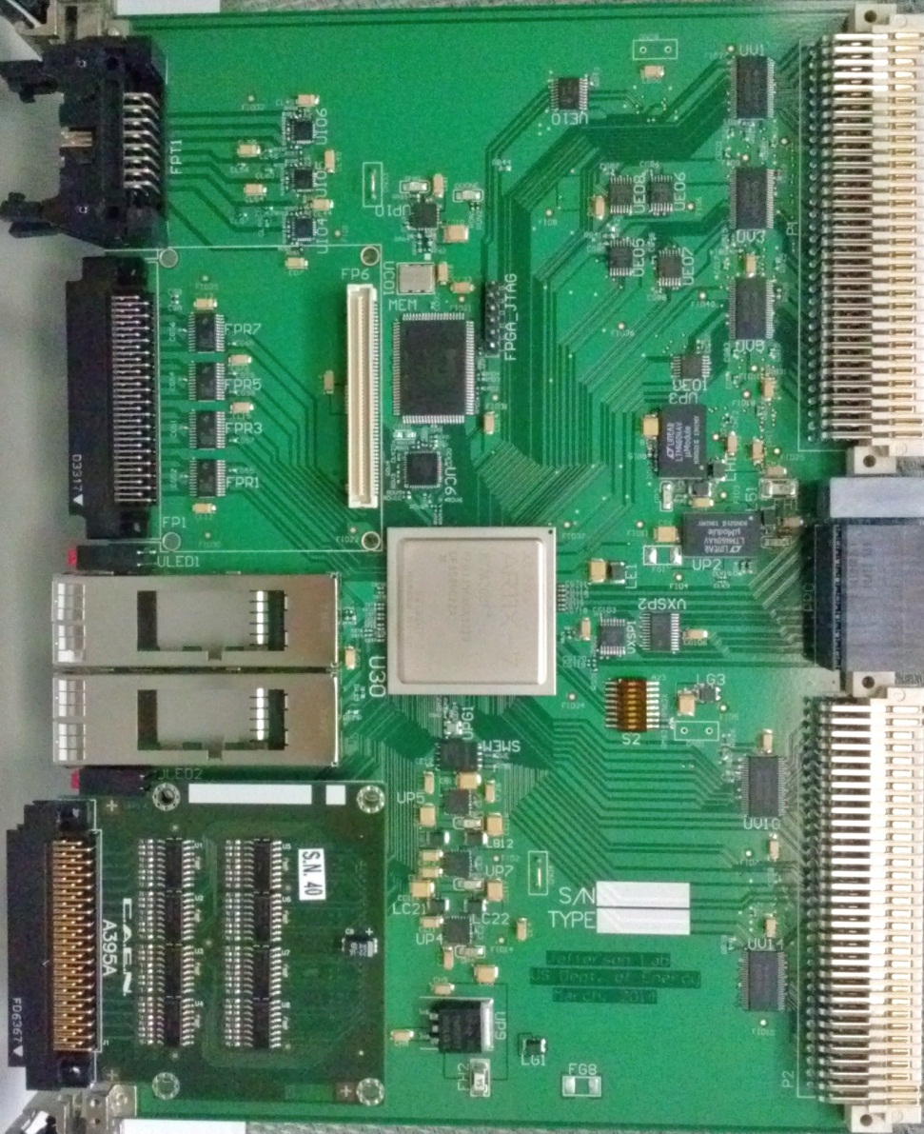
18Mbit RAM
Generic
8 differential In
8 ECL out
VME64x:
Register,
Data Readout
32 differential in
32 LVTTL in
Trigger Interface (fiber)
Trg/Clk/Reset/Busy
VXS P0:
Trg/Clk/Reset/Busy (SD)
4x Rx/Tx (to SW#A)
4x Rx/Tx (QSFP)
28 LVTTL on row A
4 + 4 LVTTL on row D
28 LVTTL on row C
2x Rx/Tx on row A & C
32 differential in
32 LVTTL in (with mezz. for differential IN)
FPGA, XC7A200T-2FF1156C

