Slide 1
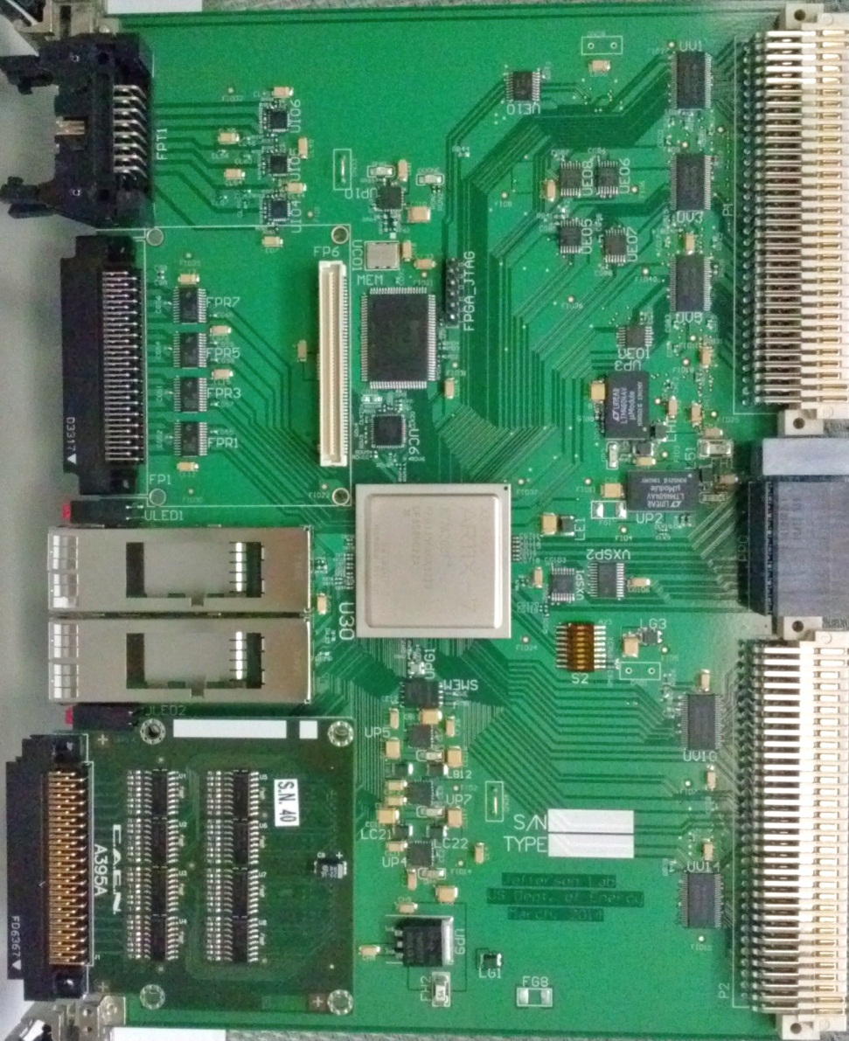
vXS fPGA-based Time to Digital Converter (vfTDC)
18Mbit RAM
Generic
8 differential In
8 ECL out
preliminary
VME64x:
Register,
Data Readout
32 differential in
32 LVTTL in
Trigger Interface
Trg/Clk/Reset/Busy
VXS P0:
Trg/Clk/Reset/Busy
4x fiber Tx/Rx
28 LVTTL on row A
4 + 4 LVTTL on row D
28 LVTTL on row C
32 differential in
32 LVTTL in (with mezz. for differential IN)
FPGA, XC7A200T-2FF1156C

Slide 2
FPGA-based TDC measurement:
It measures the edge relative to the clock directly,
  How many clock cycles passed (coarse measurement);
  Latency between the signal edge and the clock edge (fine measurement)
The common start (or common stop) can be used as a normal channel, (multiple measurement on the common signal can decrease the statistical measurement error)
If the clock is accelerator synchronized clock, there will be no need for the precise common start (or common stop). The readout trigger should be sufficient.
Easier PCB design. Actually, this is based on a PCB designed for HallA.

Slide 3
Single channel measurement:
Ch_In
Calib_In
Carry Chain
32x4 units
Calib_sel
Clock
500MHz
Register
128
FD
FD
FD
FD
FD
FD
FD
FD
FD
FD
FD
FD
FD
FD
FD
FD
FD
FD
FD
FD
Edge finder, rising/falling edge
Pipelined encoder
R_edge F_edge
Fine_Time(6:0)
(one edge per 2ns)
Clock
250 MHz
R_edge F_edge
18Kb ring buffer,
4 us deep
Fine_Time(6:0)
Dly_R_edge Dly_F_edge
Dly_Fine_Time(6:0)
Ring_Buf_read_ddr(9:0)
EdgeInfo(17:0)
Readout Lookback
Readout window
CoarseTime
FineTime
“ZERO”
suppressed
Trigger
Event
marker
Event FIFO
36(wide) x 512(deep)

Slide 4
TDC readout (data merging):
Ch#1 data(26:0)
Trigger/Clock/Reset
Ch#2 data(26:0)
Merged data(26:0)
27(wide) x 2048(deep)
Event Headers
32(wide) x 1024(deep)
Merged data(26:0)
27(wide) x 2048(deep)
Further merged
data(26:0)
(connector#1)
27(wide) x 2048(deep)
Ch#8 data(26:0)
Further merged
data(26:0)
(All channels)
27(wide) x 4096(deep)
6 → 1 merger
Merged data(26:0)
27(wide) x 2048(deep)
Ch#32 data(26:0)
Merged data(26:0)
27(wide) x 2048(deep)
Full block
Block headers
event#1 headers
event#1 data
------
event#n data
Block Trailer
Further merged
data(26:0)
(connector#6)
27(wide) x 2048(deep)
Merged data(26:0)
27(wide) x 2048(deep)
Ch#192 data(26:0)
VME Readout
Other Readout
8 → 1 merger
4 → 1 merger
Data Format
Bits (31:27, 26-24, 23:19, 18, 17:8, 7, 6:0
Format Connector# Channel# EdgeType Coarse_time 2ns Fine_time
xxxxx 0 - 5 0 - 31 1: R 0: F 4*(0 – 1023) ns 0/1 0 - 127

Slide 5
Special features of the vfTDC:
Some edges will be measured twice. This gives a real-time carry chain delay calibration, esp. the fine delay step size (LSB);
The FPGA built in IODelay elements can be used to calibrate the delay chain linearity;
External calibration is needed only for the delay offset.
Programmable: by sacrificing the channel count (192), the vfTDC can expand its measurement ranges (4 us) (limited by the total available memory size); Choosing a higher performance FPGA, the measurement LSB can be improved.

Slide 6
vfTDC in-FPGA calibration
Increment
31.25MHz
clock
Input
Output
Calib1
Ch#1 TDC
IN1
IODELAY
VME_Calib
Initialize
Calib32
Ch#32 TDC
IN32
Delay (~us)
Calib_Trg
TRG
Calib_Sel
Each group (32 channels) has one set of calibration logic, so the IODELAY is localized
One rising edge and one falling edge per 32ns.
IODELAY increases (2.5ns/32 ~78ps) every 32ns.

Slide 7
A typical channel in-FPGA calibration
(TDC Count)
Routing inside the FPGA
The 250MHz clock count was subtracted for the plot;
‘Double measurement’ is used to calibrate the LSB, here: LSB=18.2ps;
IODELAY calib: LSB= 18.1ps;
Falling edge
Double measurement
Rising edge
(In 78ps steps)

Slide 8
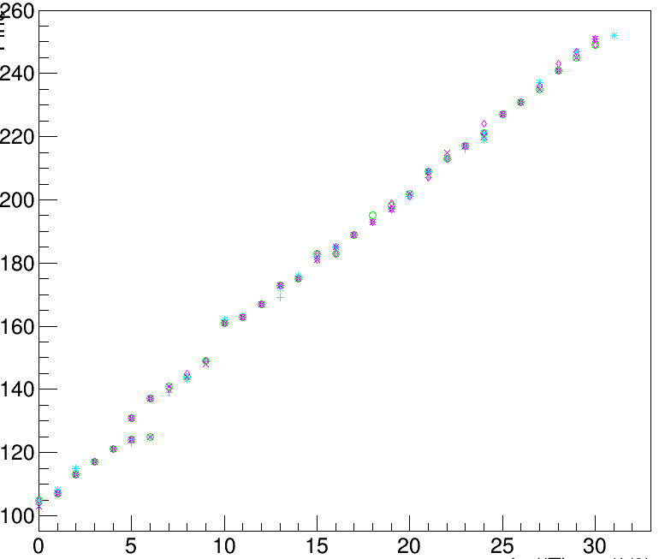
A typical channel in-FPGA calibration
(TDC Count)
* event#1
+ event#2
◊ event#3
○ event#4
X event#5
Another channel with five calibration events;
Routing specific linearity (FPGA Clock routing, Carry chain routing)
Event by event repeat, → TDC measurement reolution
(In 78ps steps)

Slide 9
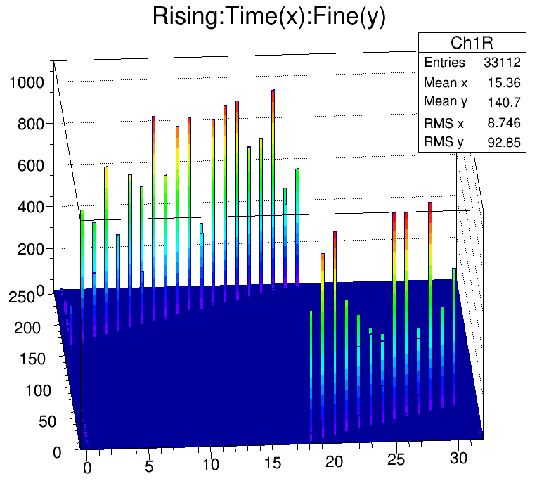
A lego plot of in-FPGA calibration
(Entries)
Another channel 1000 calibration events.
The resolution (on the majority of the calibration points) is less than one LSB (<18ps)
(TDC Count)
(In 78ps steps)

Slide 10
vfTDC status and to do lists
Status:
192 Channel TDC compiled ;
VME data readout;
Minimum pulse width 3ns, separation 3ns: guaranteed by design;
LSB: 18ps;
In-FPGA calibration resolution: <18ps
To do lists:
FPGA clock distribution specific calibration, FPGA LOCed routing;
Channel offset calibration (external calibration);
Overall TDC resolution (PCB noise, etc);
Real situation performance and feedback
Extension:
The Trigger Supervisor board can be used as a 64 channel TDC. The IOs are fully differential on the PCB, and a higher overall resolution can be achieved

Slide 11
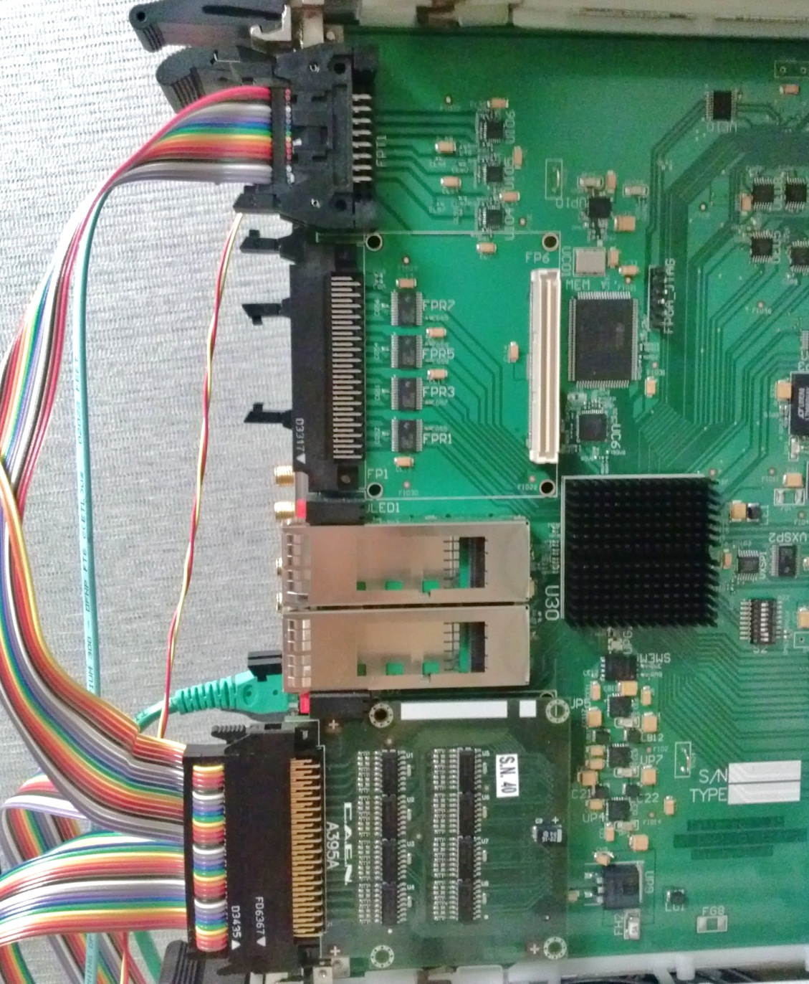
External inputs for overall noise/resolution
8 channels of test signal, synced with ClkVme, 20ns high, 20 ns low.
Various inputs are tried.
Example plots with randomly choosen channels.
8-Ch
ECL
Ouptuts
Ch1-32
Ch33-64
The signal looks like a clock
20ns
20ns
The skew between the eight channels are less than 0.4ns (peak to peak)
Ch65-96
Ch129-192
Ch97-128
CAEN
A395A

Slide 12
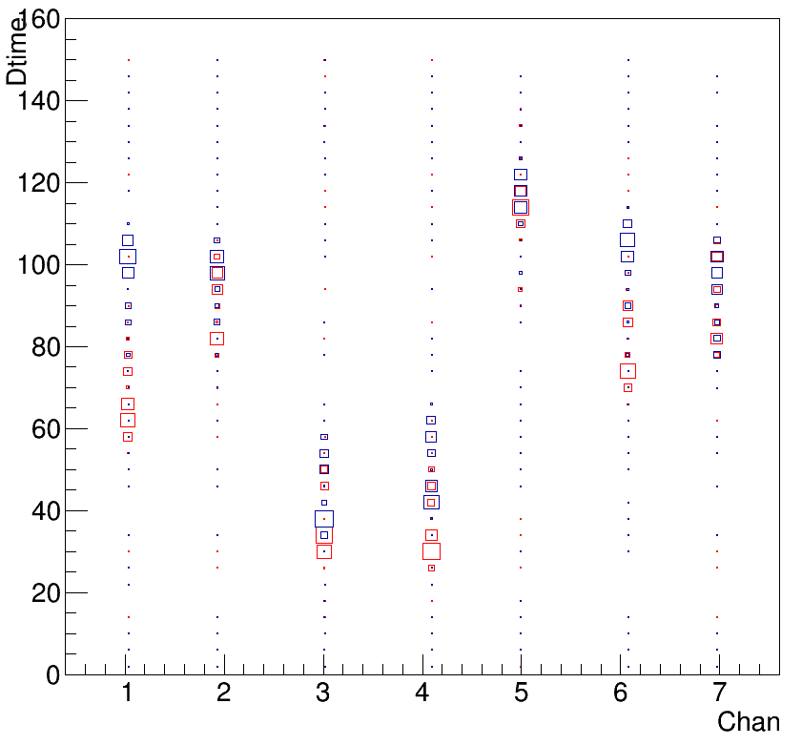
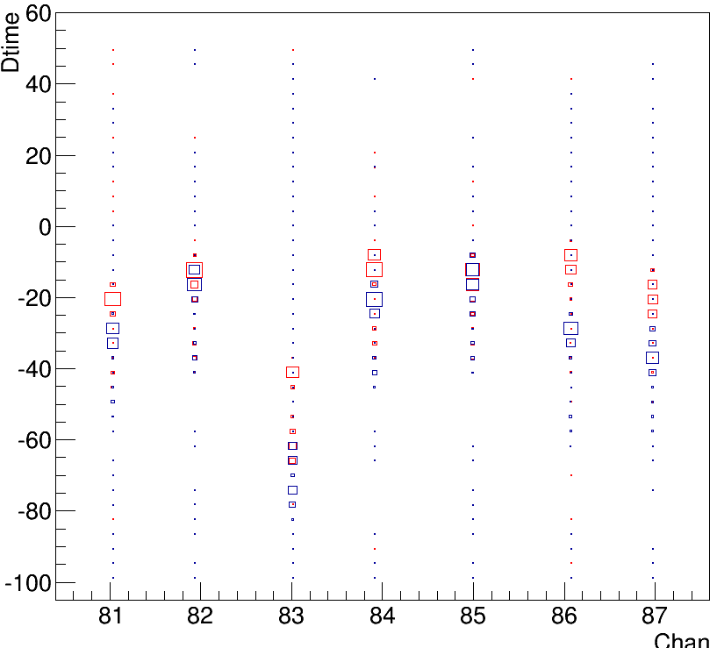
Channel to Channel measurement
8 channels of test signal, synced with ClkVme, 20ns high, 20 ns low.
Various inputs are tried.
Example plots with randomly choosen channels.
The signal looks like a clock. With ~1us DAQ window, there are ~50 edges per event
20ns
20ns
The skew between the eight channels are less than 0.4ns (peak to peak)
There are 35K events for the plots
Timing measurement difference between Ch#n and the first channel (CH#0 and Ch#80)
*RED: Edge=1, rising edge
BLUE: edge = 0, falling edge

Slide 13
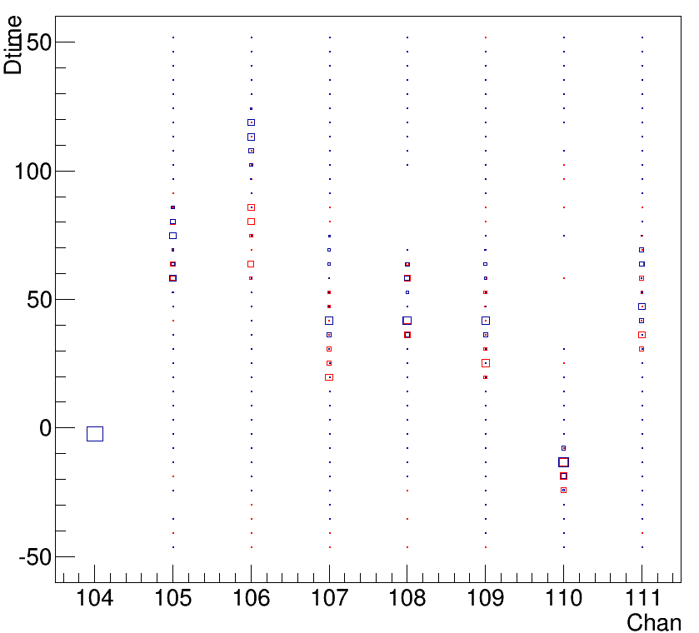
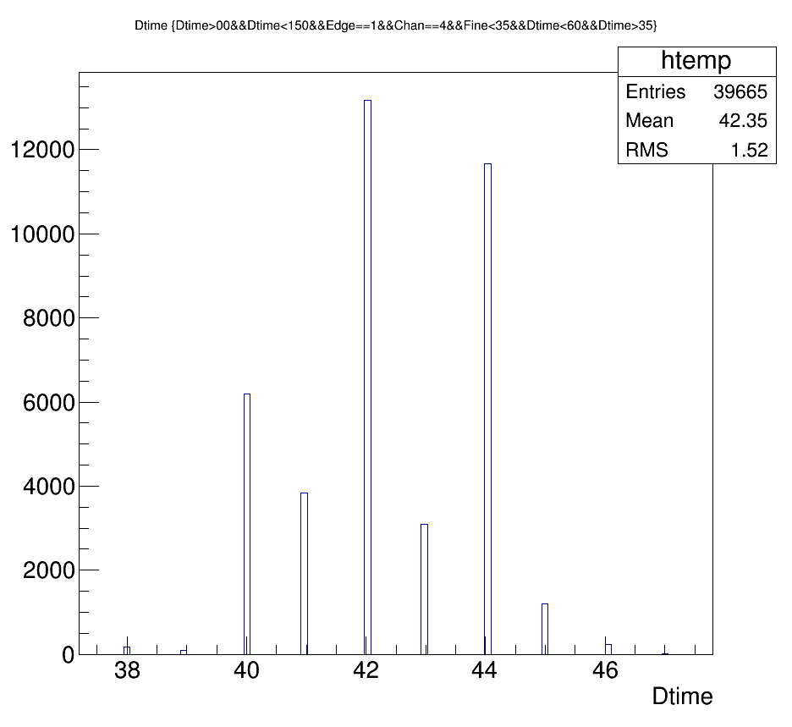
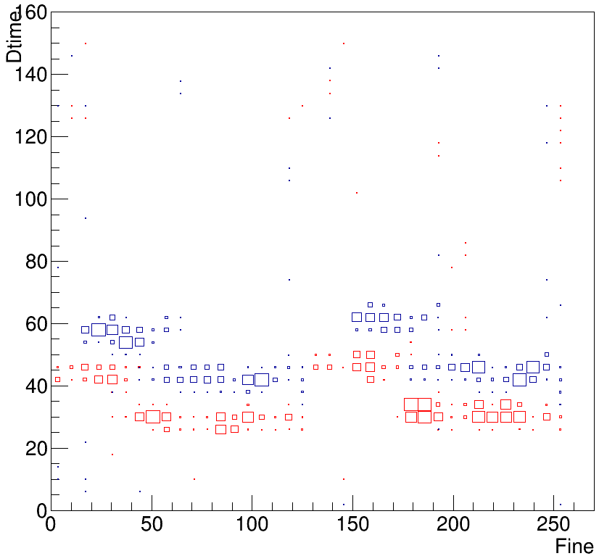
Channel to Channel measurement
Channel#4 as example, further analyze it
For Edge=1, and Fine<35, the DT = 42.4+-1.5
➔ TDC measurement RMS: 20 ps

Slide 14
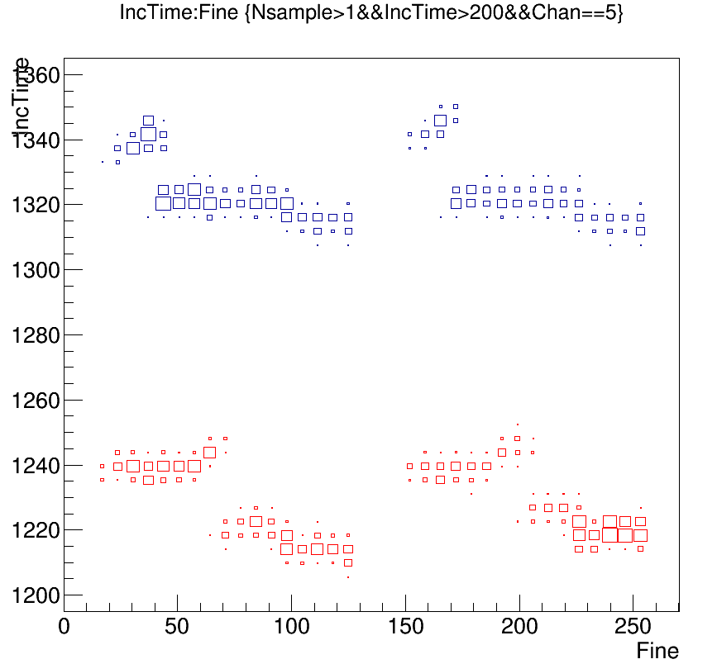
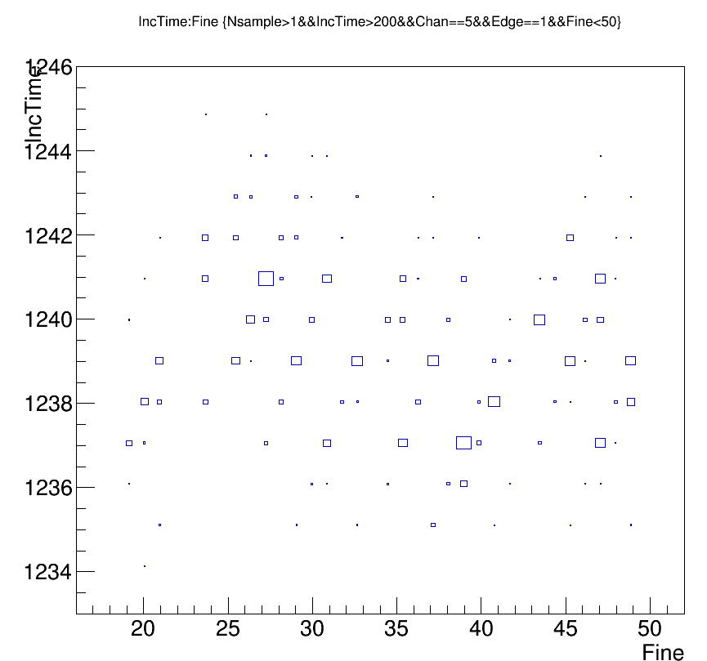
Within the same Channel measurement
Pulse width measurement
Channel#5 as example, plot all the ~50 edges in the right plot
Pulse high: ~20.8ns, pulse low: ~ 19ns
Average: 1277, (1280=20ns);
Fine<50 region: 1239+-1.7 (edge=1)
➔ TDC measurement RMS: ~25 ps

Slide 15
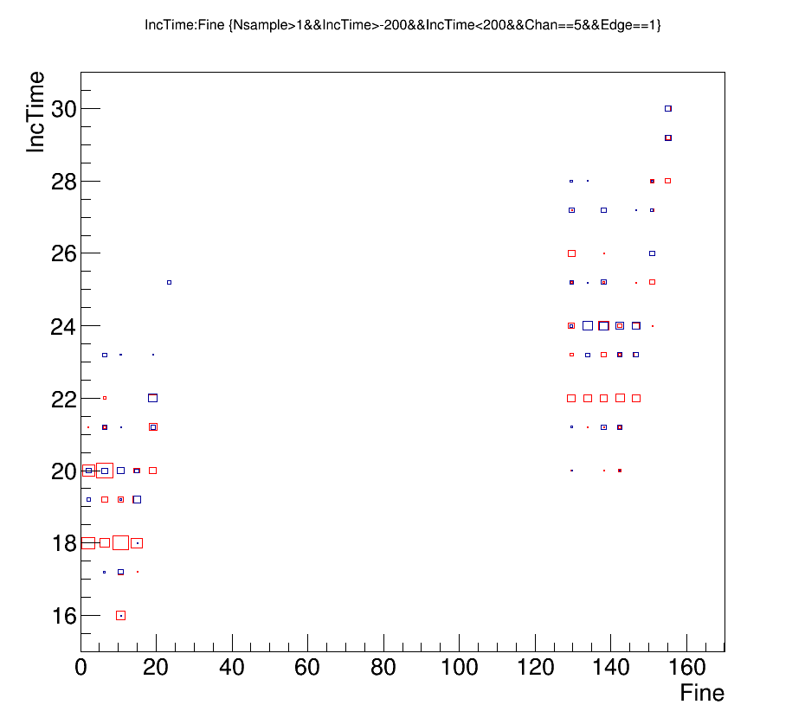
Within the same Channel measurement
Some pulses are measured in two consecutive clock cycles, when the carry chain range is longer than the clock period (feature of the carry chain).
Channel#5 as example,
The 2n range corresponds to 128-DeltaT
Fine>128 has different range than that for Fine<128. This means that the Clk250 is not perfectly 50% duty cycle.
Duty cycle difference: 100ps (/4ns)
LSB: 2ns/105=19ps

