Slide 1
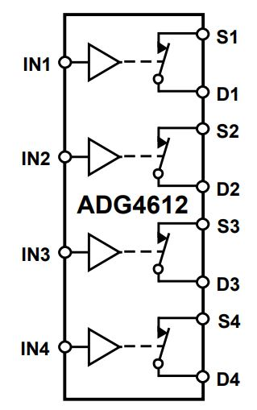
LED calibration pulse measurement
LED(1)
FPGA_enable(1)
Calibration pulse generation circuit
LED(2)
FPGA_enable(2)
2 op-amp in parallel drive 36-channels
LED(…)
LED Cal pulse
FPGA_enable(…)
DAC_D(0)
FPGA_DAC
6-bit
500 MSPS
DAC_D(1)
DAC_D(2)
LED(36)
DAC_D(3)
FPGA_enable(36)
DAC_D(4)
DAC_D(5)
DAC_OUT
DAC_Zero
FPGA
1, 0, Z
LED Cal pulse
To another four sets
Ground

Slide 2
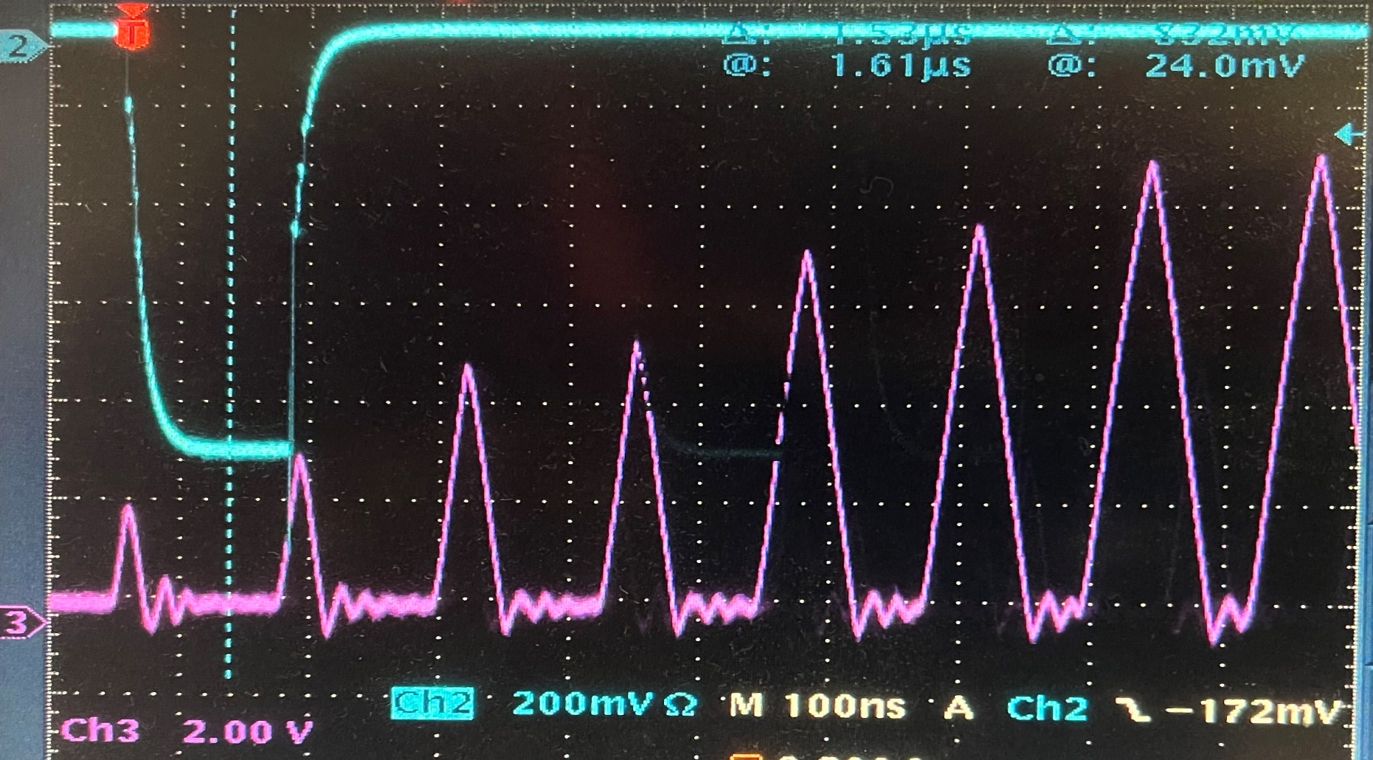
Calibration pulse vs DAC setting (oscilloscope picture)
Trigger output
DAC setting,
0x7f
0
Calibration
pulse
Width
Width
4ns
8ns
12ns
16ns
20ns
24ns
28ns
32ns

Slide 3
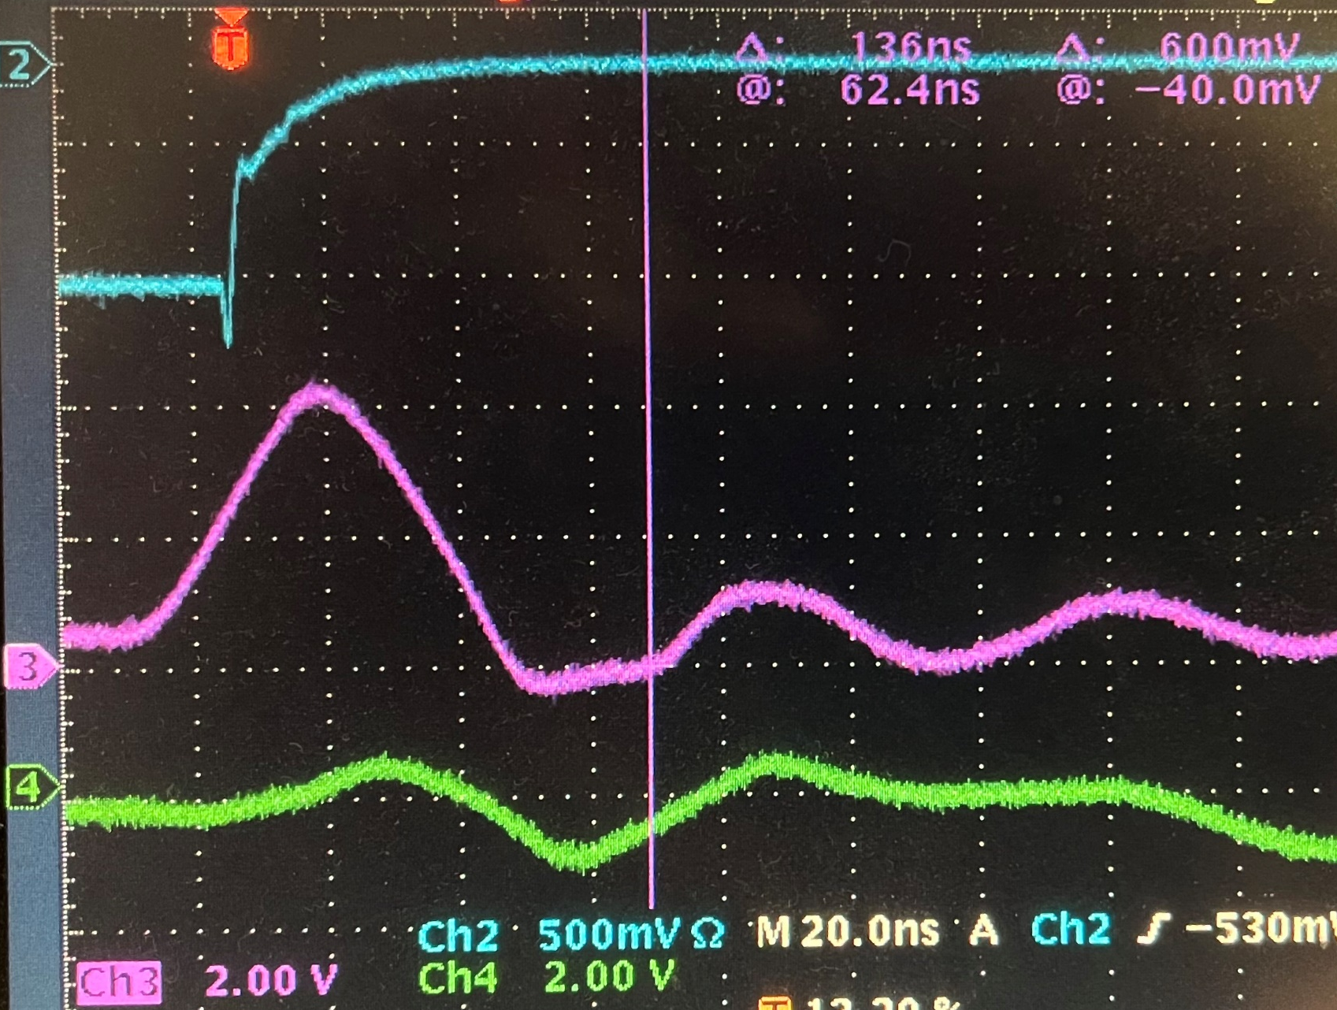
Calibration pulse vs DAC setting (oscilloscope picture)
Trigger output
Zoom in on the smaller pulse
Edge slop:
~1V/6ns
Calibration
pulse

Slide 4
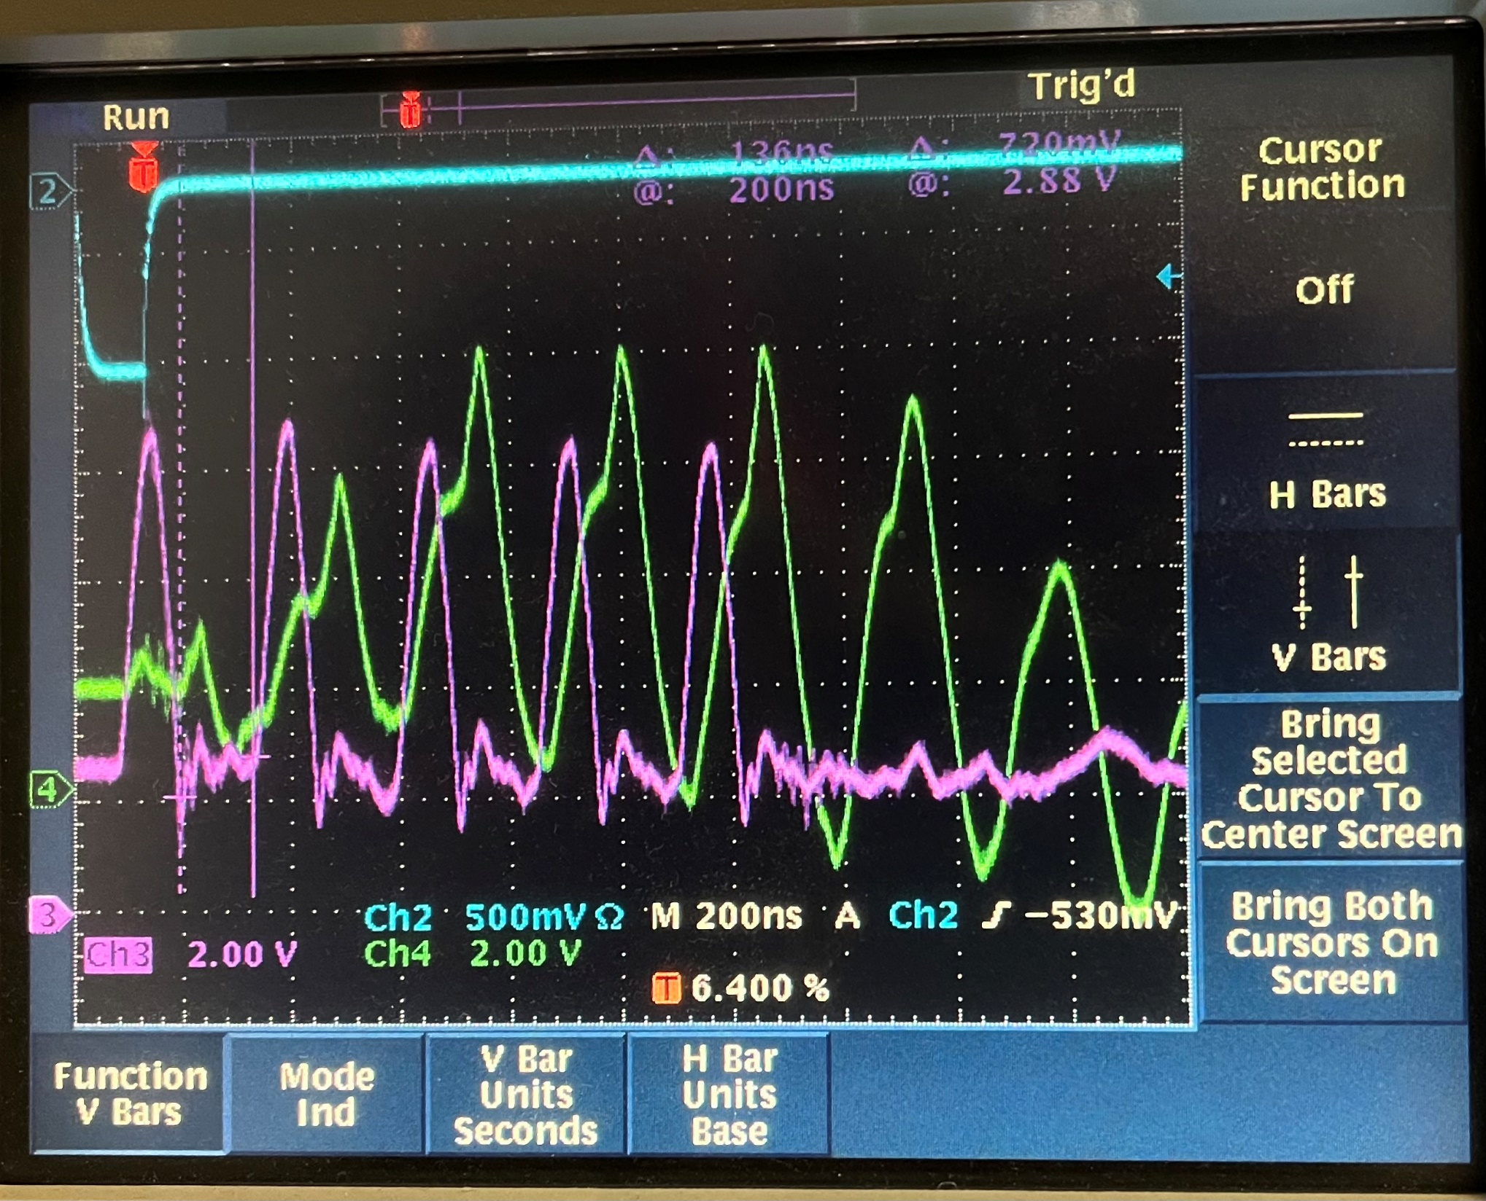
The measurement at the BLUE LED is unreliable, but here is an example with floating probe ground
Trigger output
Probe at the VLD board
Probe at the blue LED anode (not the same LED as NPS), The LED cathode back to VLD (another ~150 ft wire/cable)

Slide 5
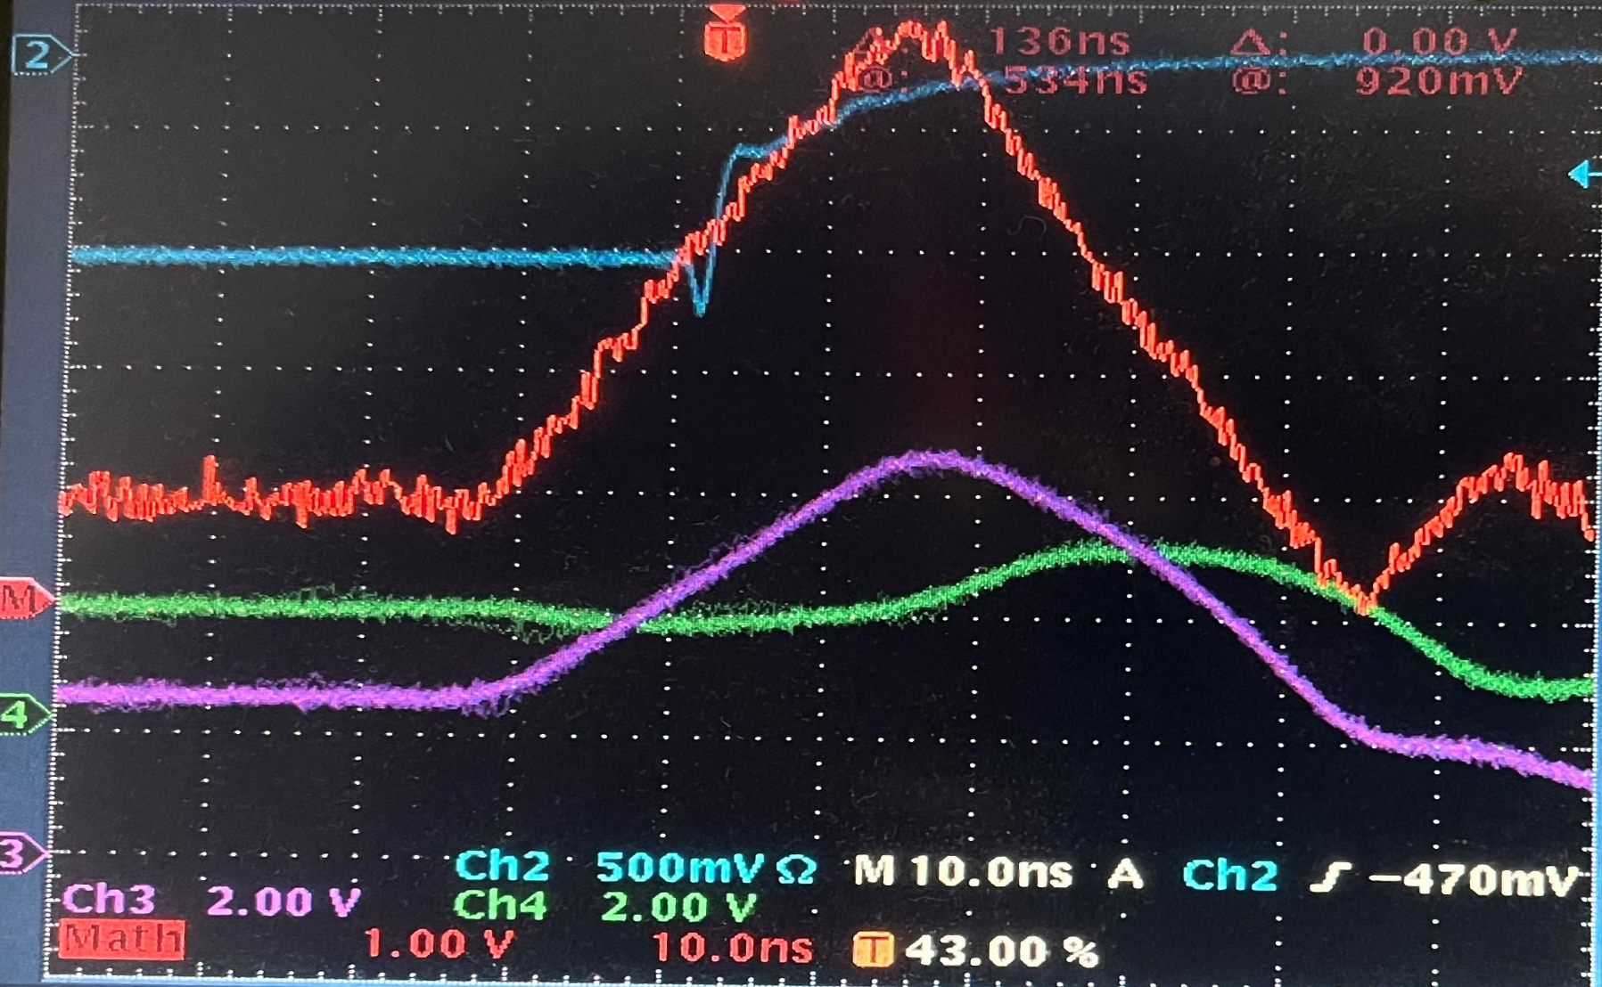
Set the calibration pulse baseline to about 2V to compensate for the BLUE LED light emission threshold
Trigger output
Probe at the blue LED anode (carhode to ground
Probe at the VLD board

Slide 6
LED calibration pulse measurement
The following (until next date mark, on page 21) are measured on Feb. 28th, 2022
LED(1)
FPGA_enable(1)
Calibration pulse generation circuit
LED(2)
FPGA_enable(2)
2 op-amp in parallel drive 36-channels
LED(…)
LED Cal pulse
FPGA_enable(…)
DAC_D(0)
FPGA_DAC
6-bit
500 MSPS
DAC_D(1)
F
DAC_D(2)
LED(36)
DAC_D(3)
FPGA_enable(36)
DAC_D(4)
A
B’
B
DAC_D(5)
C
D
DAC_Zero
DAC_OUT
FPGA
1, 0, Z
E
LED Cal pulse
To another four sets
Ground

Slide 7
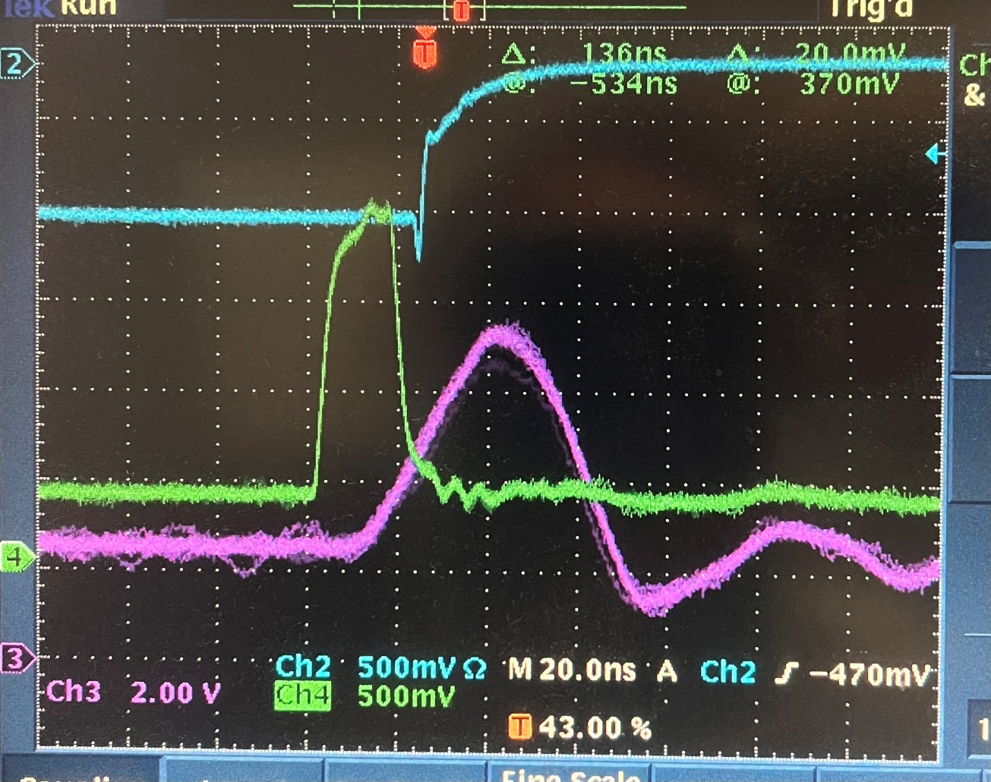
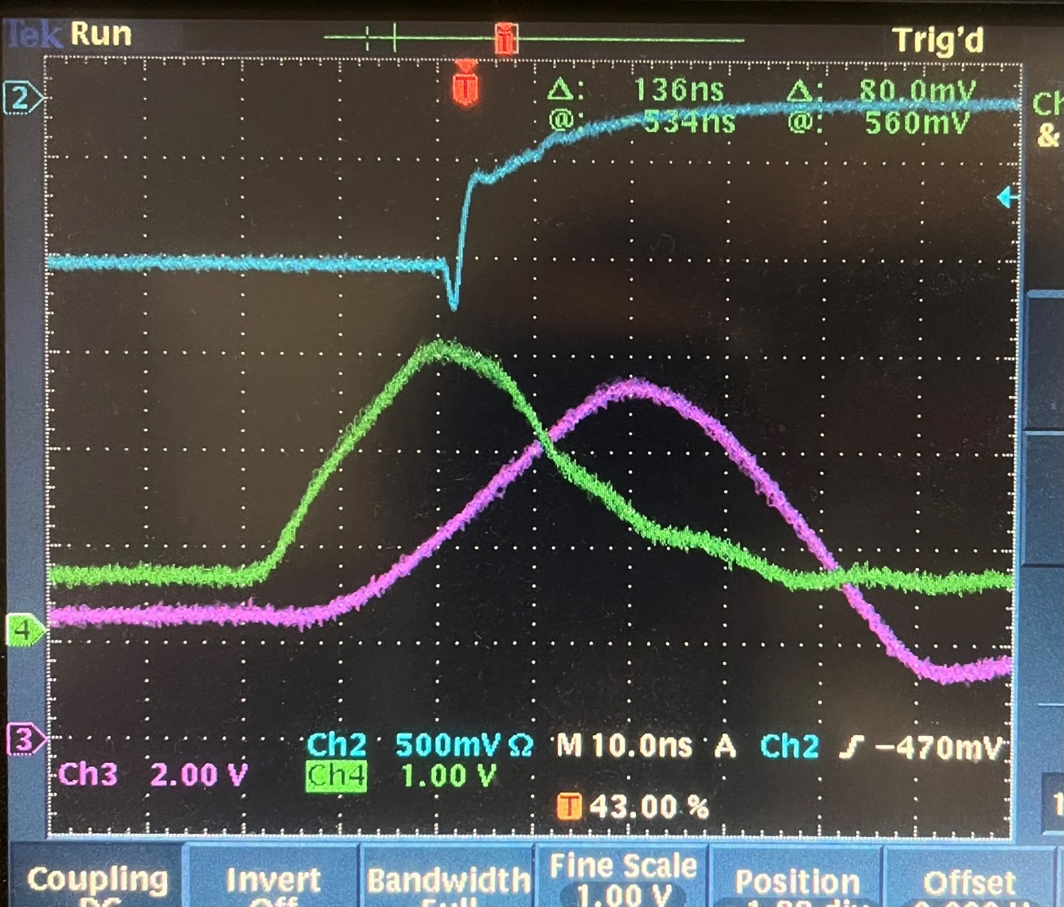
B
The ‘op-amp’ end of DAC output
The ‘DAC’ + input
A
Calib at the cable (30 cm from PCB)

Slide 8
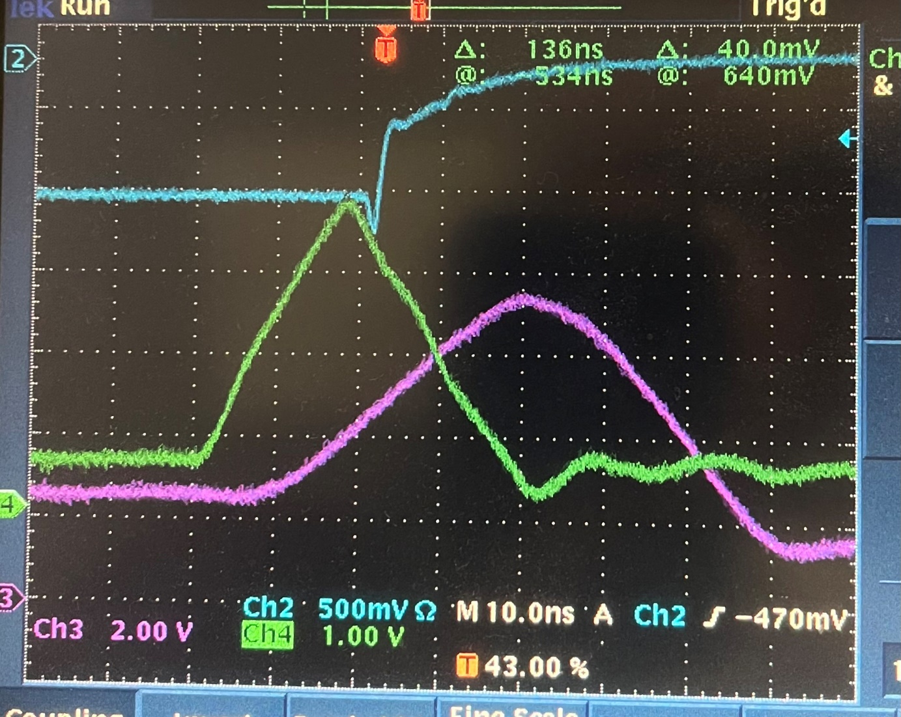
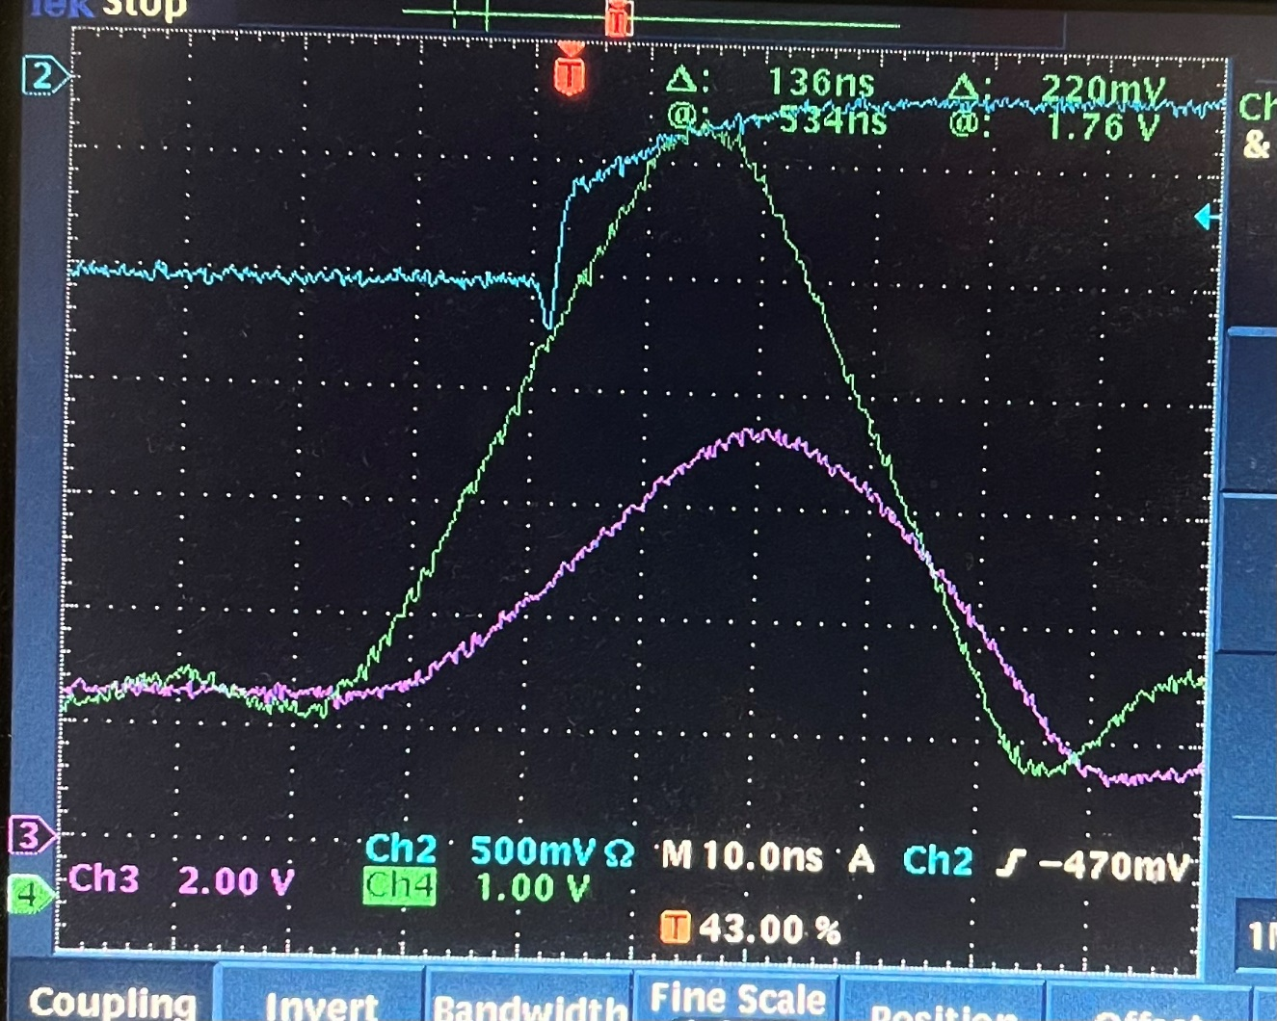
C
D
The ‘op-amp’ + input
The ‘op-amp’ output

Slide 9
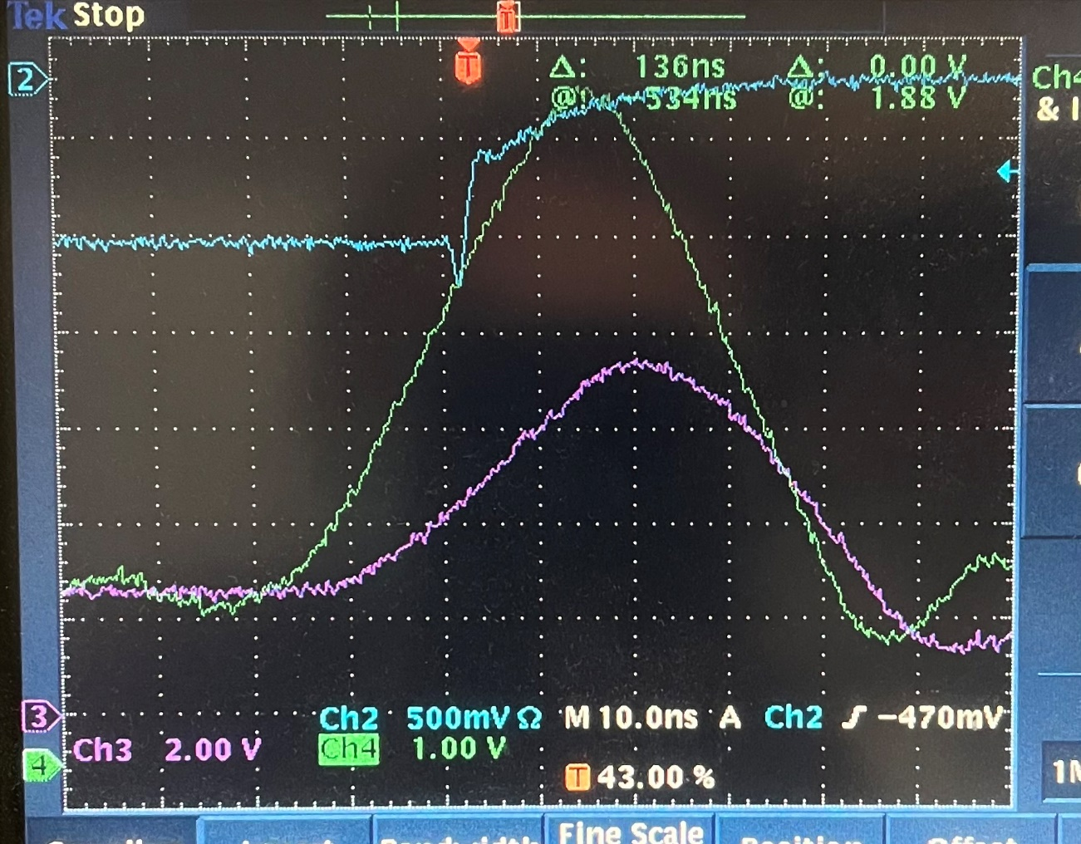
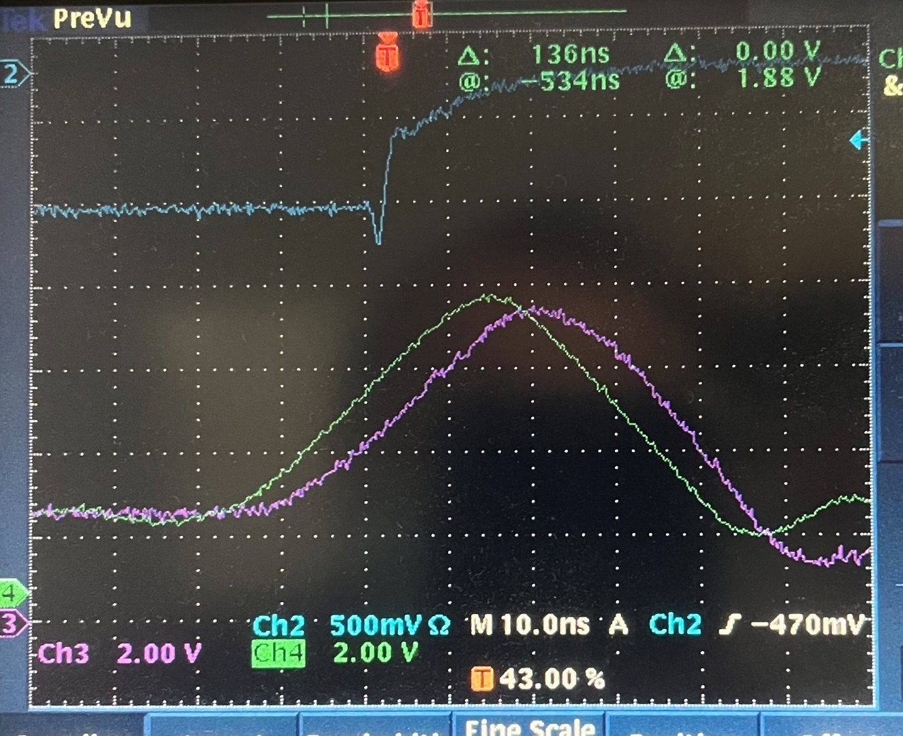
E
E
The same, but 2V vertical scale, to compare with Calib on the cable
The ‘op-amp’ after the 0.5Ohm

Slide 10
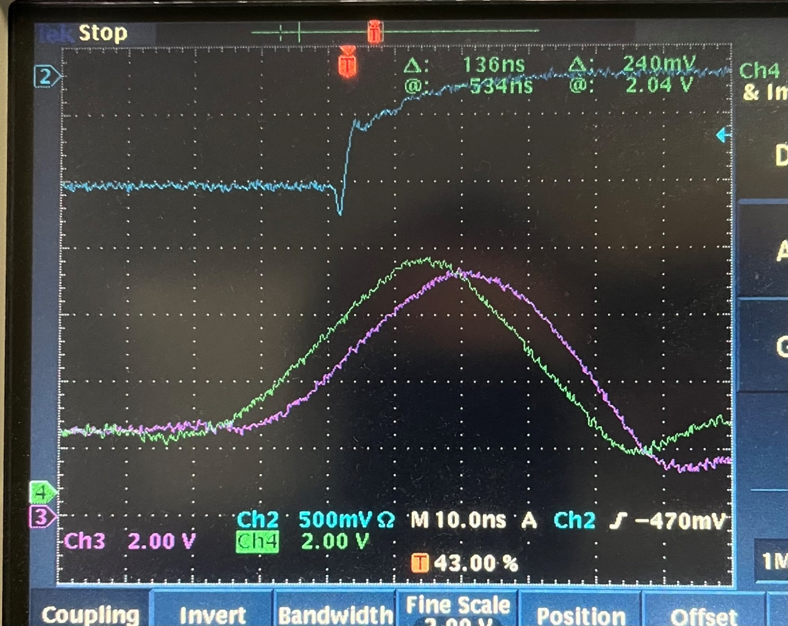
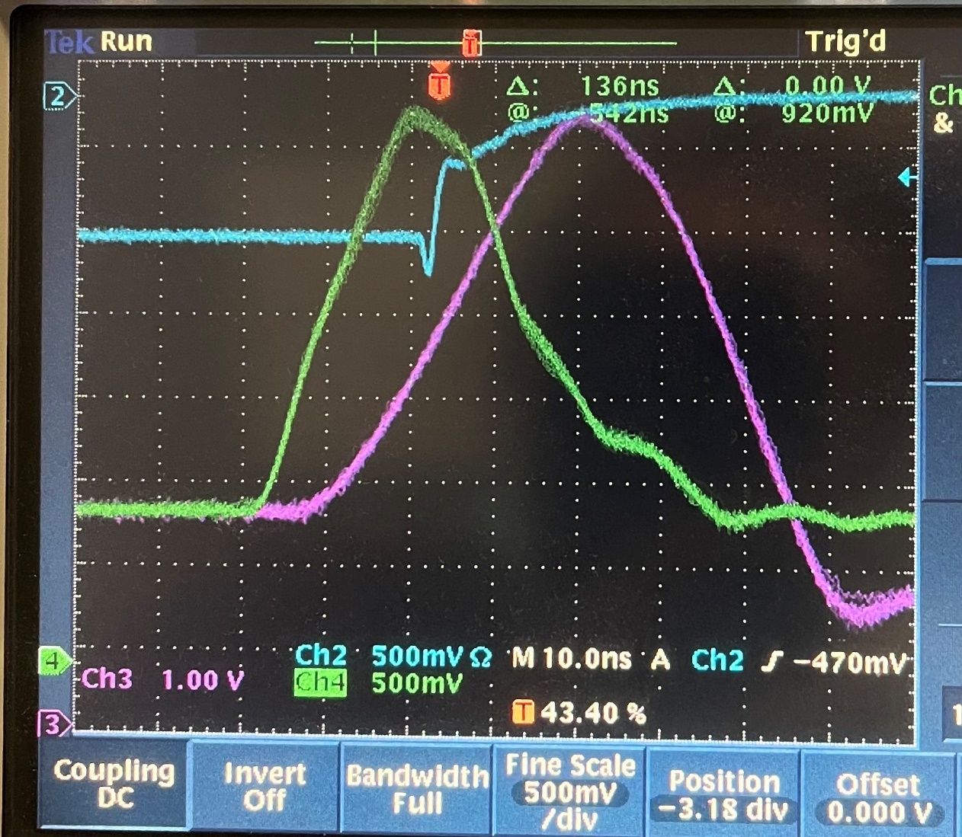
E
Disable the other op-amp
B’
Probe at the DAC- input

Slide 11
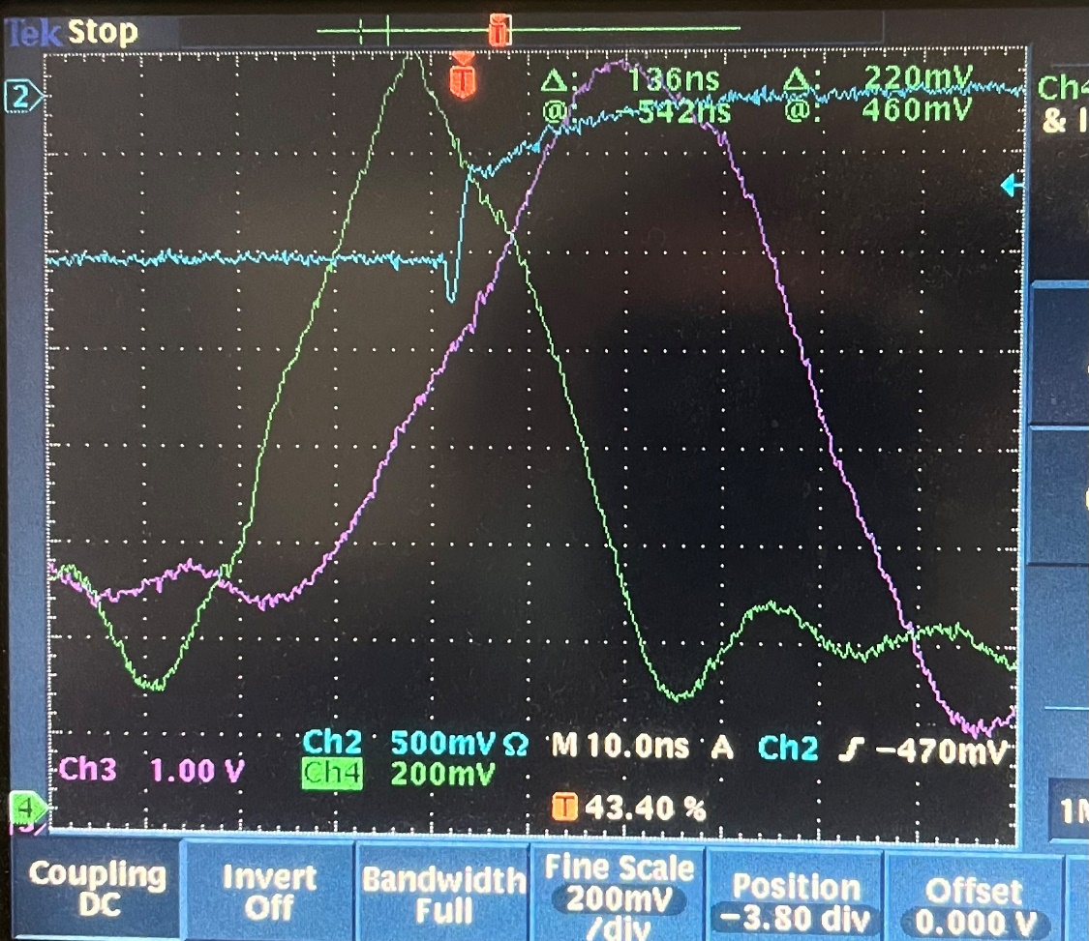
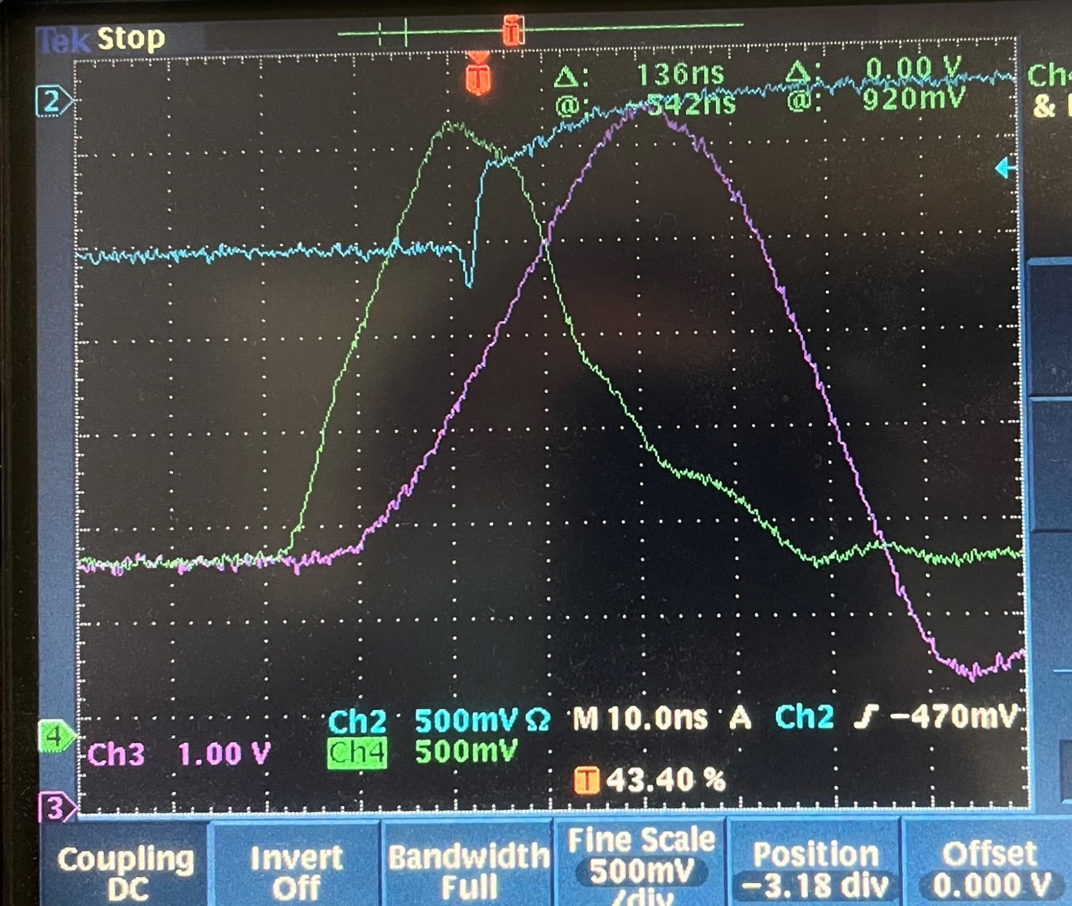
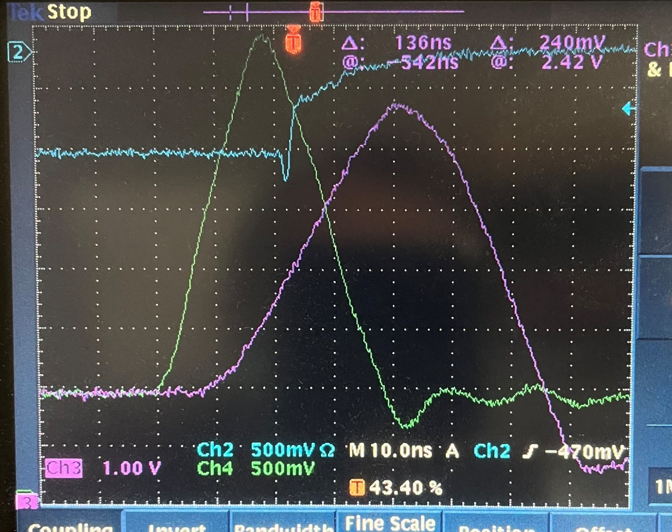
Probe at the DAC output with one op-amp
DAC-
Probe at the DAC output
DAC_o

Slide 12
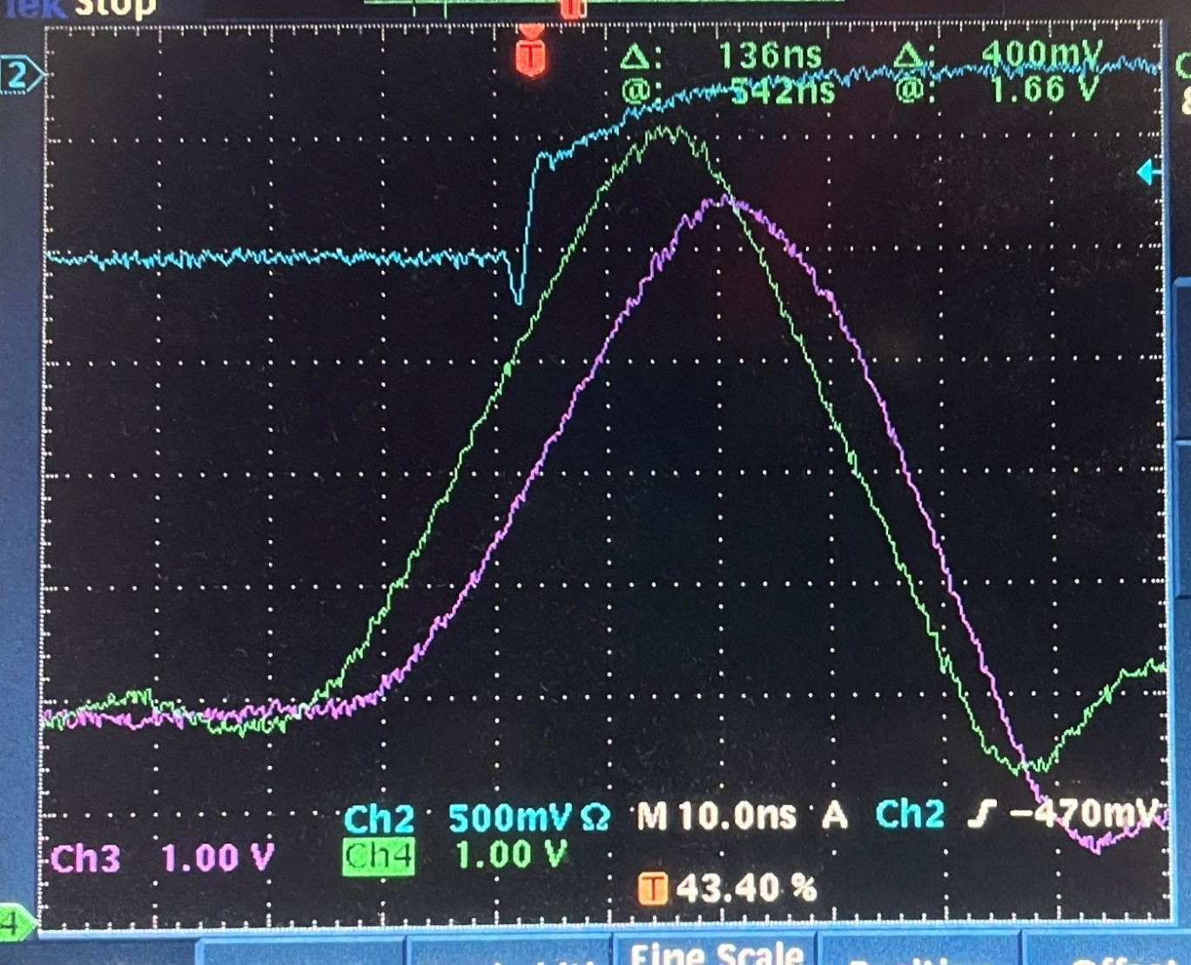
Op-amp output, with all the other op-amp disabled
B’
DAC output with one op-amp active
Only one CH

Slide 13
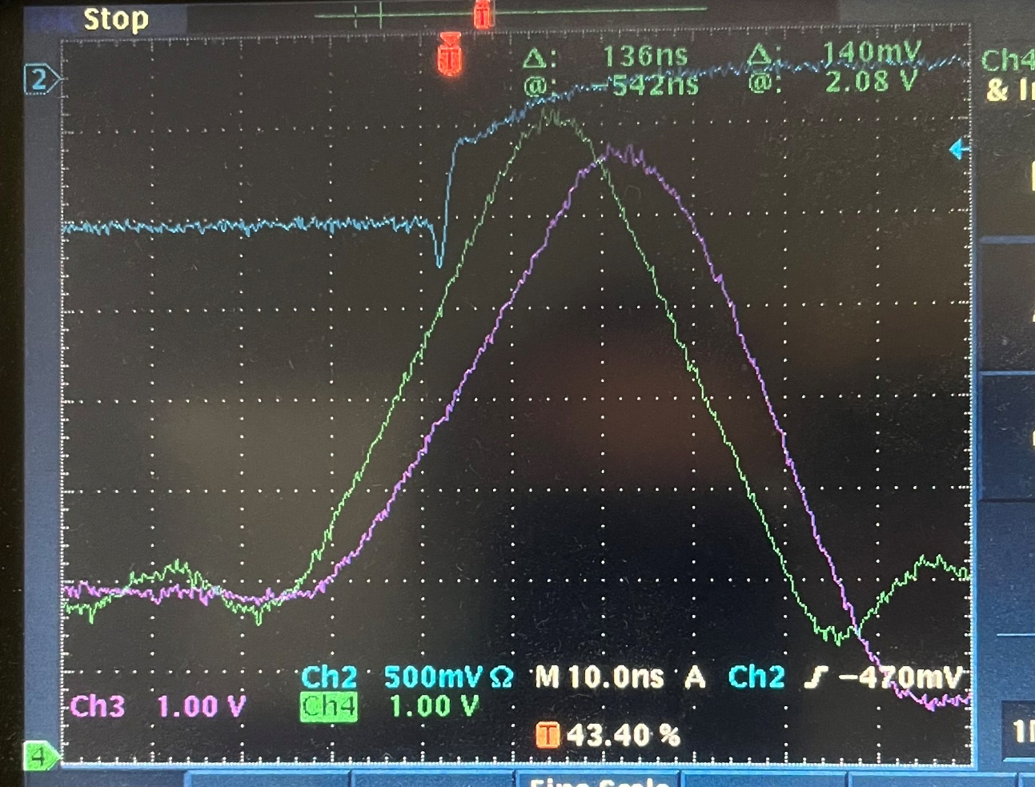
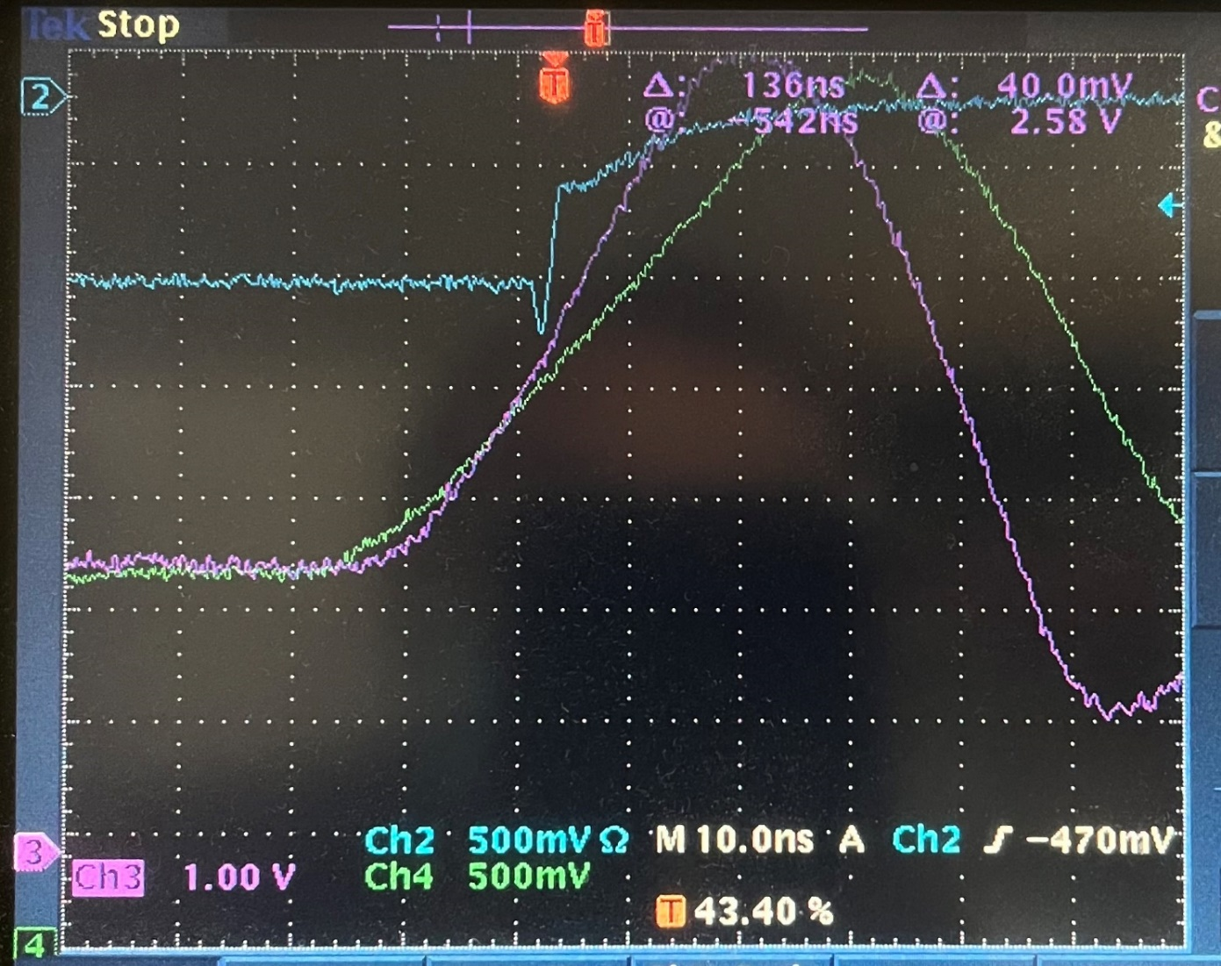
No_amp
Same as before, after 0.5 Ohm
36-ch
With all the 36 switches ON. Lower amplitude and slower calib pulse

Slide 14
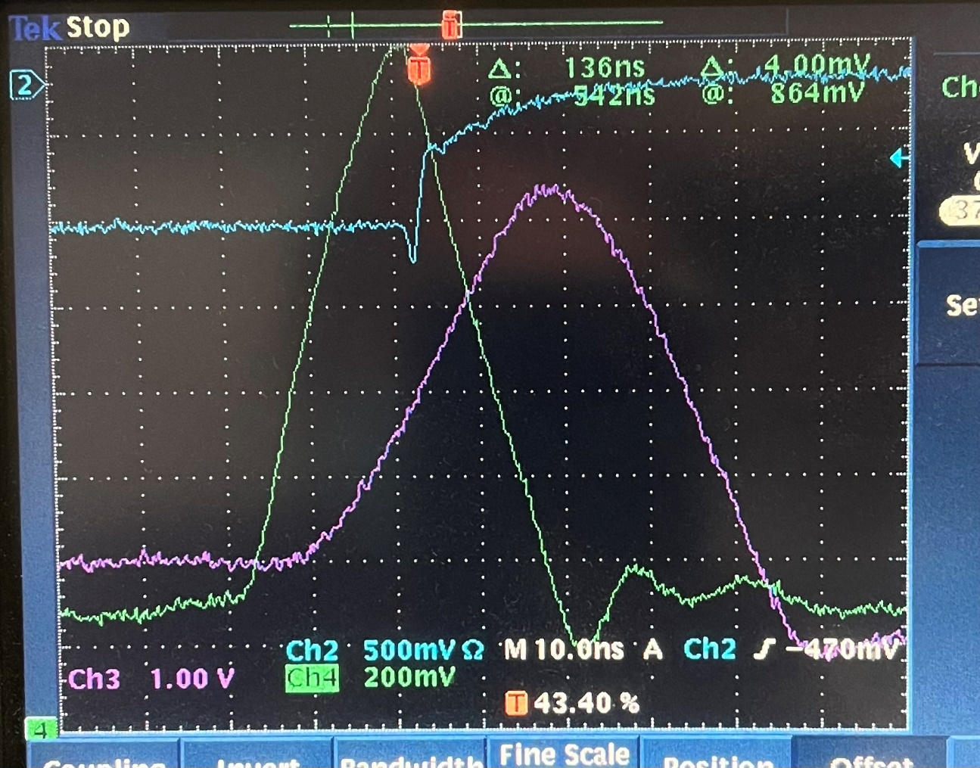
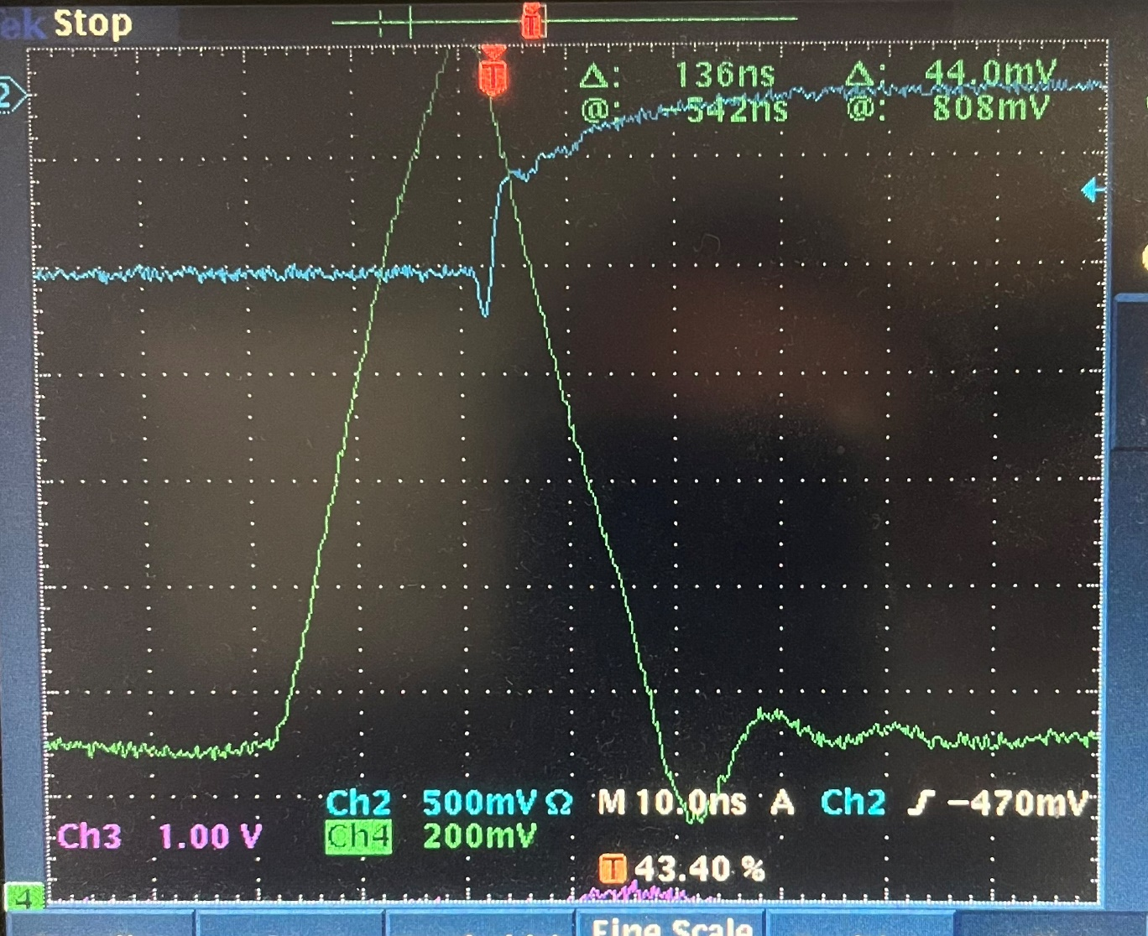
One opamp
No opamp
DAC output with one Ch (one switch on)
DAC output with zero Ch (all the switches are OFF)

Slide 15
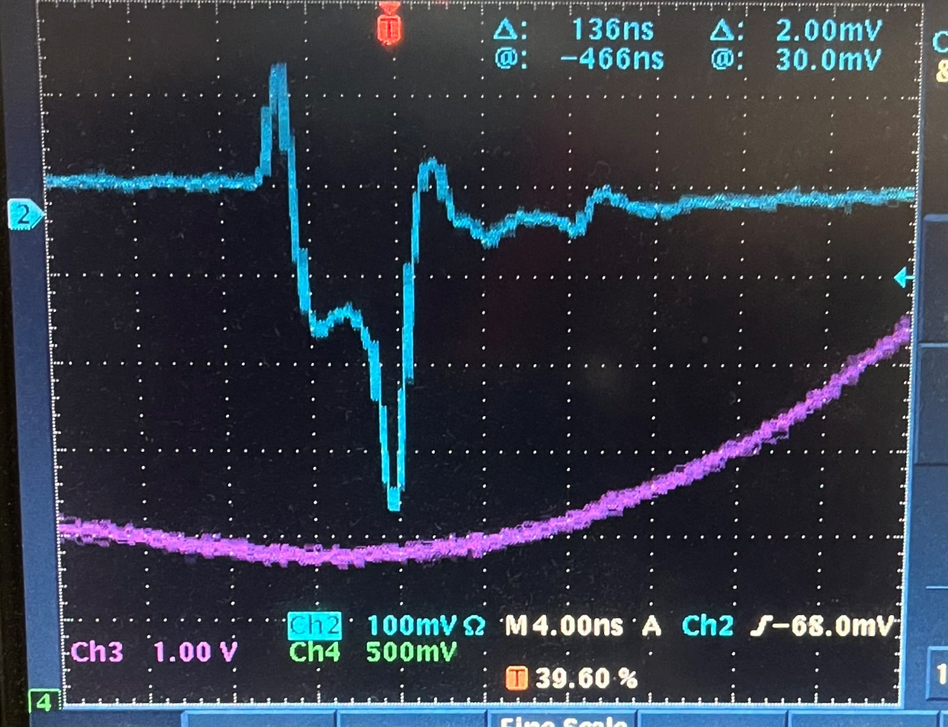
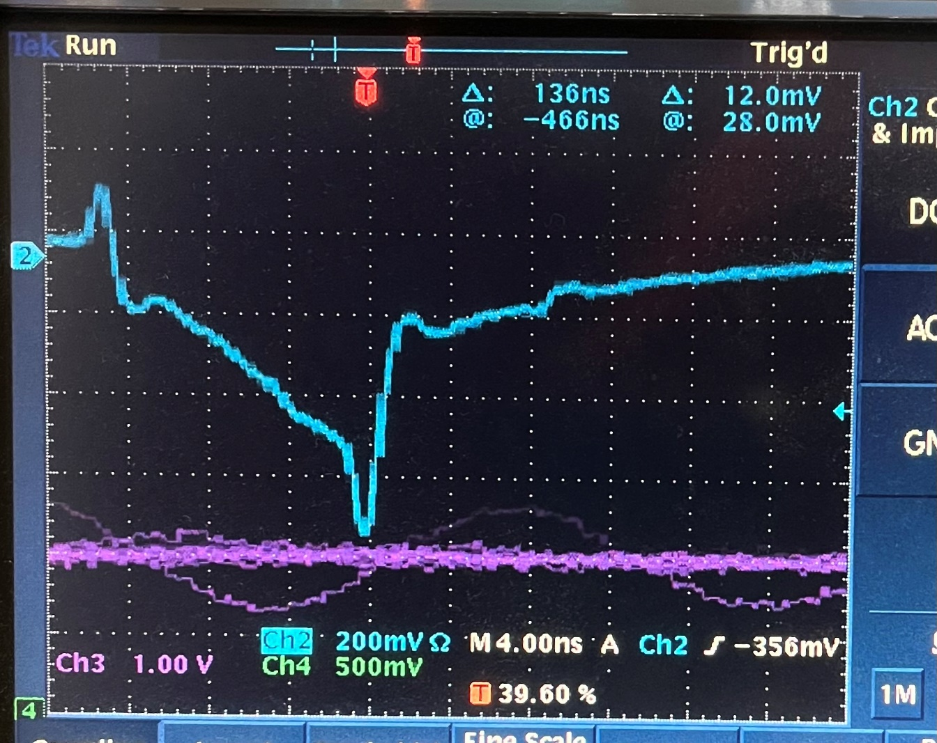
0x1
LEMO output, 4ns, (100mV/grid)
0x2
LEMO output, 8ns

Slide 16
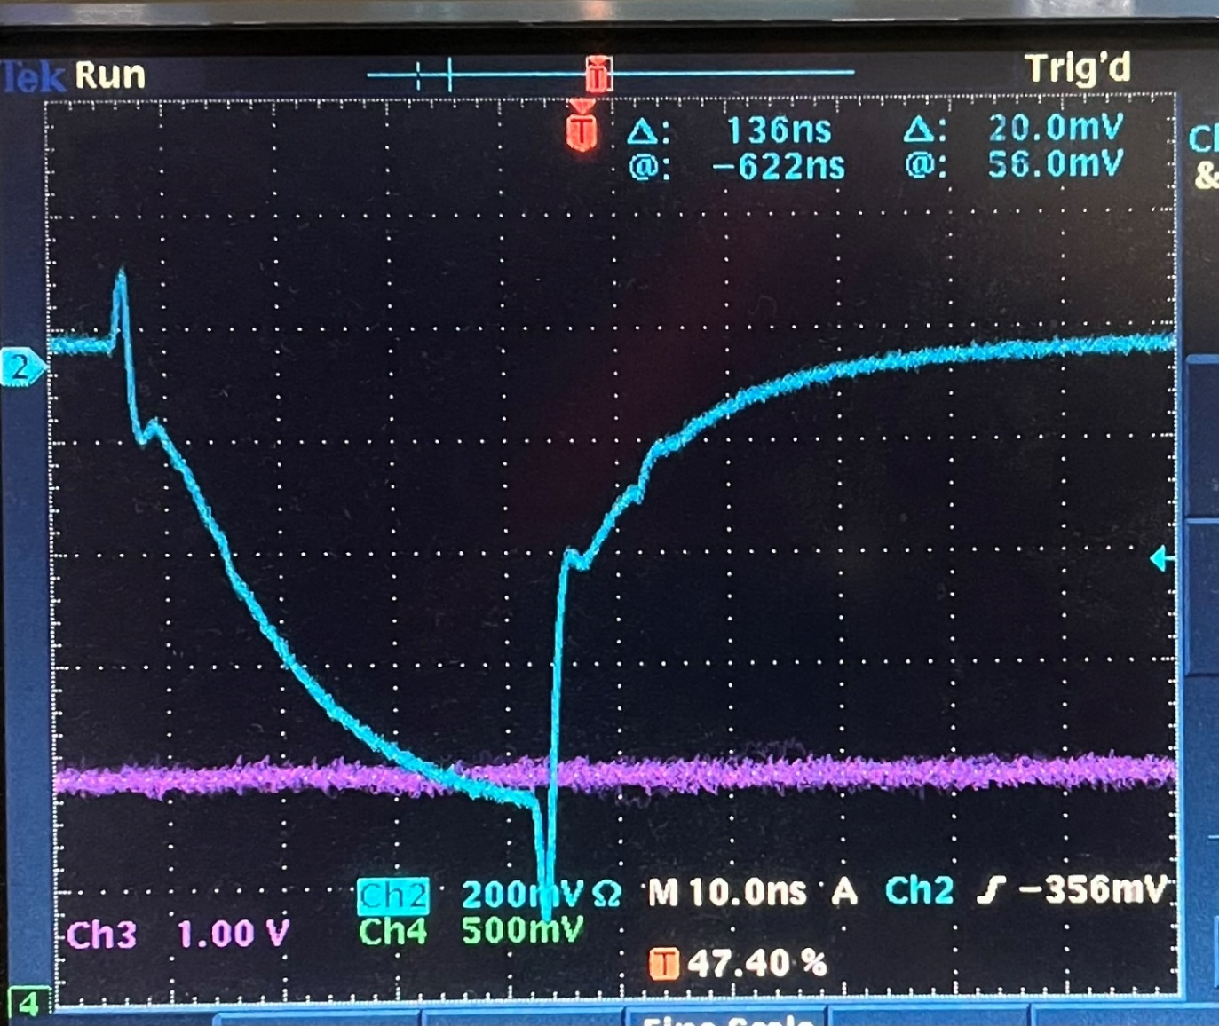
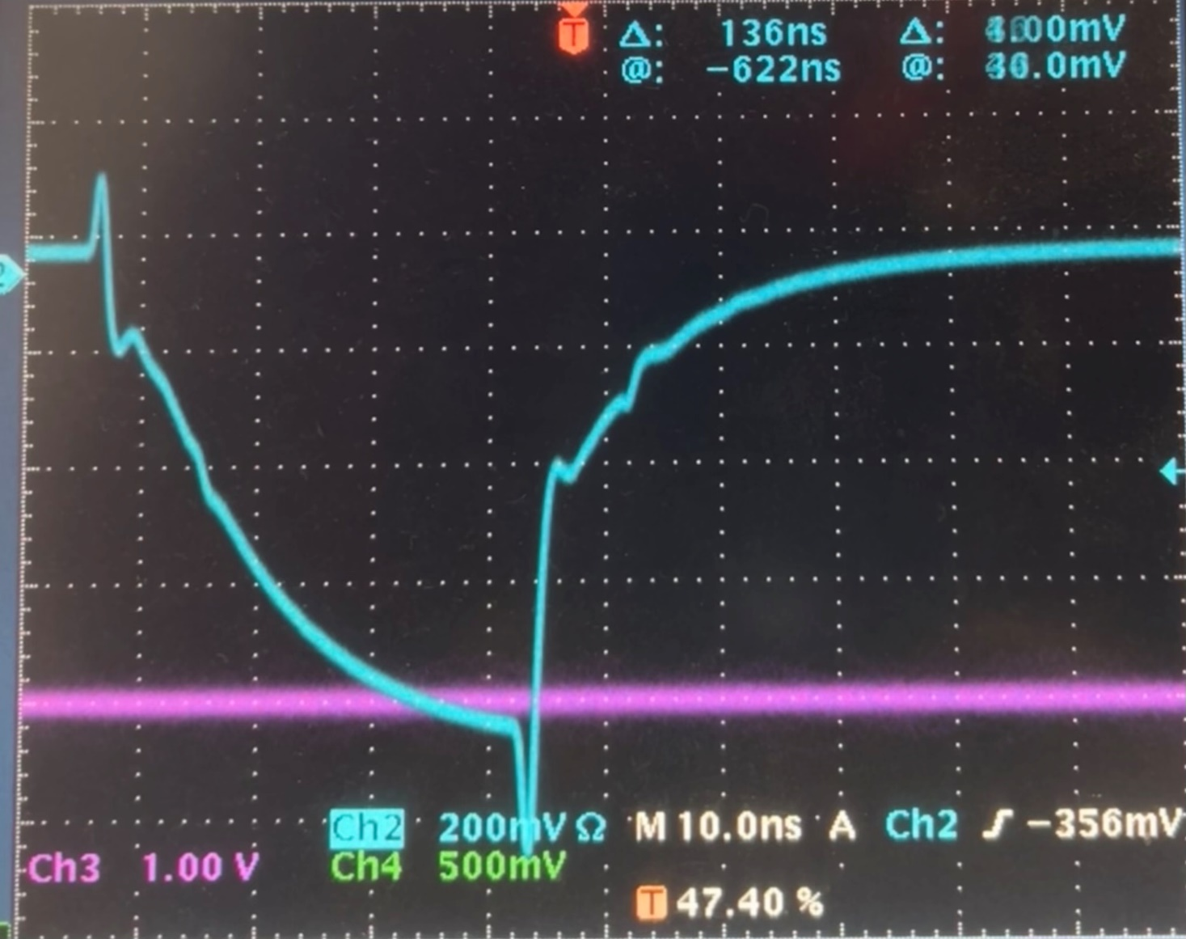
Accumolated LEMO, pulse width 32ns
0x8
LEMO output, pulse width 32ns
0x8

Slide 17
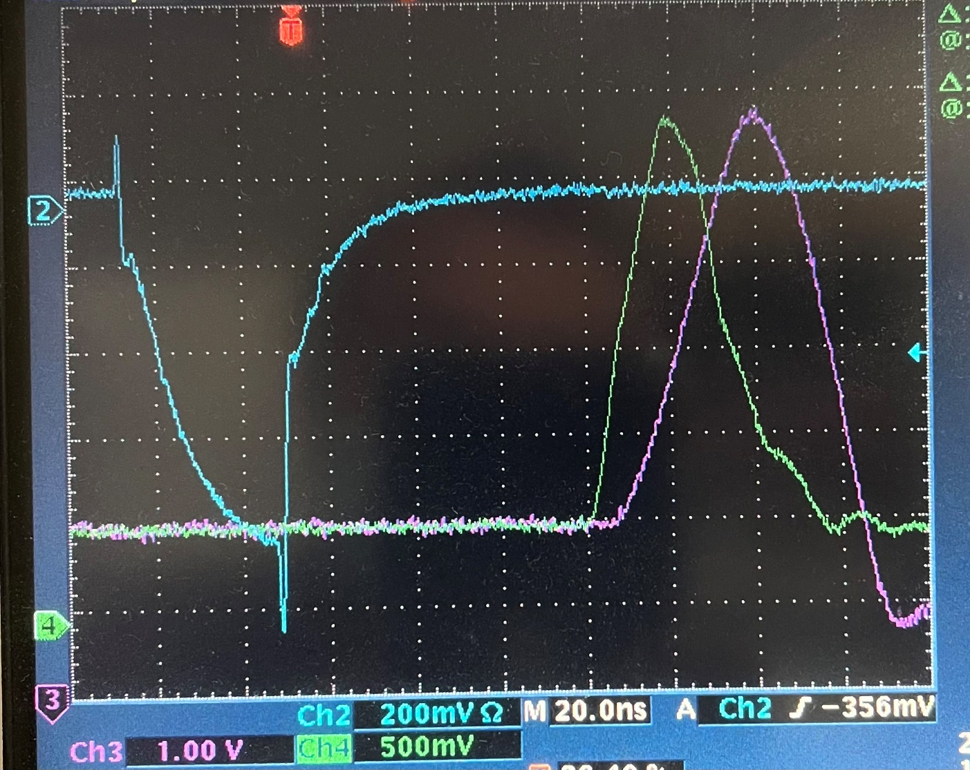
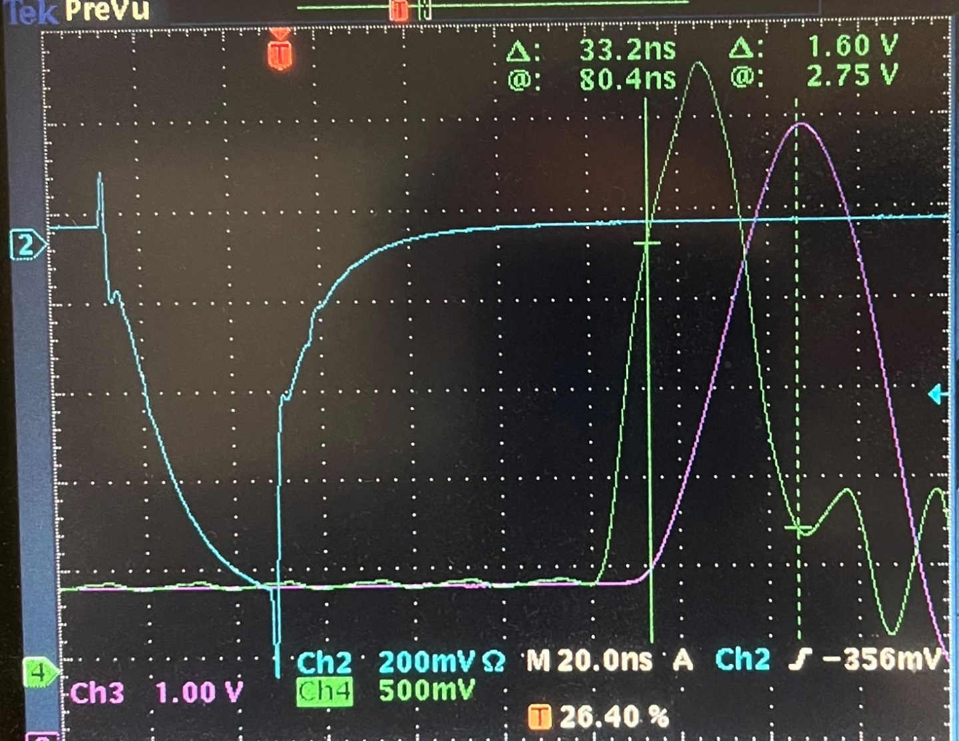
Remove the DAC compensation cap (5pF), the DAC output is oscillating at ~50MHz. This plot is the average (to average out the osc.), the actual DAC output is faster
Reproduce the pulse shape

Slide 18
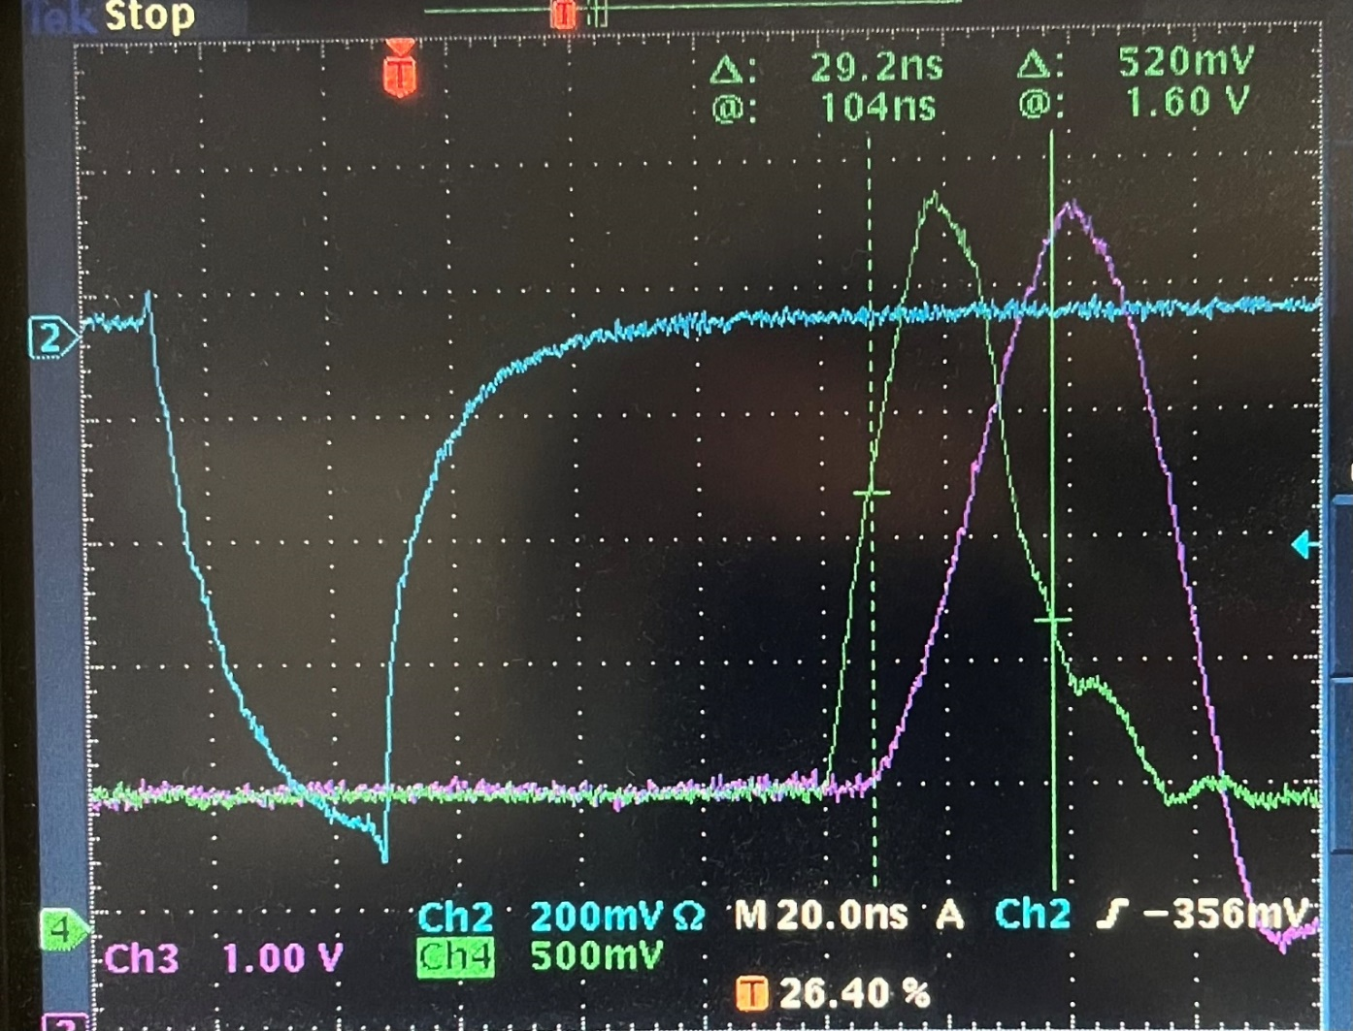
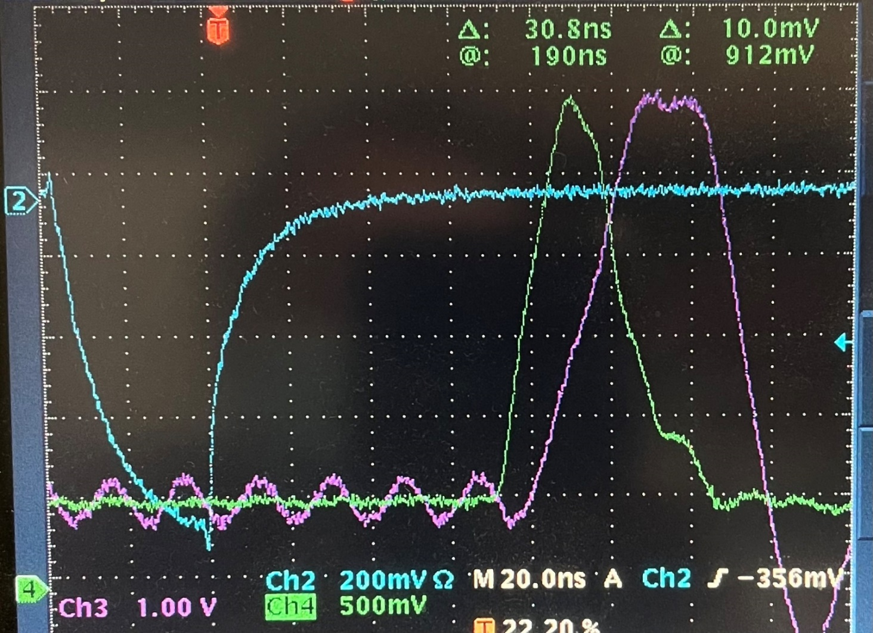
Add a 5pF cap in parallel with RFP13/18, the NIM output is better
Add the Cc back to the DAC, Remove one Cc of the two Calib opamp. The average pulse
Same as left, except it is a single trigger, oscillation, and faster calib signal

Slide 19
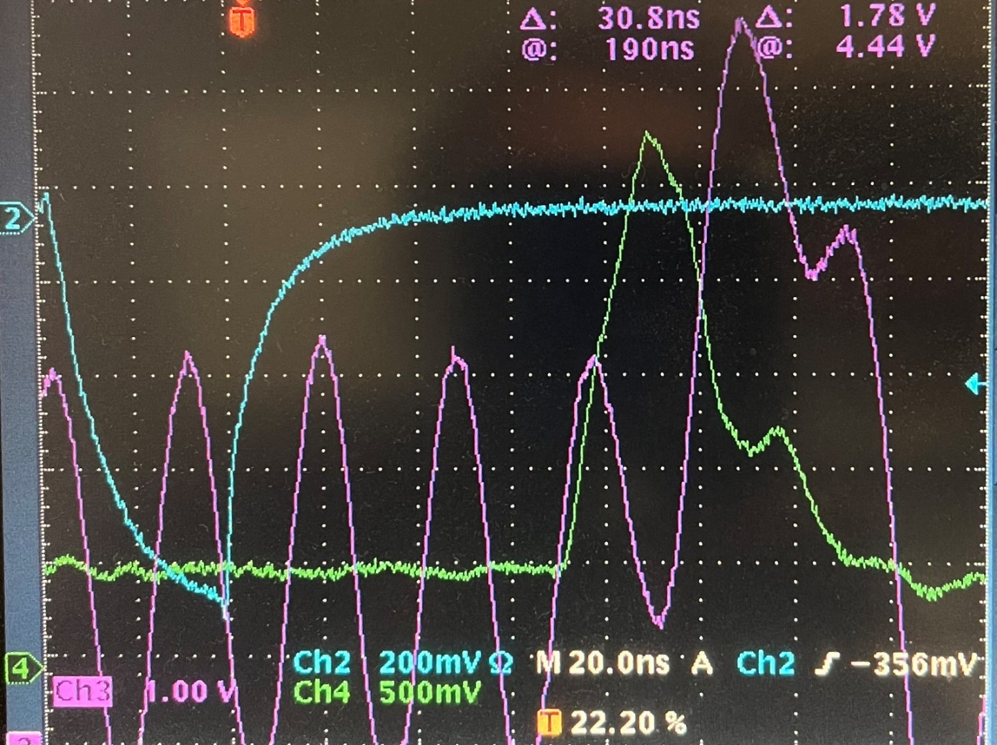
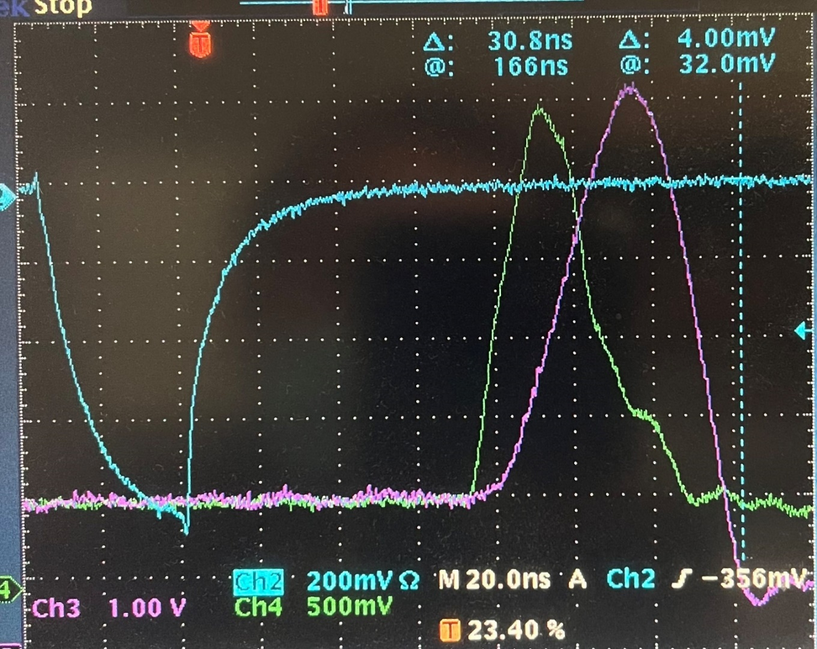
Remove both Cc, the oscillation is ~35 MHz, though the Calib pulse is faster
Add a 5pF in parallel with RFP16, no visible change
Replace 3.3pF compensation capacitors. It is stable, and the pulse is bigger. (slop is faster)

Slide 20
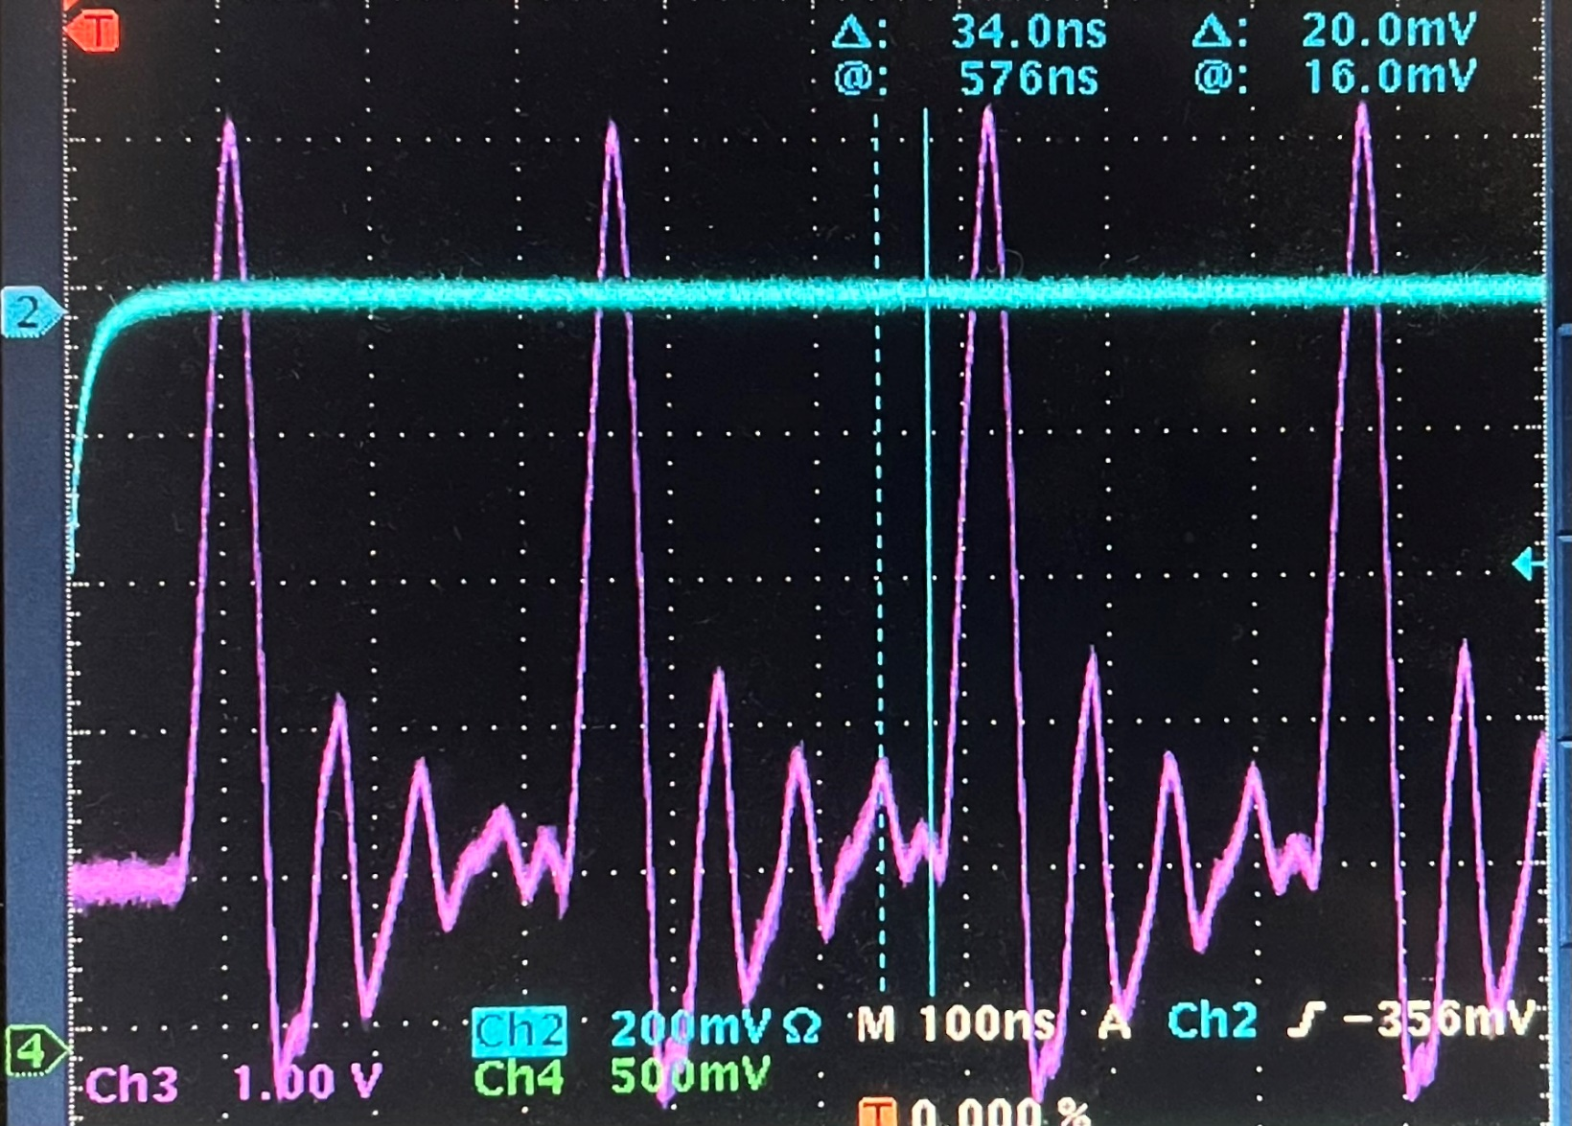
Larger scale to show the falling edge

Slide 21
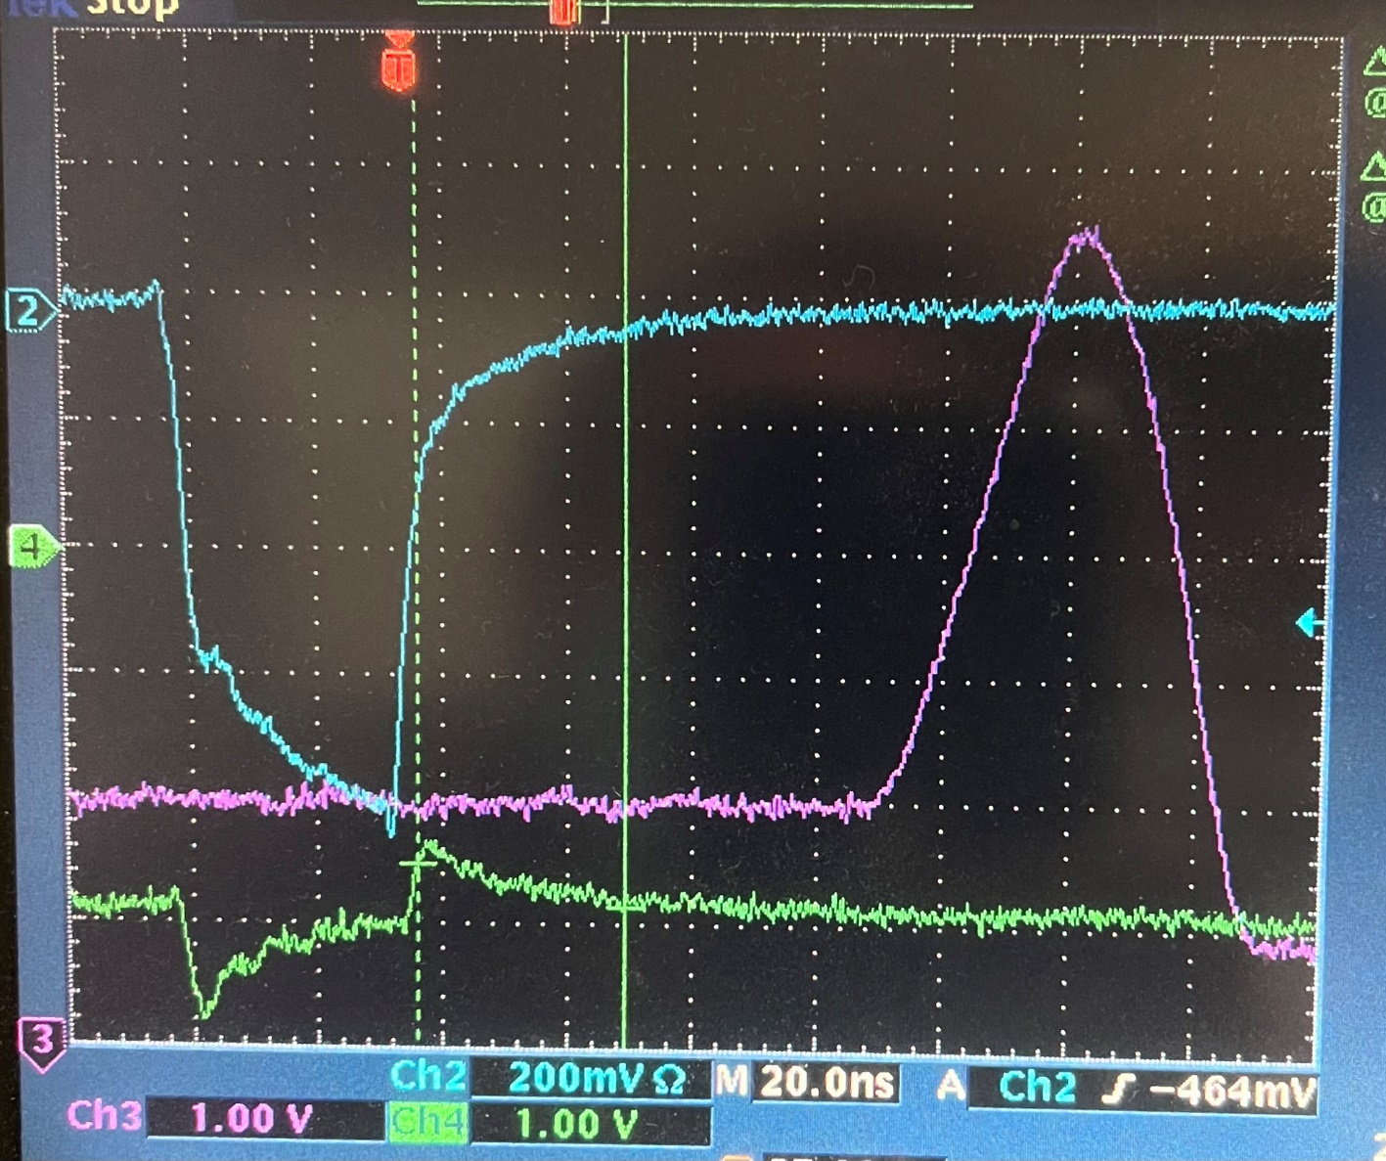
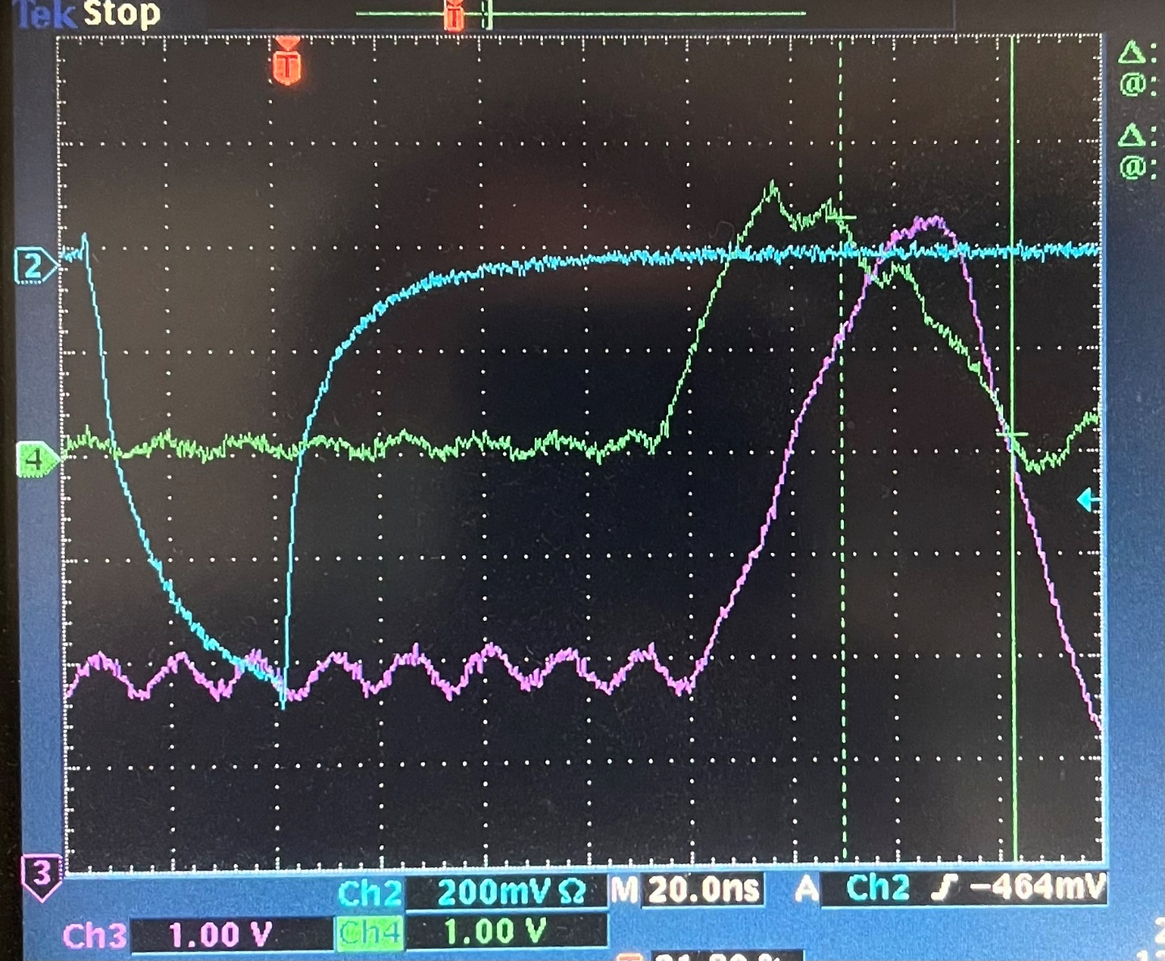
The following are measured on Mar. 2nd, 2022
Add a 2.2pF cap from pin#5 to ground.
Also replace the 5pF Cc with 2.2pF for the DAC, and Top_onboard opamp.
The DAC output is oscillating (cold solder)
When the probe touched pin#5 of MCH6541, the ECL output falling edge improves a lot. The green shows the pin#5, which should be a constant.

Slide 22
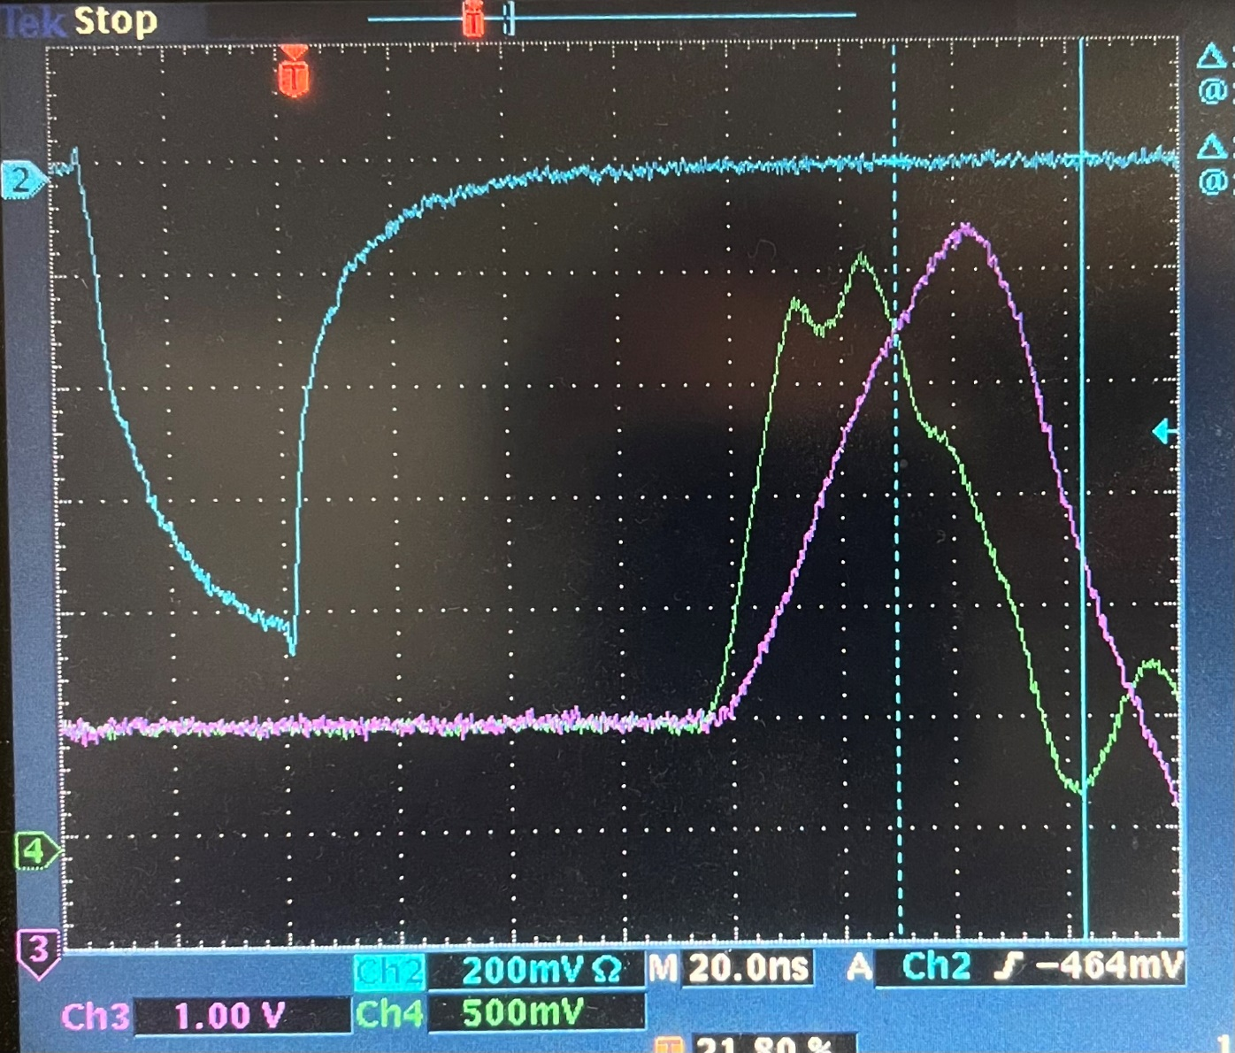
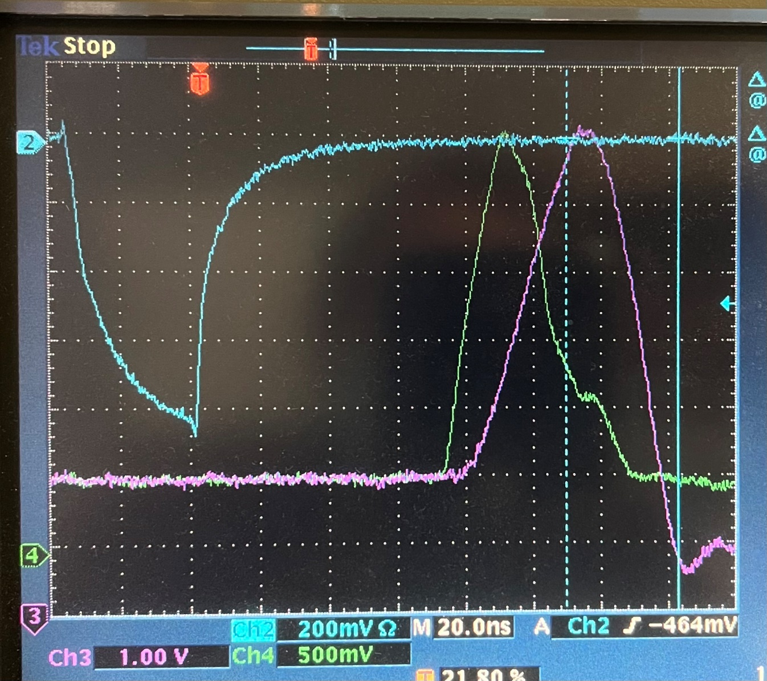
Reflow solder for Cc of the DAC, and also increase to 4.4pF (I think that it is still 2.2pF). The amp output is stable with 2.2pF compensation. This is the TOP_onboard connector (2.2pF)
This is the bottom_onboard connector. (the DAC Cc might be 4.4pF) (3.3pF Cc for the Calib Op-amp set on Feb. 28th) GREEN: DAC output, PURPLE: CALIB on the cable.

Slide 23
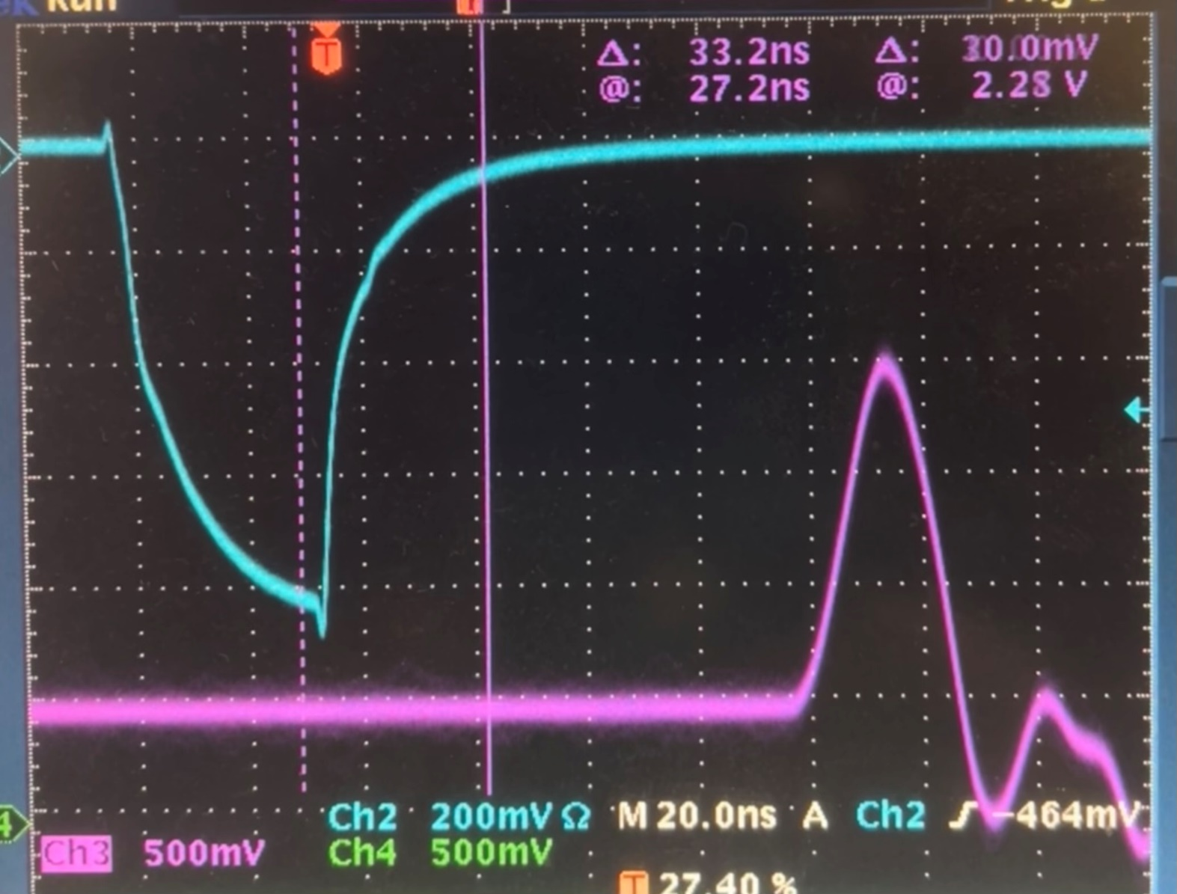
Small pulse (4ns), the signal seen on the cable. It can be ~20ns, and up to 1.5V (above the LED threshold). This is the front panel bottom connector, 5pF compensation capacitor
The linear DAC setting should be:
0x00, 0x01, 0x02, …, 0x13, 0x14, 0x40, 0x41, 0x42, …, 0x7e, 0x7f (bit#6 is DAC_ZERO, the designed base line)
The DAC_ZERO is equivalent to 0x11 as seen on the setup, ➔ 1.64K.
The actual resistor is 1.33K on VLD.

Slide 24
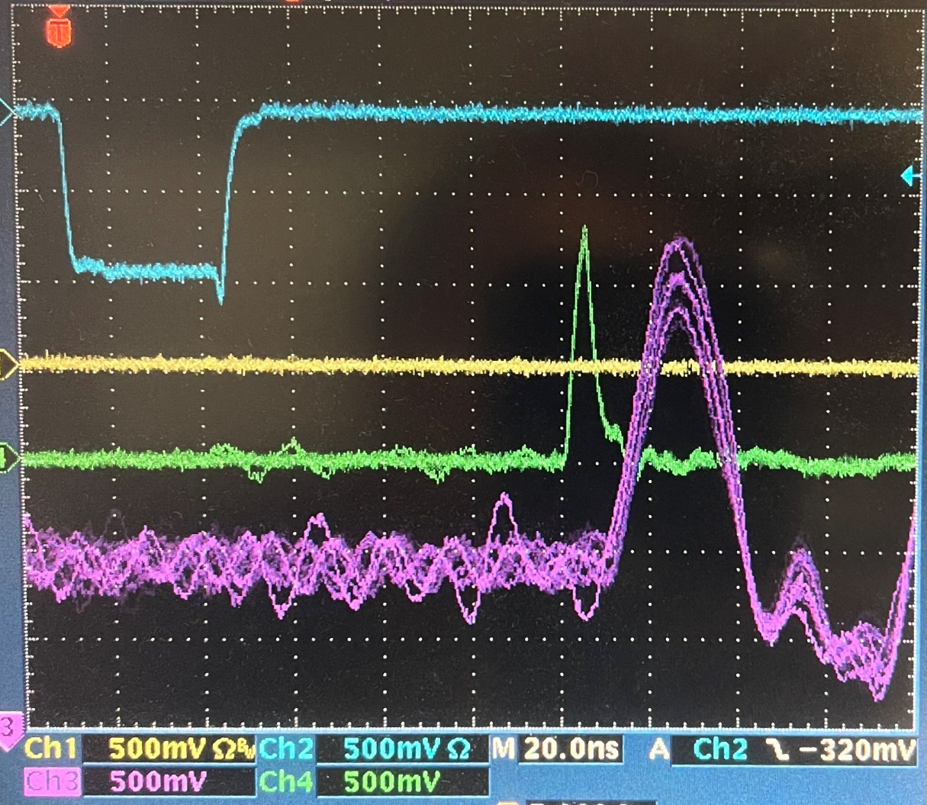
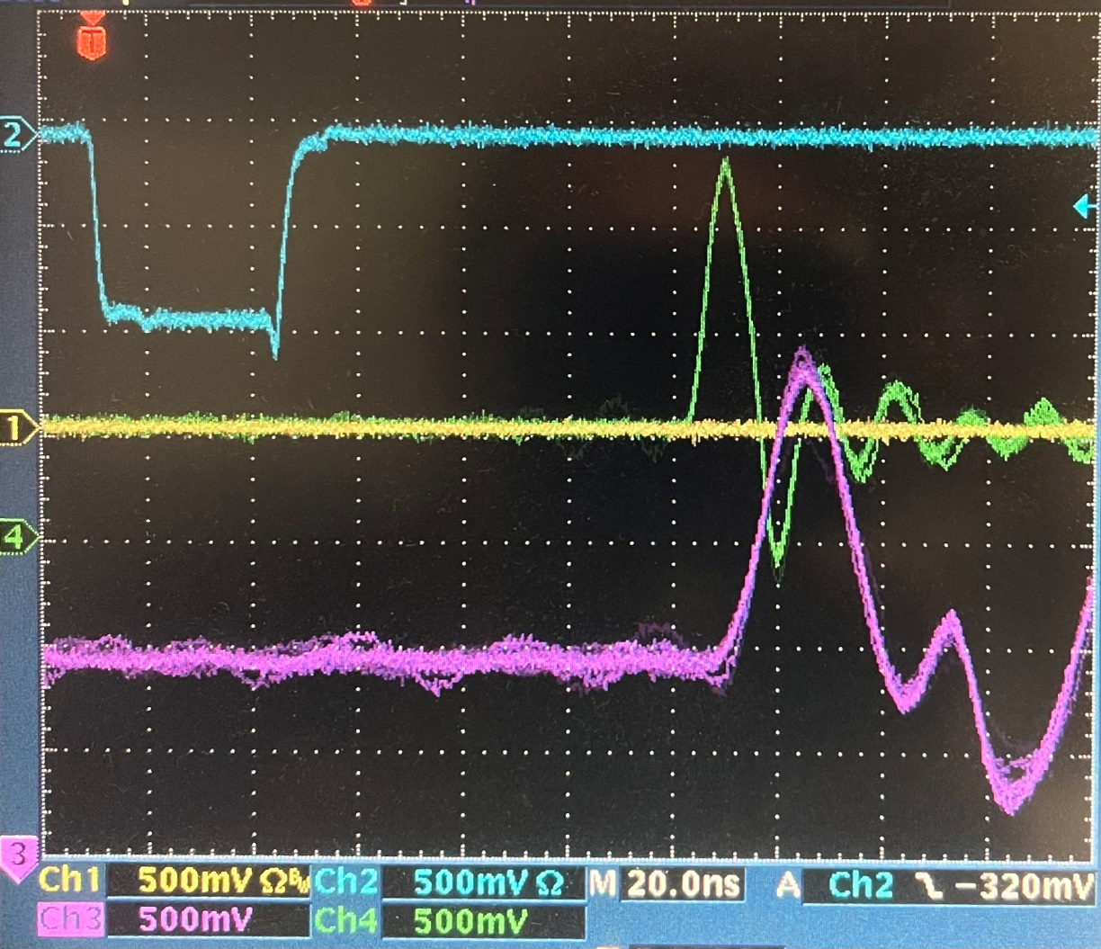
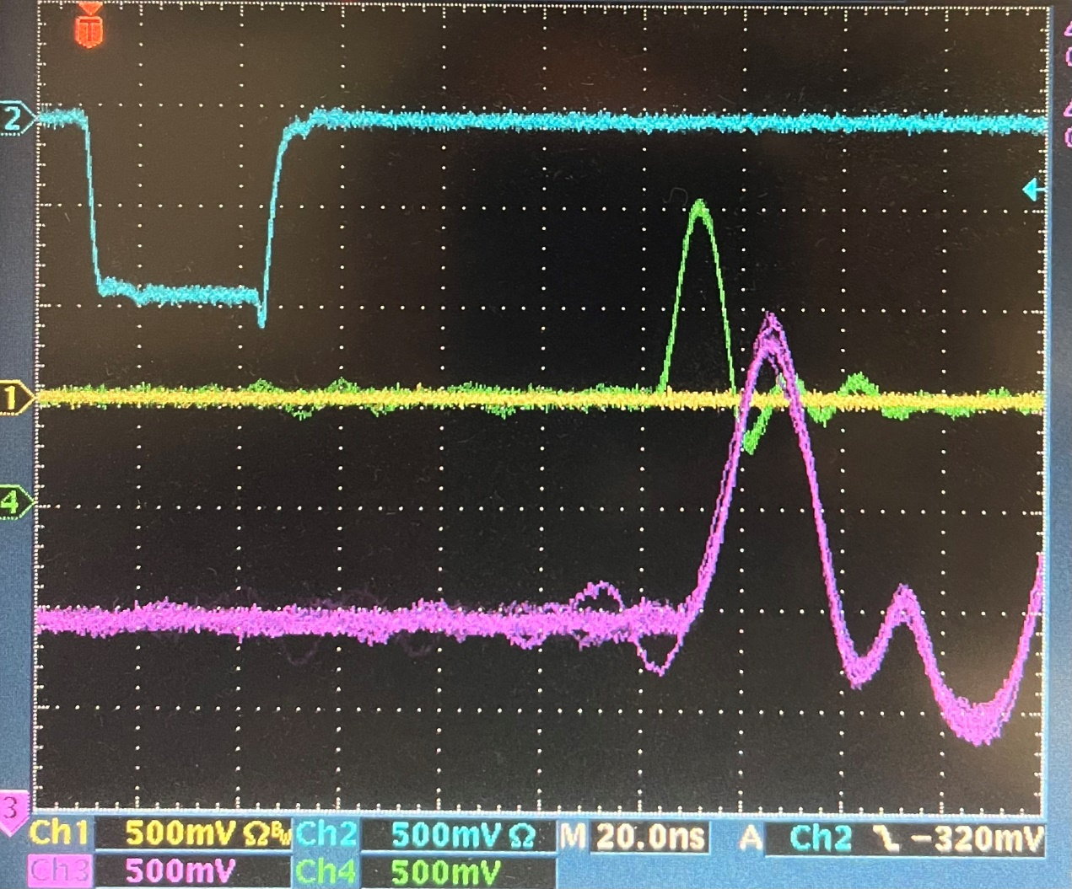
The following are measured on Mar. 21st, 2022, the DAC compensation capacitor study.
Compensation capacitor: 5pF, 4ns pulse (0x11 as base, 0xFF square wave)
Vin (near the DAC input pin):
Vout (near the ADCop-amp of the resistor):
Vop-amp (near the ADCop-amp input pin):
Vcal (on the long cable, near the VLD):
1.3V, Base_Width: 8ns
1.3V, Base_Width: 12ns
1.0V, Base_Width: 13ns
1.4V, Base_Width: 28ns

Slide 25
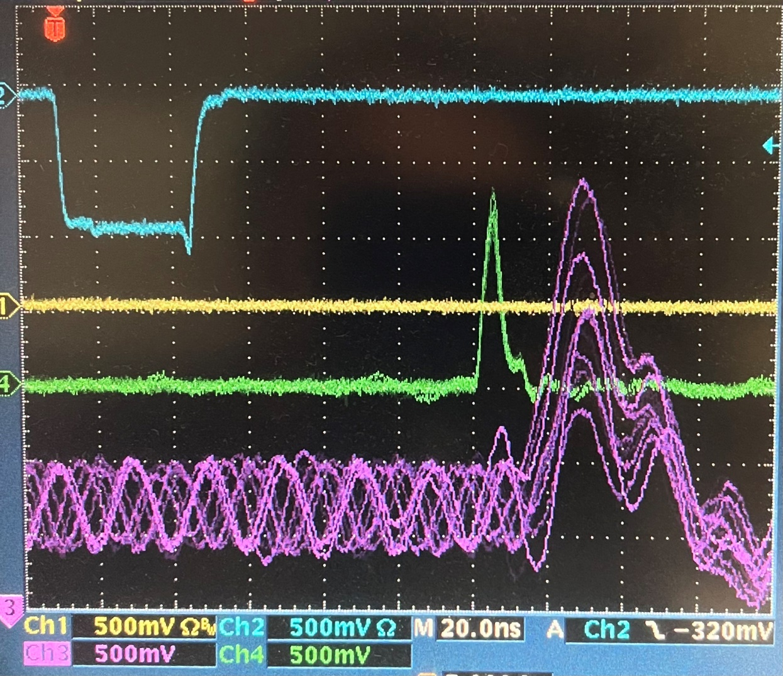
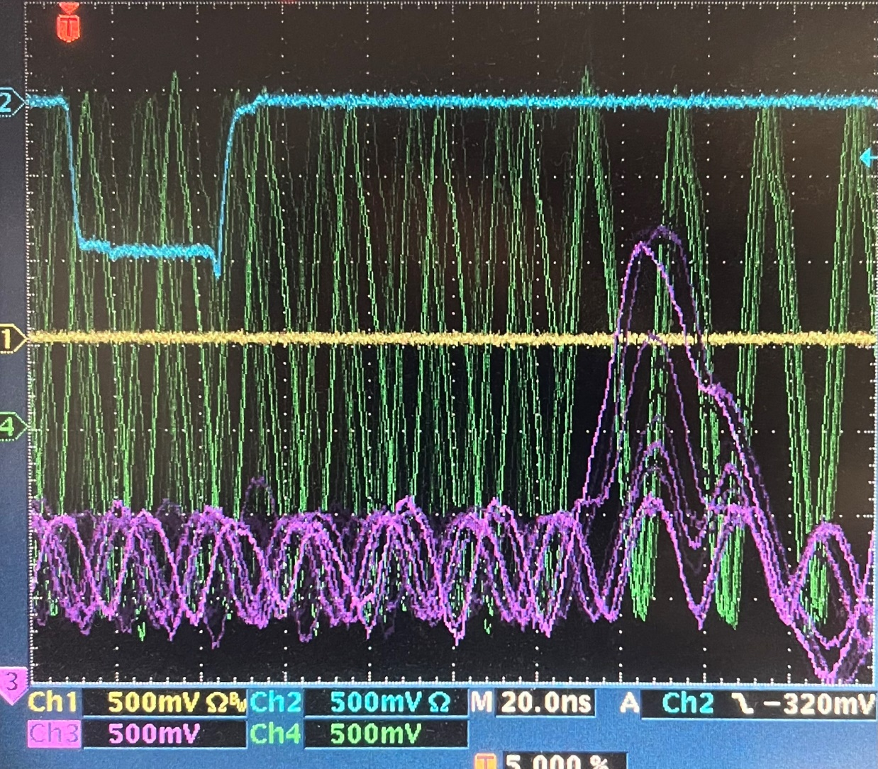
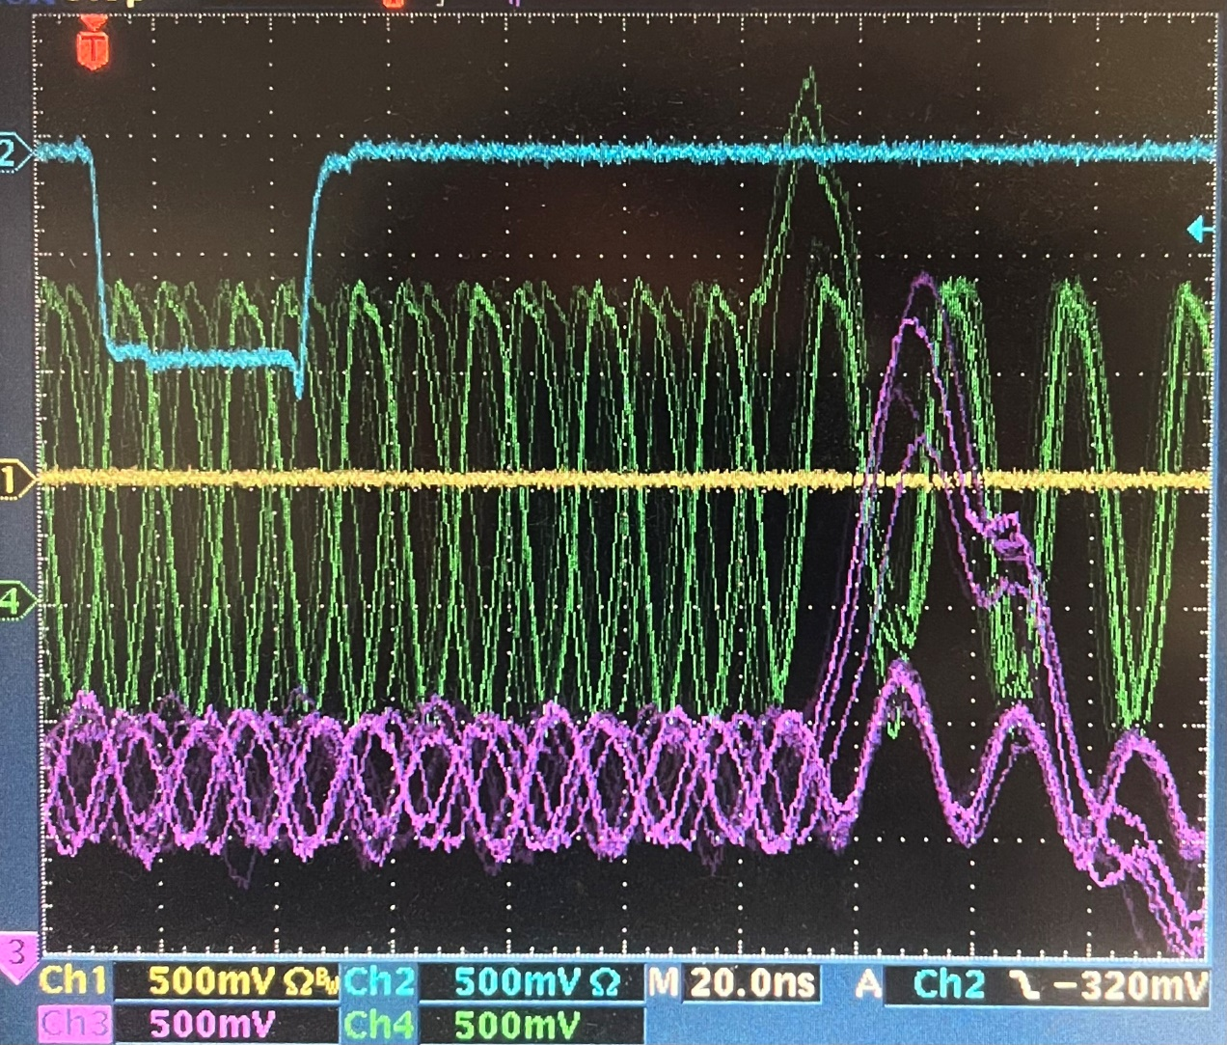
The following are measured on Mar. 21st, 2022, the DAC compensation capacitor study.
Compensation capacitor: 0pF (removed), 4ns pulse (0x11 as base, 0xFF square wave)
Vin (near the DAC input pin):
Vout (near the ADCop-amp of the resistor):
Vop-amp (near the ADCop-amp input pin):
Vcal (on the long cable, near the VLD):
1.2 V, Base_Width: 8 ns
2.5 V osc, Base_Width: ? ns (50 MHz)
1.8Vosc + 1.0 V, Base_Width: 20 ns (50 MHz)
0.5Vosc + 1.8 V, Base_Width: 30 ns (50 MHz)

Slide 26
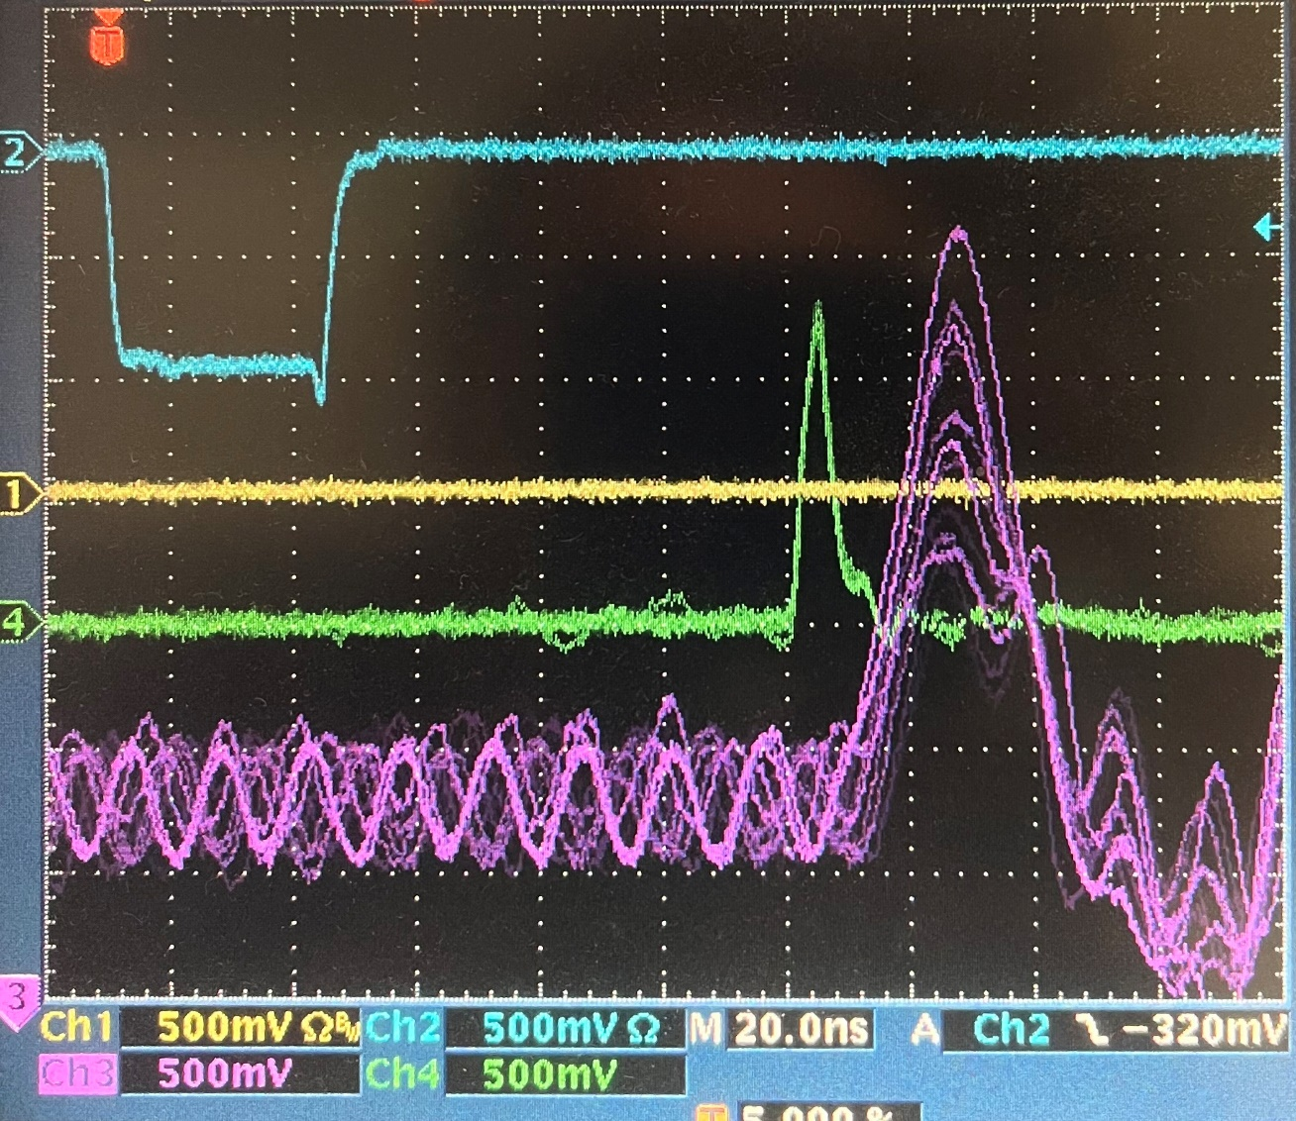
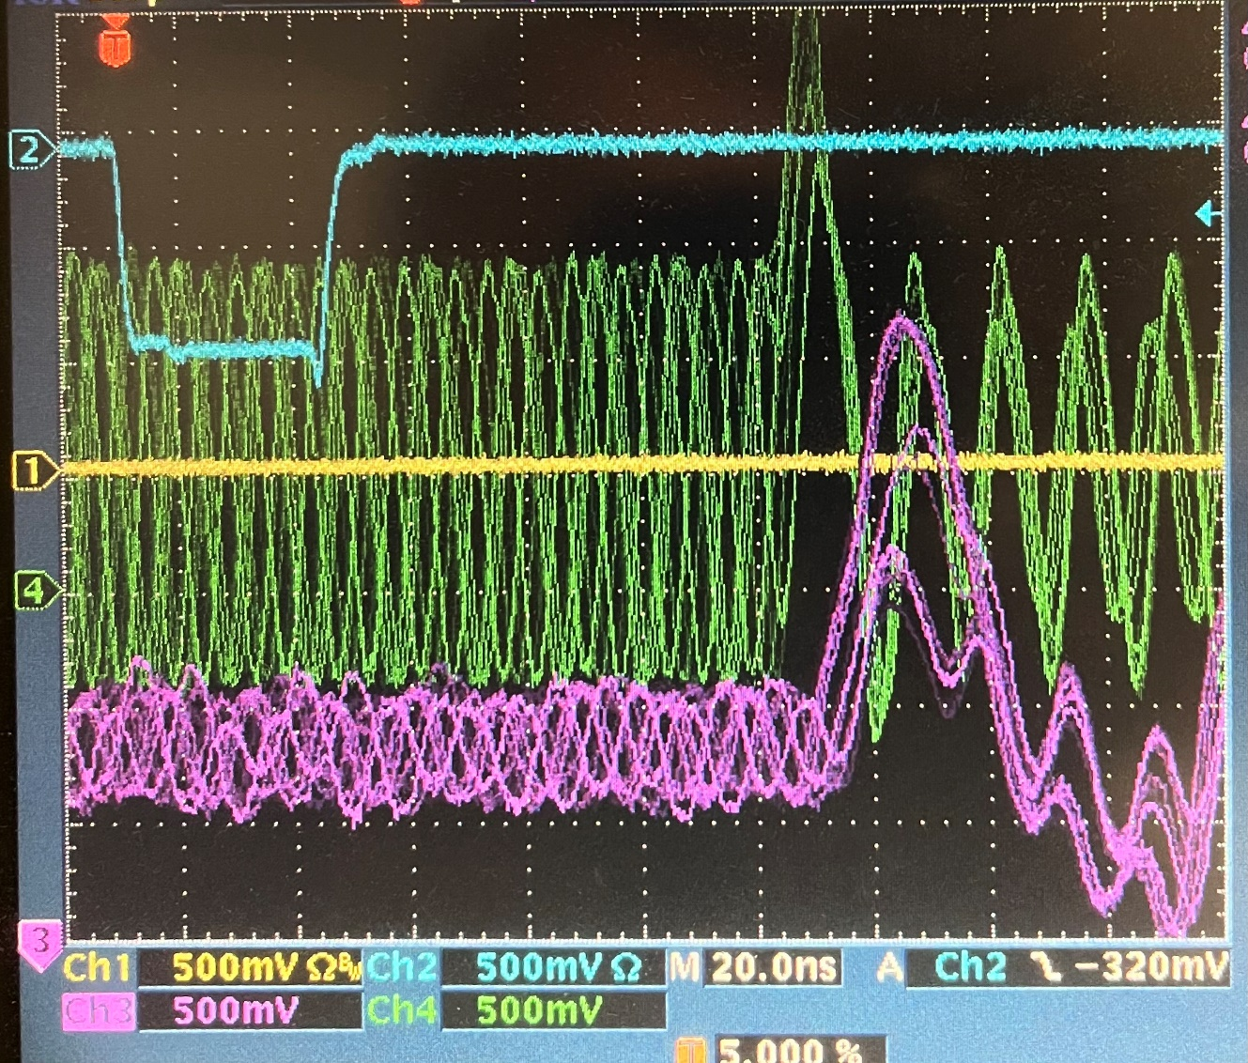
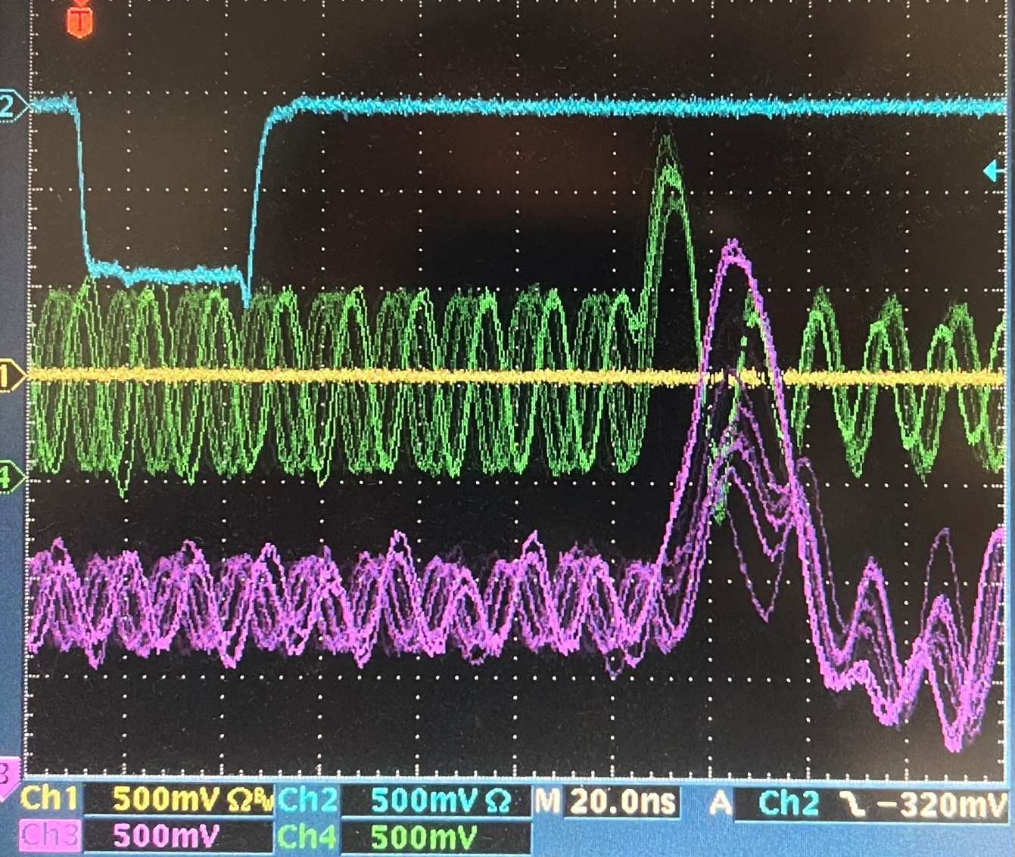
The following are measured on Mar. 21st, 2022, the DAC compensation capacitor study.
Compensation capacitor: 2.2pF, 4ns pulse (0x11 as base, 0xFF square wave)
Vin (near the DAC input pin):
Vout (near the ADCop-amp of the resistor):
Vop-amp (near the ADCop-amp input pin):
Vcal (on the long cable, near the VLD):
1.3 V, Base_Width: 8 ns
1.8 Vosc + 0.8V, Base_Width: 65 MHz
0.9 Vosc + 0.6V, Base_Width: 65 MHz
0.5 Vosc + 1.7V, Base_Width: 65 MHz

Slide 27
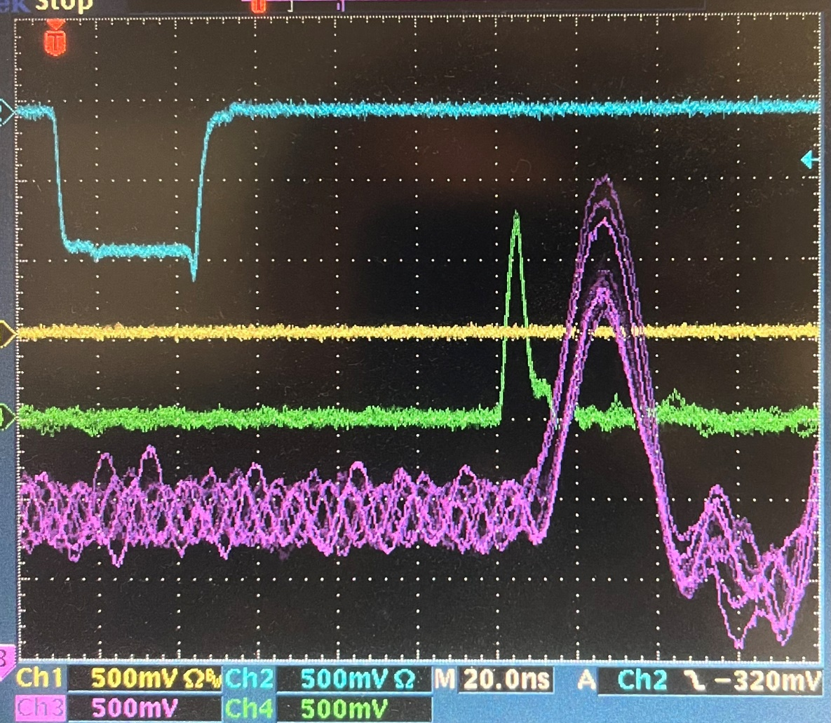
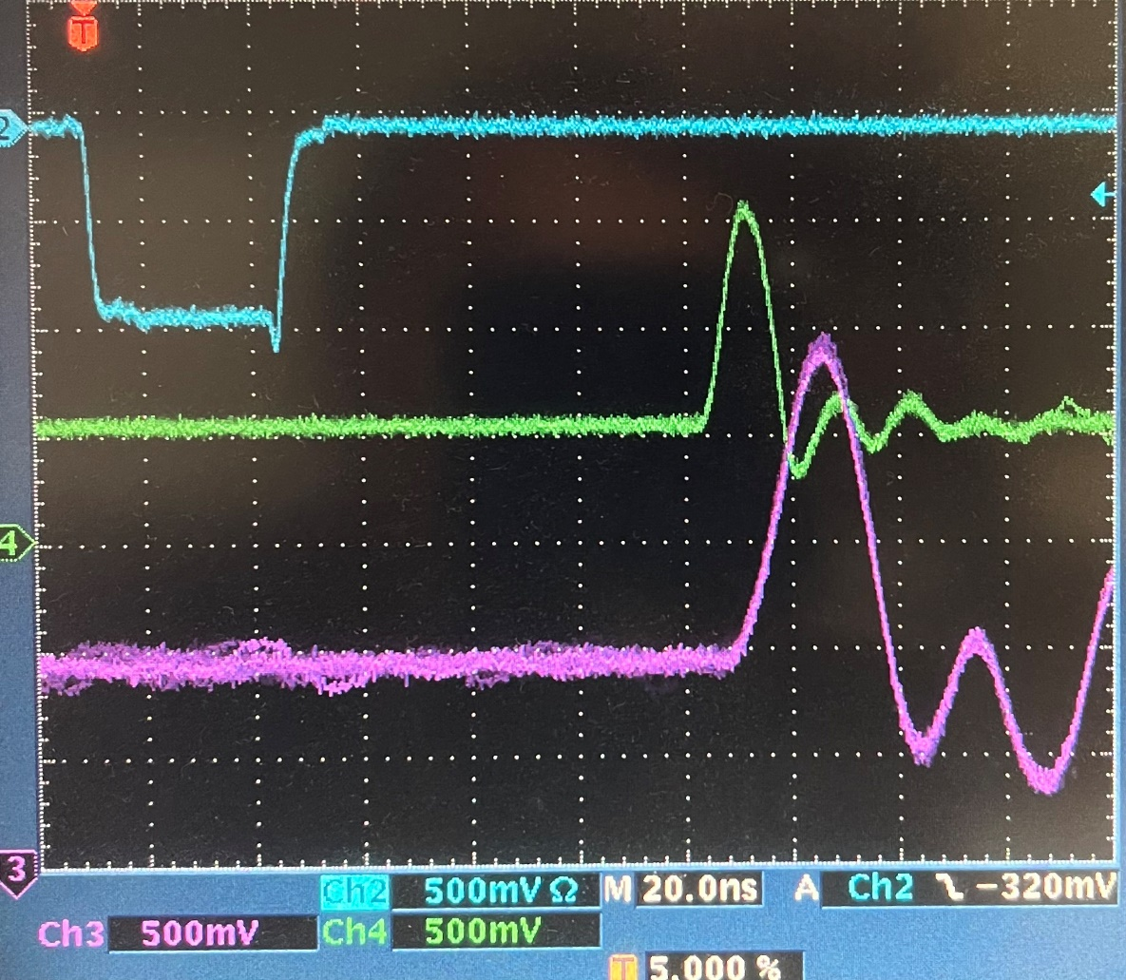
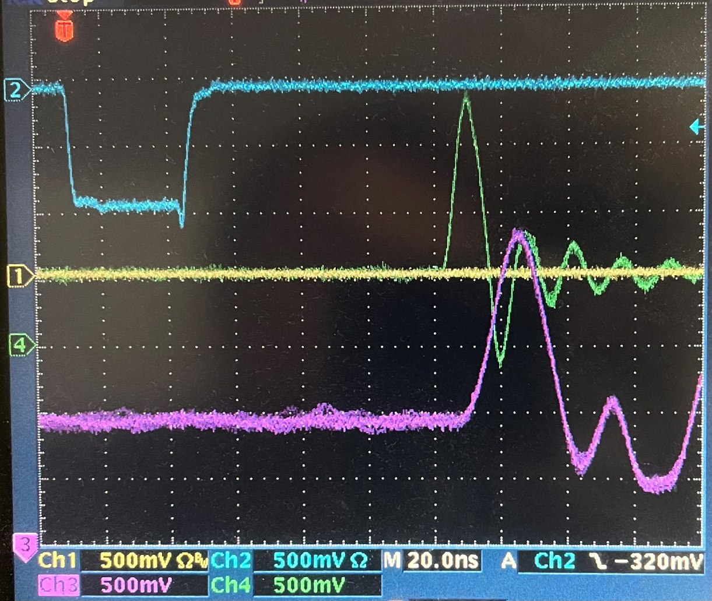
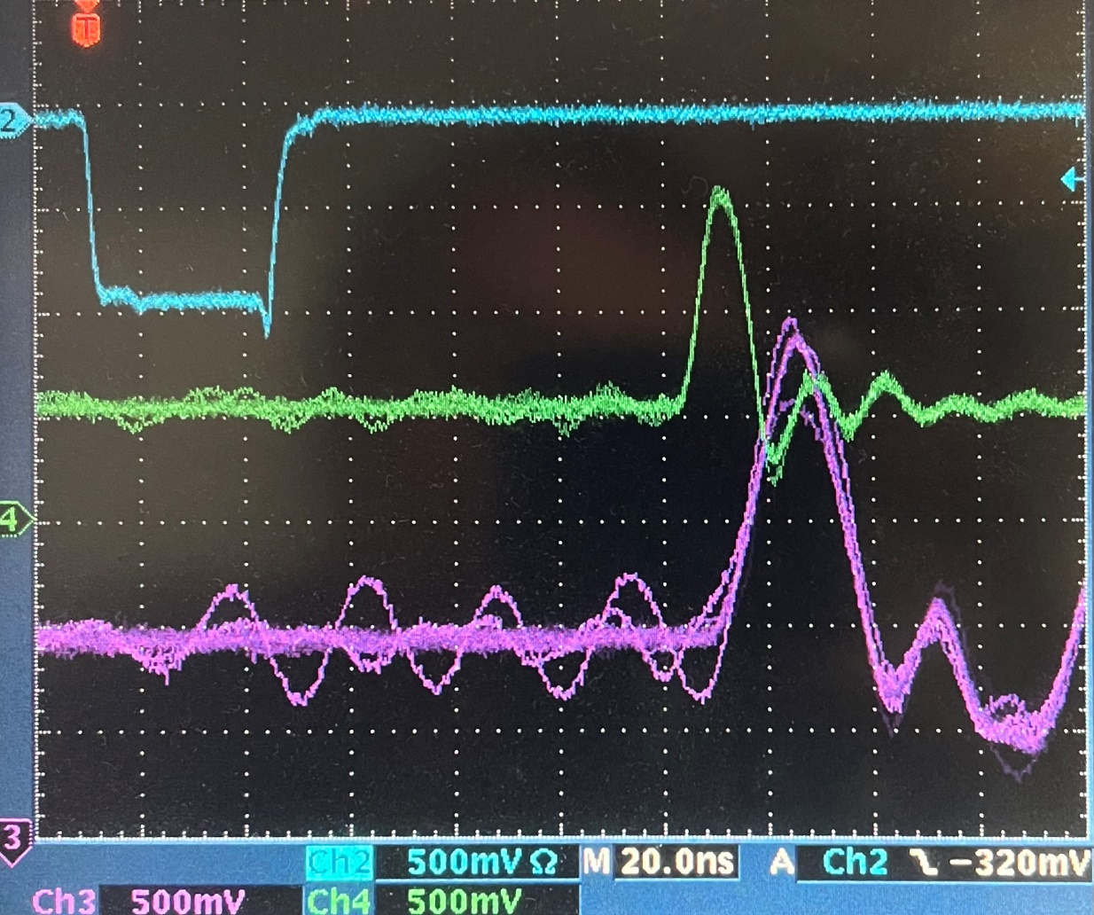
The following are measured on Mar. 21st, 2022, the DAC compensation capacitor study.
Compensation capacitor: 4.4pF, 4ns pulse (0x11 as base, 0xFF square wave)
Vin (near the DAC input pin):
Vout (near the ADCop-amp of the resistor):
Vop-amp (near the ADCop-amp input pin):
Vcal (on the long cable, near the VLD):
Vcal on OnBoard_top connector output:
1.2 V, Base_Width: 8 ns
1.3 V, Base_Width: 12 ns
1.0 V, Base_Width: 13 ns
1.3 V, Base_Width: 28 ns
1.4 V, Base_Width: 28 ns

Slide 28




The following are measured on Mar. 21st, 2022, the DAC compensation capacitor study.
Compensation capacitor: 3.3pF, 4ns pulse (0x11 as base, 0xFF square wave)
Vin (near the DAC input pin):
Vout (near the ADCop-amp of the resistor):
Vop-amp (near the ADCop-amp input pin):
Vcal (on the long cable, near the VLD):
Vcal on OnBoard_top connector output:
1.3 V, Base_Width: 8 ns
1.6 V, Base_Width: 12 ns
1.1 V, Base_Width: 14 ns
1.5 V, Base_Width: 28 ns
1.5 V, Base_Width: 26 ns

Slide 29




The following are measured on Mar. 21st, 2022, the DAC compensation capacitor study.
Compensation capacitor: 3.3 pF, 8ns pulse (0x11 as base, 0xFF square wave)
Vin (near the DAC input pin):
Vout (near the ADCop-amp of the resistor):
Vop-amp (near the ADCop-amp input pin):
Vcal (on the long cable, near the VLD):
Vcal on OnBoard_top connector output:
1.4 V, Base_Width: 8 ns + 4ns
2.3 V, Base_Width: 20 ns
1.7 V, Base_Width: 20 ns
2.5 V, Base_Width: 36 ns
2.6 V, Base_Width: 36 ns

Slide 30




The following are measured on Mar. 21st, 2022, the DAC compensation capacitor study.
Compensation capacitor: 3.3 pF, 4ns pulse (0x11 as base, 0xFF square wave), added a 12pf capacitor over the 220 Ohm resistor of amplifier input (between DAC and Opamp)
Vin (near the DAC input pin):
Vout (near the ADCop-amp of the resistor):
Vop-amp (near the ADCop-amp input pin):
Vcal (on the long cable, near the VLD):
Vcal on OnBoard_top connector output:
1.2 V, Base_Width: 8 ns
1.5 V, Base_Width: 12 ns
1.1 V, Base_Width: 14 ns
1.5 V, Base_Width: 28ns
2.5 V, 36ns (input: 1.6V, 20ns by 8ns pulse)

Slide 31



The following are measured on Mar. 21st, 2022, the DAC compensation capacitor study.
Compensation capacitor: 15pF, 4ns pulse (0x11 as base, 0xFF square wave)
Vin (near the DAC input pin):
Vout (near the ADCop-amp of the resistor):
Vop-amp (near the ADCop-amp input pin):
Vcal (on the long cable, near the VLD):
1.2 V, Base_Width: 8 ns
0.6 V, Base_Width: 16 ns
0.5 V, Base_Width: 16 ns
1.1 V, Base_Width: 24 ns

Slide 32




The following are measured on Mar. 21st, 2022, the DAC compensation capacitor study.
Compensation capacitor: pF, 8ns pulse (0x11 as base, 0xFF square wave)
Vin (near the DAC input pin):
Vout (near the ADCop-amp of the resistor):
Vop-amp (near the ADCop-amp input pin):
Vcal (on the long cable, near the VLD):
Vcal on OnBoard_top connector output:
1.2 V, Base_Width: 8 ns + 4ns
0.9 V, Base_Width: 20 ns
0.7 V, Base_Width: 22 ns
1.7 V, Base_Width: 30 ns
1.8 V, Base_Width: 30 ns

Slide 33



The following are measured on Mar. 25th, 2022, Check the Calibration signal rising/Falling time with analog switch
Compensation capacitor: pF, 8ns pulse (0x11 as base, 0xFF square wave)
With ~5V pulse, the rising time is ~5ns,
The falling time is ~10ns,
The recovery time (after switched off) is ~us, which is caused by the large capacitance of the long cable
A faster calibration signal (smaller rising edge and falling edge) can be generated this way than the op-amp alone.

Slide 34




The following are measured on Mar. 28th, 2022, Check the Calibration signal rising/Falling time with analog switch and calibration pulse setting coincidence (also with TRIGGER signal)
Set the Swith_Enable width to 0x77 (very large), and move the switch_enable toward the pulse. From left to right, the 0x74 register is set to: 0x7700, 0x7720, 0x7736, 0x7738. The pulse shape change might be caused by the cable (reflection).
The rising edge is ~5ns for a 8V pulse, much faster than the op-amp slop

Slide 35




The following are measured on Mar. 28th, 2022, Check the Calibration signal rising/Falling time with analog switch and calibration pulse setting coincidence (also with TRIGGER signal)
For the same switch_Enable delay, change the swith_enable width. The register 0x74 is set (from left to right plots) to 0x0836, 0x0636, 0x0436, 0x0A36 (the time scale was changed from 20ns in plot#1 to 10ns in plot#2, 3, and 4)
The falling edge is much slower than the rising edge.

Slide 36



The following are measured on Mar. 28th, 2022, Check the Calibration signal rising/Falling time with analog switch and calibration pulse setting coincidence (also with TRIGGER signal)
The following plots are some sample pulses (as seen on the cable) with various settings.
Initial pulse width at the DAC input: 44ns;
0x74 register setting: 0x0636
Initial pulse width at the DAC input: 52ns;
0x74 register setting: 0x0633
Initial pulse width at the DAC input: 80ns;
0x74 register setting: 0x1228

