Slide 1
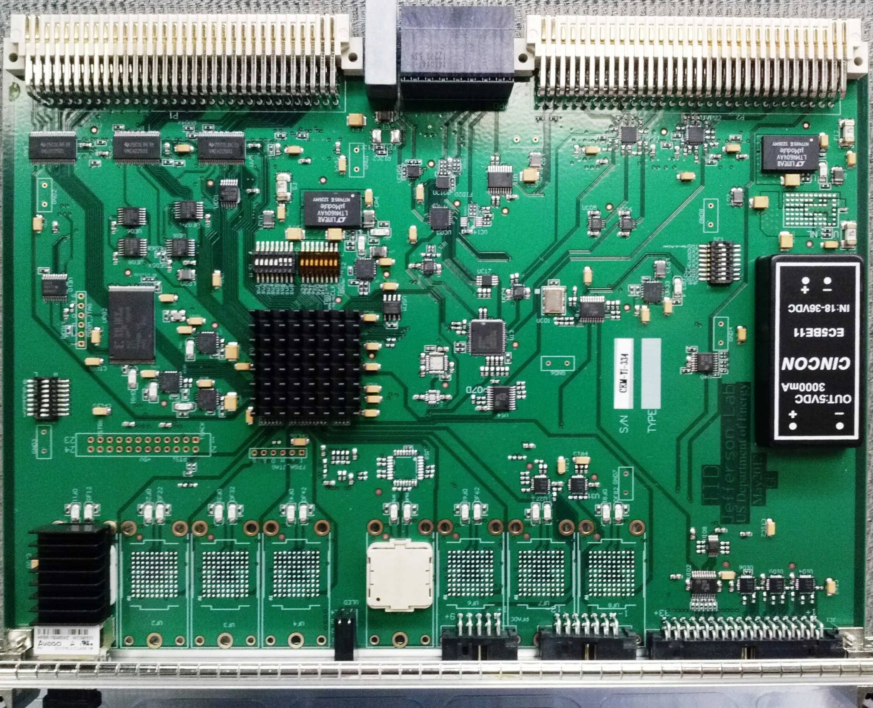
Production TI board picture

Slide 2
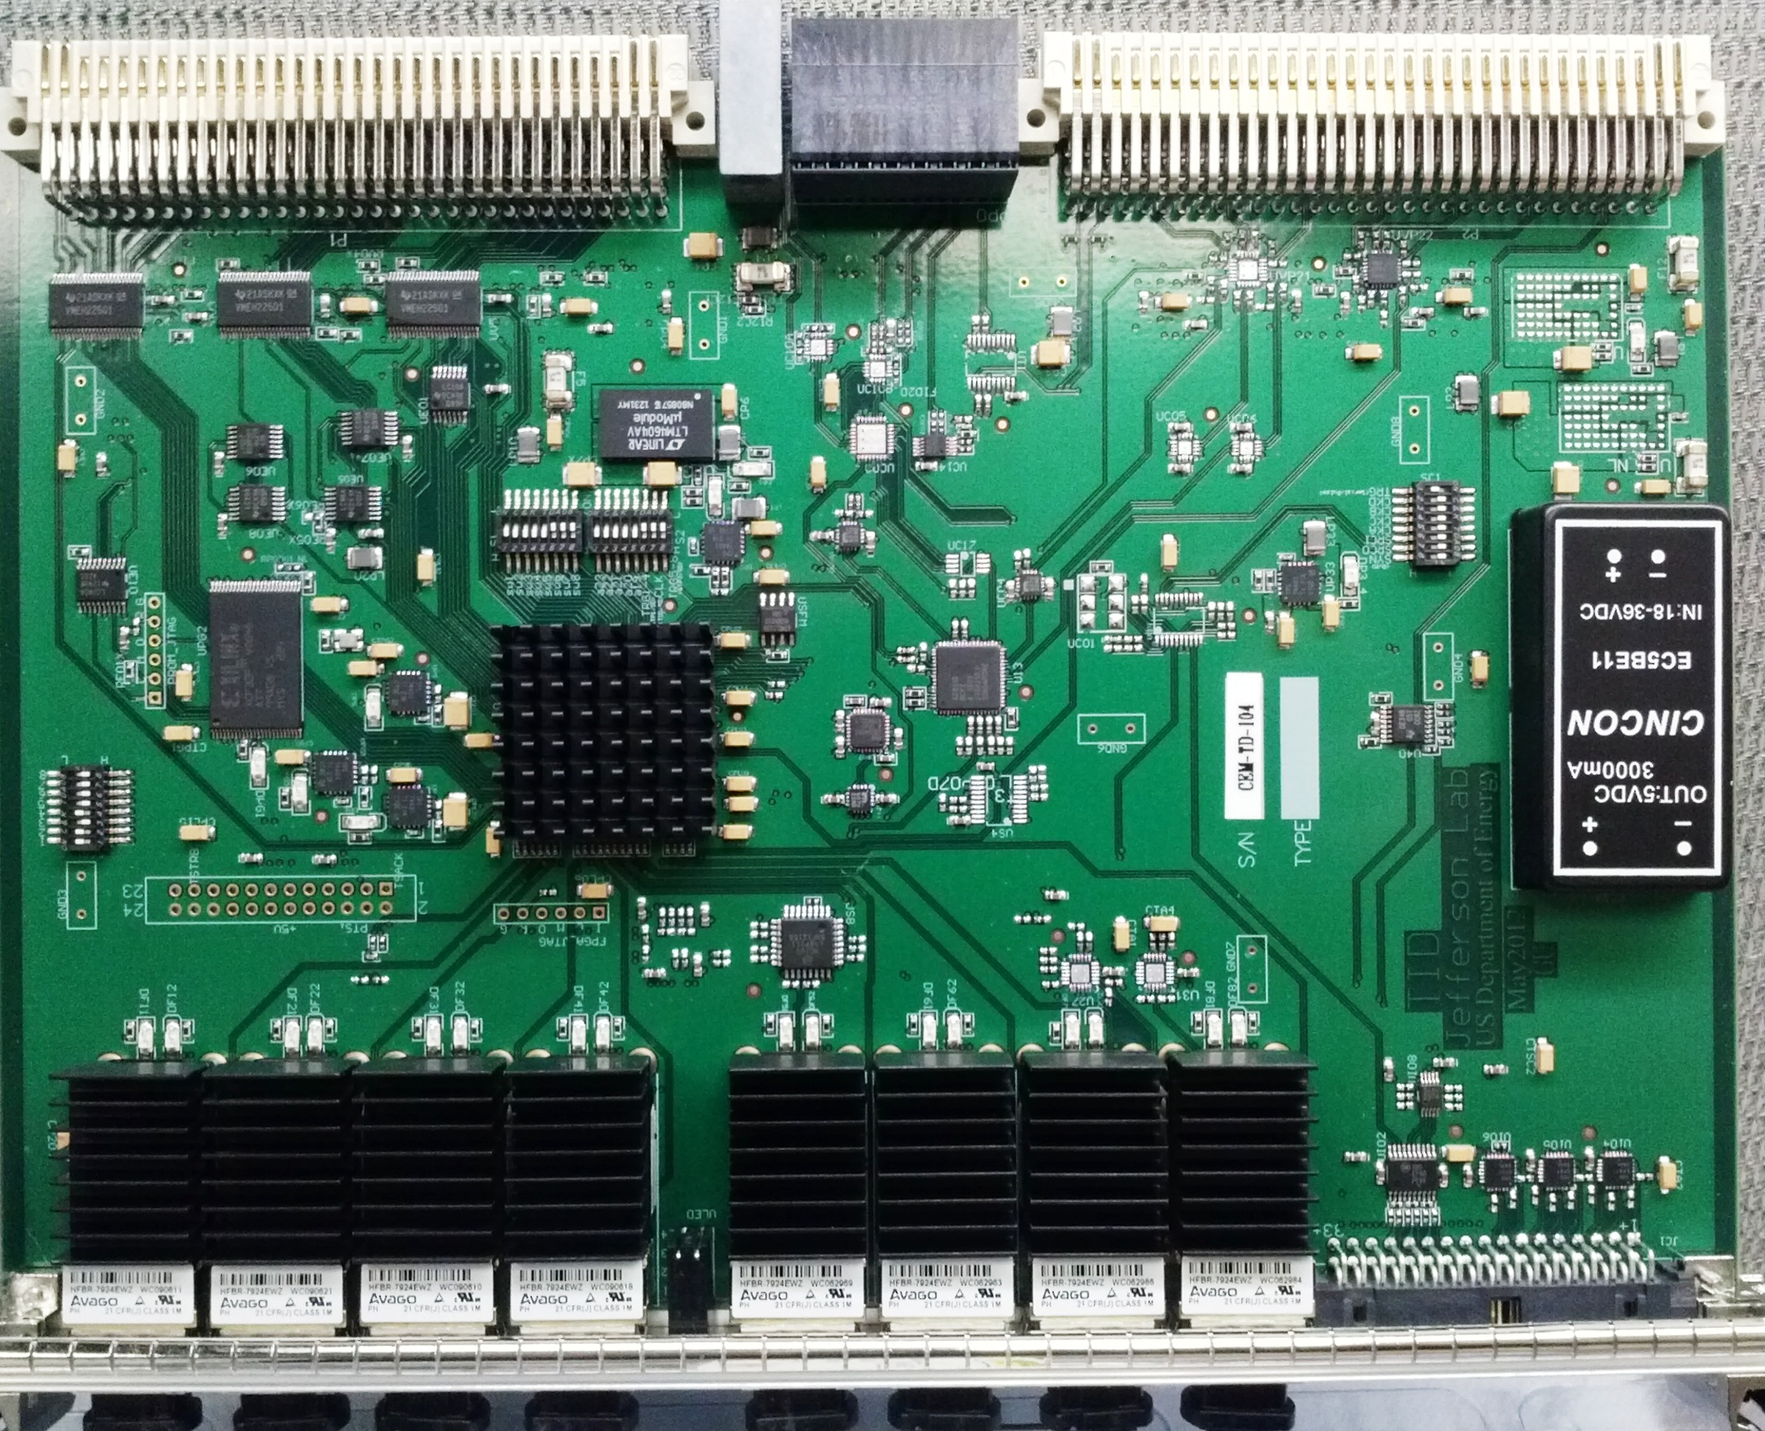
Production TD board picture

Slide 3
TI board block diagram
Asyn Trg Input
(front panel)
LED
indicators
PROM XCF32P
(32 Mb, 2 ver.)
Generic
outputs
JTAG
Inhibit
JTAG
VME 64X
Power supply
8 (ECL)
Trg, Busy, etc.
6+1
4
Emergency
VME→JTAG
User
AM
PROGRAM
VME64X (control,readout)
SYNC
HFBR#1
FPGA
Xilinx XC5VLX30T
-1FF665C
Trigger Fanout
(MC100EP14)
TRIGGER
HFBR#2
SYNC Fanout
(MC100EP14)
SYNC
BUSY
I²C (SD, CTP)
HFBR#3
SYNC Fanout
SYNC
VXS P0
Fast communication
HFBR#4
GBE resampler
(AD2805)
Trigger Fanout
(2x MC100EP14)
HFBR#5
Clock Fanout
(MC100EP111)
Clock Synthizer
(AD9510)
Clock
switch
HFBR#6
HFBR#7
Clock select
(MC100EP57)
Vme P2
Front Panel Con.
HFBR#8
Clock
Oscillator (250 MHz)
Status
Front Panel
TI: not populated
Trigger
TD: not populated
SYNC

Slide 4
TI FPGA block diagram
HFBR#5 In
HFBR#1 In
serial
P0 out
P0 in
Clk_SYS
250
SYNC
encoding
ClkGiga
Clock
manager
200
Phase
Alignment
Loopback
SYNC src sel
62.5
P0 FP out
33MHz
vme
SYNC
Decooding
Sync
width
TI use
FrontPanel Trigger In
Clock
TI use
VME 64X
A24 register
A32 Data
TrigIn(6:1)
Prescale
scaler
match
TriggerWord
Generation
TriggerRule
(TS function)
VME trigger
EventType
Lookup
P0 trig1 trig2
P2, FP trigger
Random
Trigger
Generation
(4kHz-500KHz)
TrgWord(15:0)
HFBR#(1-4)
Trigger Source Sel.
HFBR#(5-8)
Trigger
decoding
HFBR#1
TI event
Data Gen.
Data
Buffer
HFBR#2
Status
HFBR#3
GTP
Serializer/Deserializer
HFBR#4
Busy
Source
Select
HFBR#5
HFBR#6
HFBR(8:1) Status
Trigger Acknowledge
Readout acknowledge
Busy etc.
I²C engine
( SD )
I²C engine
(CTP/GTP)
HFBR#7
HFBR#8
BUSY logic
SD busy
SD_link
buffer
CTP_link
buffer
JTAG engine
( FPGA )
JTAG engine
( PROM )
CTP busy
BUSYs

Slide 5
TS board block diagram
Generic Input
(front panel)
LED
indicators
PROM XCF32P
(32 Mb, 2 ver.)
Ext Trg Input
(front panel)
JTAG
16
JTAG
PROGRAM
VME 64X
Power supply
24
Emergency
VME→JTAG
User
AM
Event type lookup tables and partition triggers
I²C, JTAG
etc.
SYNC generation
VME64X
(control,readout)
32
GTP Trg Input
(VME P2)
VME Trigger
32
TRIGGER generation
SYNC
BUSY throttling
Trigger
Status (busy,Etc)
TRIGGER/SYNC loopback
Data generation &readout
BUSY
2x QSFP
(to TI, etc.)
TRIGGER
VXS P0
Fast communication
SYNC
Clock manager
I²C (SD)
Xilinx XC5VFX70T
-2FF1136C
12 (ECL)
CLOCKS
Generic
outputs
10 (LVCMOS)
Clock Buffer
(MC100LVEP111)
SMA
Level Translators
LVPECL→LVDS etc.
SMA
(acc. Clock)
Oscillator
(250 MHz)

Slide 6
TS FPGA Block diagram
30x5
crossP x
30x5
crossP x
30x5
crossP x
30x5
crossP x
Four TS partitions
15x3
crossP x
serial
P0 output
15x3
crossP x
13x4
15x3
crossP x
13x4
FP Async. input
Prescale, scalers
Window match
15x3
crossP x
13x4
SYNC
encoding
13x4
250
30x5
crossP x
Clk_SYS
Clock
manager
200
30x5
crossP x
62.5
30x5
crossP x
30x5
crossP x
33MHz
vme
loopback
SYNC
Decooding
TS use
15
15x8 lookup tables
VME 64X
A24 register
A32 Data
A24 TSpartition
FP Sync input
Prescale, scalers
Window match
30
TriggerWord
Generation
TriggerRule
VME trigger
15x8
15x8
4
16
3
Random
Trigger
(4kHz-500KHz)
8
15x11
16x11
4
16x11
8
15x11
GTP input
Prescale, scalers
Window match
3
30
15x8
15x8
16
TrigWord
TS event
Data Gen.
Data
Buffer
Trigger
decoding
TS part 1
Data Gen.
TS 1
data
TS part 2
Data Gen.
TS 2
data
TS part 3
Data Gen.
TS 3
data
TS part 4
Data Gen.
TS 4
data
I²C engine
(CTP/GTP)
P0 trigger
I²C engine
( SD )
TI#A
GTP Serializer Deserializer
TI#B
TI#A, #B Status
BUSY logic
JTAG engine
( FPGA )
JTAG engine
( PROM )
SD busy
SD_link
buffer
BUSYs

Slide 11
HallA SBS TS board block diagram
External
BUSY inputs
LED
indicators
PROM XCF32P
(32 Mb, 2 ver.)
Local Trigger
(L1 trigger)
JTAG
4+1
JTAG
PROGRAM
VME 64X
Power supply
24
Emergency
VME→JTAG
User
AM
Event type lookup tables and partition triggers
I²C, JTAG
etc.
SYNC generation
VME64X
(control,readout)
5
ReadoutTrig
(L2 trigger)
VME Trigger
16
TRIGGER generation
SYNC
BUSY throttling
Trigger
Status (busy,Etc)
TRIGGER/SYNC loopback
Data generation &readout
BUSY
2x QSFP
(to TI, etc.)
TRIGGER
VXS P0
Fast communication
SYNC
Clock manager
I²C (SD)
Xilinx XC5VFX70T
-2FF1136C
12 (ECL)
CLOCKS
Local trigger(4:1)
FastClear(4:1)
Readout trigger
10 (LVCMOS)
Clock Buffer
(MC100LVEP111)
SMA
Level Translators
LVPECL→LVDS etc.
SMA
(acc. Clock)
Oscillator
(250 MHz)

Slide 12
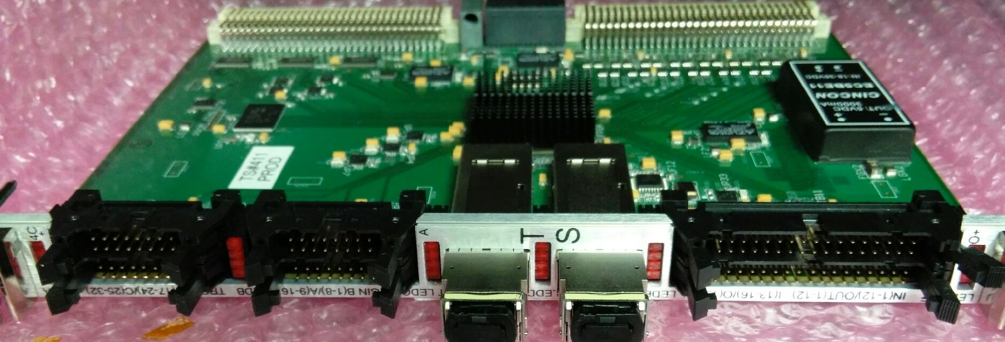
HallA SBS Trigger block diagram
VME reg. 0x6C
Program table
Local Trigger
Lookup table
32x1
Trigger Rule
L5/6, BIP#1
Local TRG#1
Width
R17/18, TRG#1
L7/8, BIP#2
Local TRG#2
Width
R19/20, TRG#2
L9/10, BIP#3
Local Trigger
distribution
Local TRG#3
Width
R21/22, TRG#3
L11/12, BIP#4
Local TRG#4
Width
R23/24, TRG#4
UL1/2, TRG#1
Delay
Match
FastClear#1
Width
R5/6, FastCl#1
UL3/4, TRG#2
Delay
Match
R7/8, FastCl#2
UL5/6, TRG#3
FastClear#2
Width
UL7/8, TRG#4
VME 0x28
Bit(16:12)
DAQ# enable
Delay
Match
FastClear#3
Width
R9/10, FastCl#3
UL9/10, TRG#5
Delay
Match
FastClear#4
R11/12, FastCl#4
NO
Width
LL1/2, #1
ReadOut Trigger
Delay, Prescale,
Lookup table,
Trigger Rule
Trigger
Width Ext
YES
LL15/16, #8
Delay/Width
LR1/2, #9
Trigger
word
second
word
Serializer
VXS P0, TRG
LR15/16, #16
Serializer/Fiber
QSF#A, to TI
VME P2 GTP
#1 --- #32
Prompt Trigger
Serializer/Fiber
QSF#B, to TI
VME P1
VXS P0
VME P2
UL
UR
LL
LR
QSFA
QSFB
L
R

