Slide 1
Trigger Distribution Latency
William Gu
Data Acquisition Group
Dec. 21, 2012

Slide 2
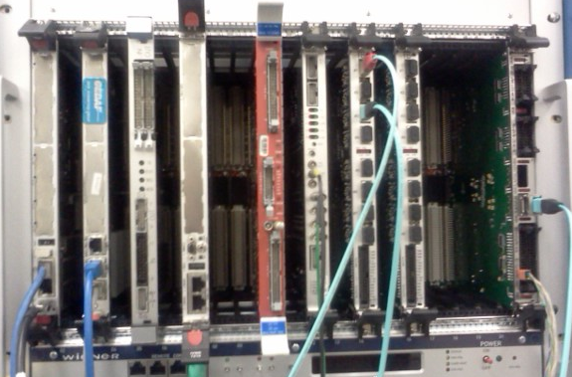
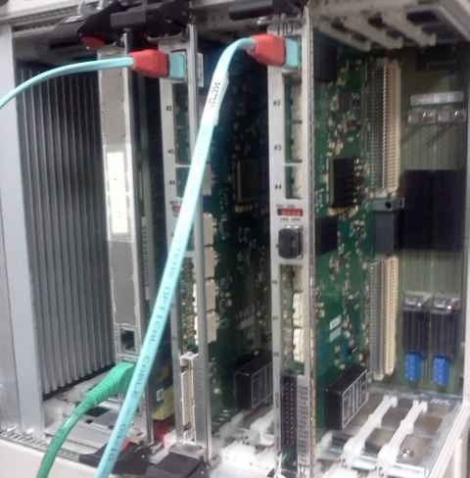
Measurement setup
Generated by TI, synced with VME clock; probed at TS input connector
TrigIn
After signal receiving and event type lookup table. One clock before Serializer
TStrig
TS Serializer
TS MGT serializer at 16-bit trigger word with 62.5MHz
SD/TD
P0 backplane from TS→SD;
P0 backplane from SD→TD
TI Deserializer
TI MGT deserializer,
TI Trigger Stroe
trigger_strobe, one clock delay of the parallel data
TI trg_out
4ns ealier than the Trigger_1 to the P0/crate

Slide 3
Measurement setup
Firmware:
TS: V10.7
TI: V5.3
TD: V1.6
TS sync delay (0x79 reg): 0x54
TI sync delay (0x50 reg, bits(15:8)):
TI in slot3: 0x08
TI in slot6: 0x00
Fiber Length: 5m ➔ 25ns
Two TI boards fanout the trigger_1 synchronously (within 4ns)
M6100, slot#3
TD, slot#14
SD, slot#12
TS, slot#21
TI, slot#6
TI, slot#3

Slide 4
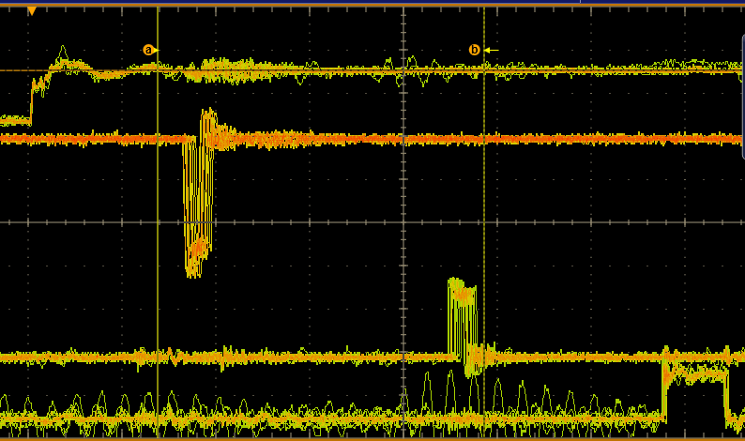
Measurement Results
TrigIn
TStrig
TI Trigger Stroe
TI trg_out
The skew from “TI trigger_1 output” to “TS trigger input” is less than 4ns (250MHz clcok)
The trigger words are serialized/deserialized with skew of 16ns (62.5MHz clock phase)

Slide 5
Latency from figure
TrigIn
TStrig
TI Trigger Stroe
TI trg_out
TS: 162ns-174ns
MGT: 443ns-455ns
TI: 674ns
TI in slot #3: register (offset 0xB8): 0xe000fc0c;
TI in slot #6: register (offset 0xB8): 0xe000fc0d;
Itemized latencies:
TS processing | 170ns + matching window width
TS Serializer/TI deserializer | 230ns
SD/TD delay | 25ns
5m fiber | 25ns
TI trigger delay | 50ns + alignment delay setting

Slide 6
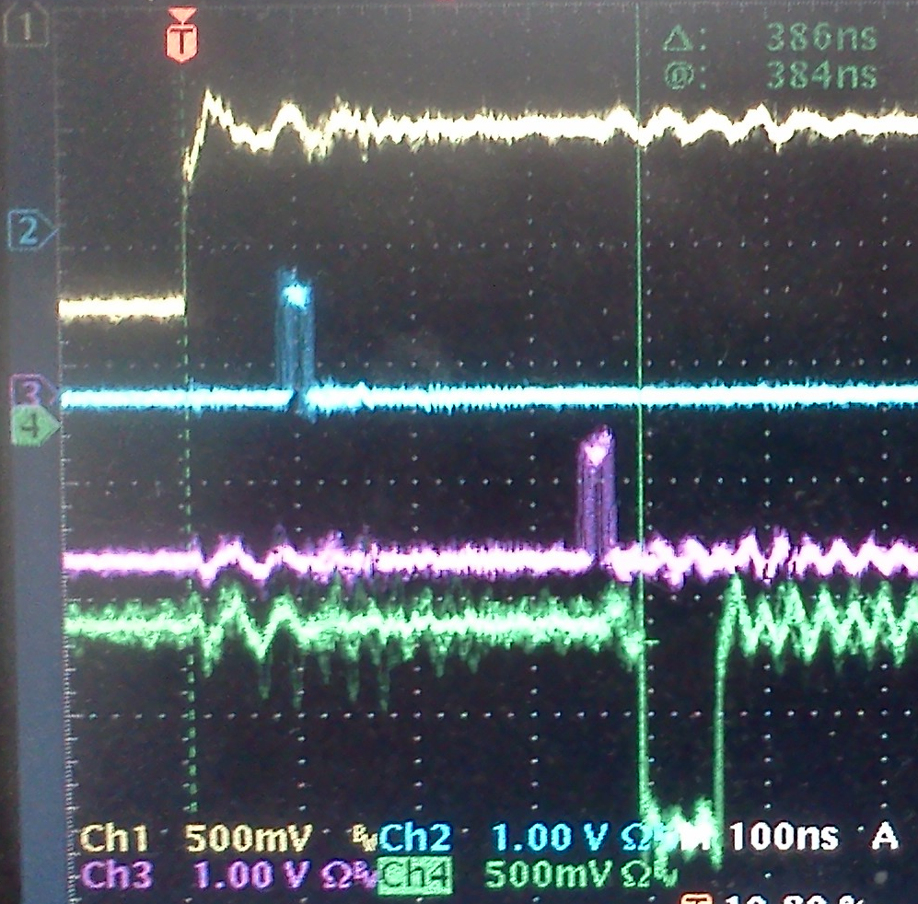
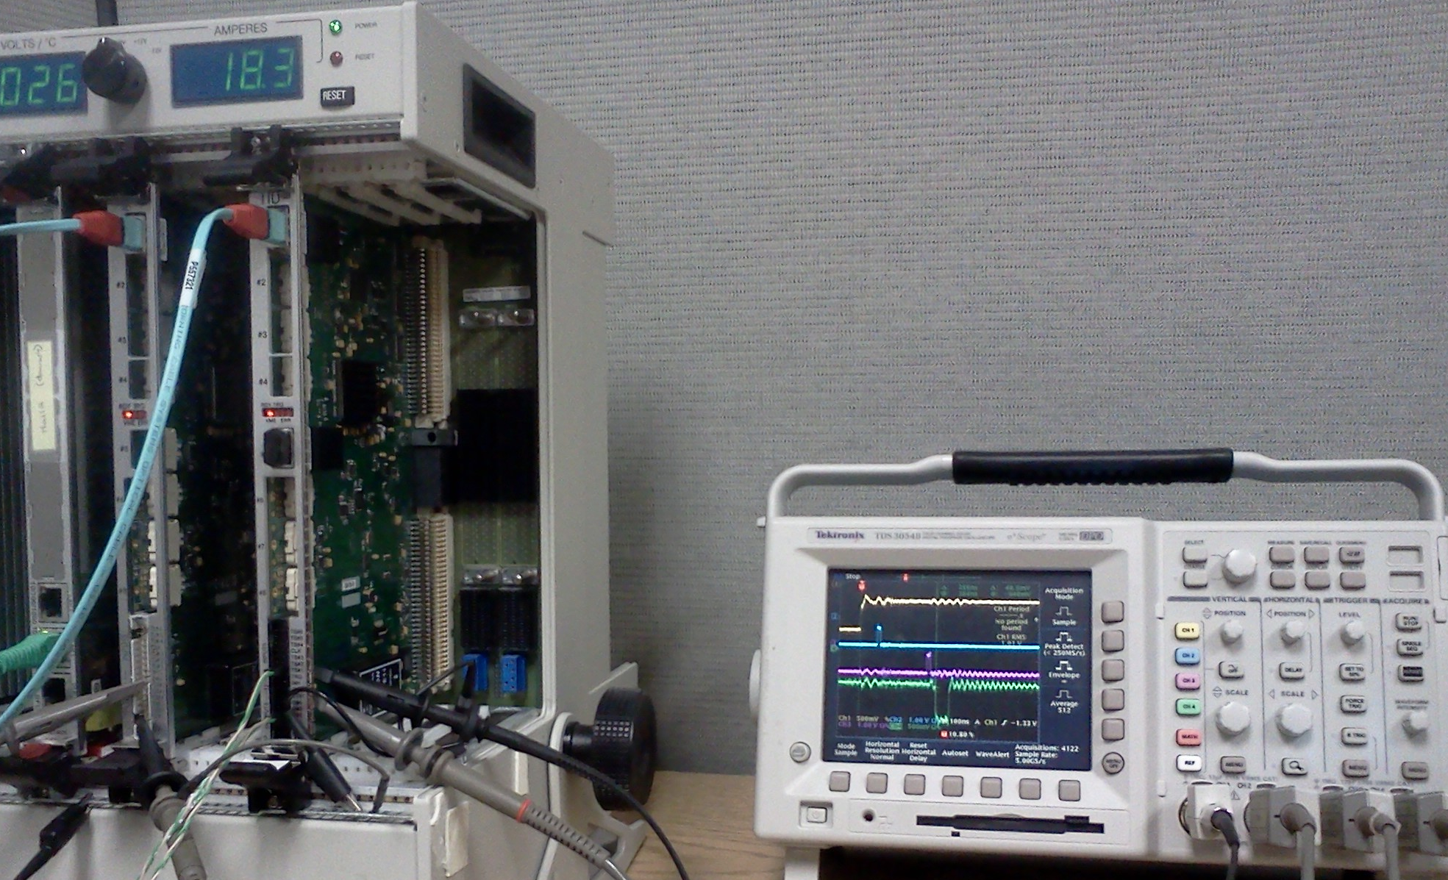
TI_master latency measurement
Firmware:
TI: V5.5
TI_M sync delay (0x7c) : 0x24
TI sync delay (0x50): 0x00
Fiber Length: 3m ➔ 15ns

Slide 7
TI_master Latency from figure
TrigIn
“TS”trig
TI Trigger Strobe
TI trg_out
TImaster: 76-88ns
MGT: 328-340ns
TI: 386ns
TI in slot #3: register (offset 0xB8): 0xe000fc00
Itemized latencies:
TImaster processing | 80ns + matching window width
TS Serializer/TI deserializer | 235ns
3m fiber | 15ns
TI trigger delay | 50ns + alignment delay setting
The measurement is consistent with the TS→SD→TD→TI measurement.
TS event type generation needs ~90ns more than that of Timaster.
The total trigger distribution latency is ~500ns minimum.

