Slide 1
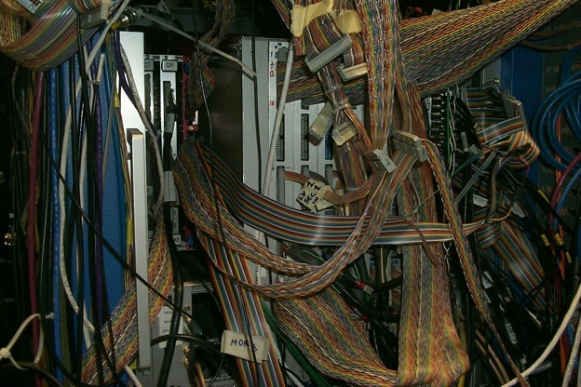
Data Acquisition at JLab
Graham Heyes
Data Acquisition Support
Experimental Nuclear Physics

Slide 2
Data Acquisition
data acquisition
Verb - Data acquisition is defined as the process of collecting and organizing information.
The data acquisition support group helps experimenters to take the data from their detectors and store it for future analysis.
Hopefully this talk will :
Show why such a group of people is needed.
Demonstrate some of the challenges and techniques.
Be interesting!

Slide 3
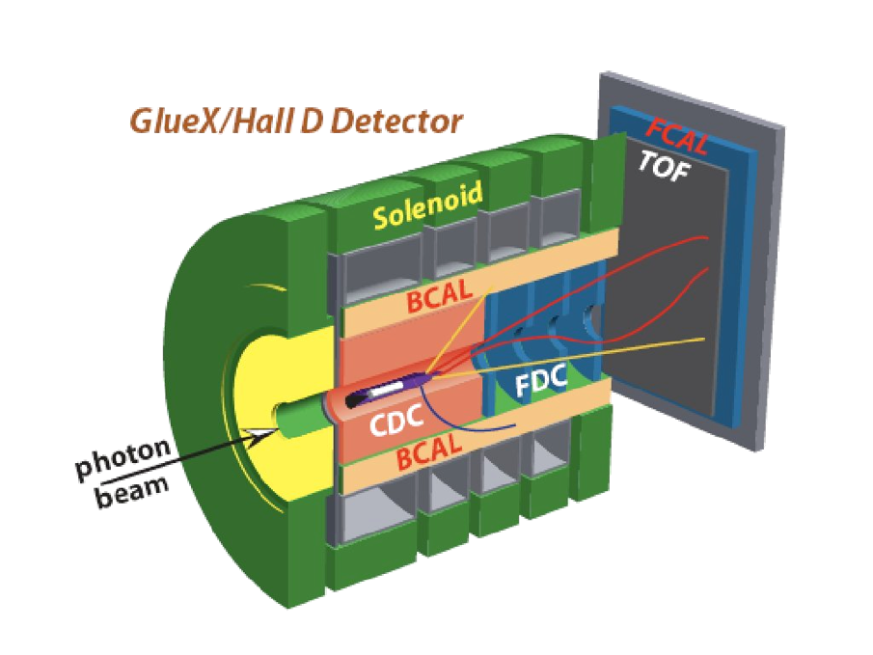
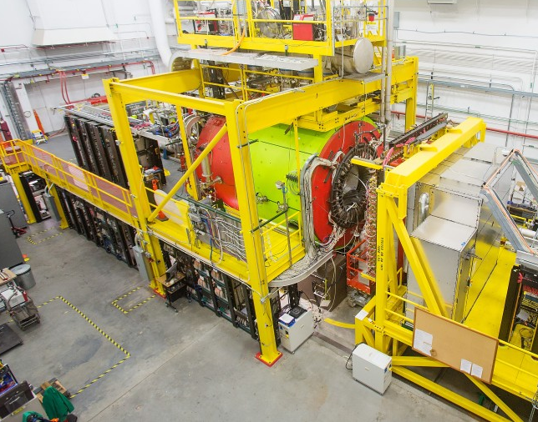
Detection and data acquisition
When a particle interacts with a target particles from the interaction enter a detector.
Sub-detectors measure properties of these particles as electrical signals.
Three basic types of measurements are charge, time and count.
Electronics and software convert electrical signals into digital data that can be stored and later analyzed.
ADC = charge, TDC = time, Scaler = count
All of the data generated from one interaction is called an event.

Slide 4
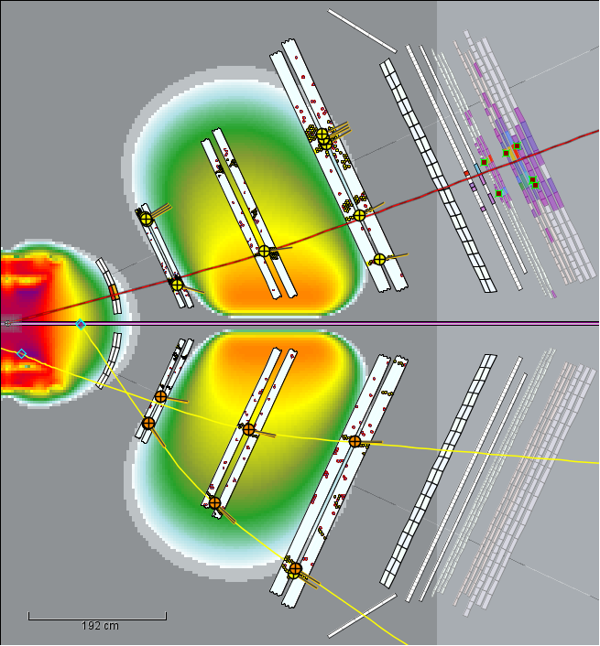
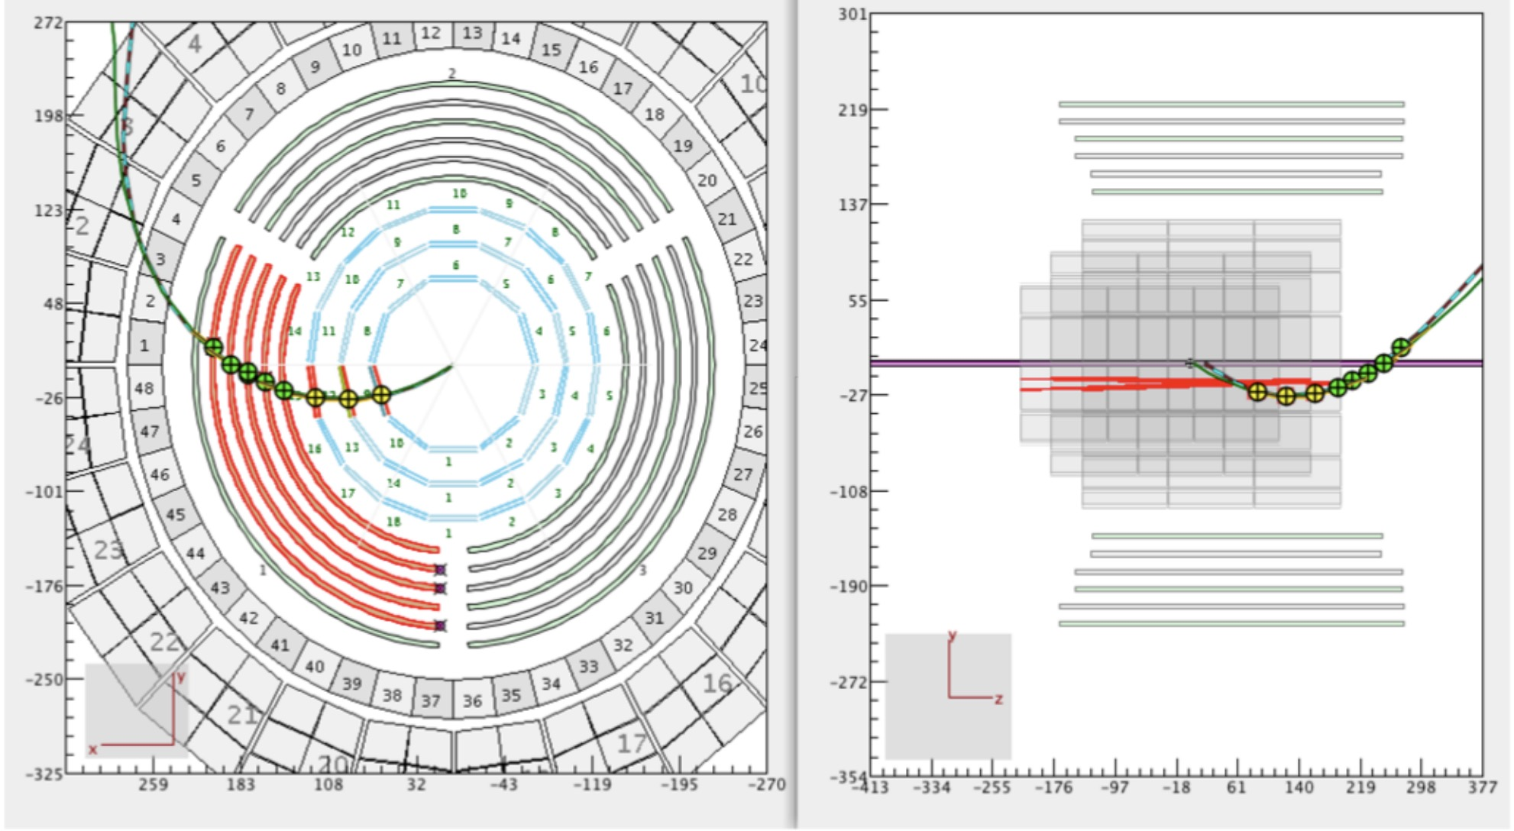
The event as a unit of data
Data from one event has no history. It doesn’t depend upon events that went before and doesn’t influence later events.
Events occur with random timing.
Hardware may not be ready for new data.
Dead time when data is lost.
Events may overlap in time, event pileup.
Peak event rate can be more than the average.
Event size depends upon the physics.
Accidental hits unconnected with event.
Electronic noise.
Distribution of event sizes.
Some very large events.

Slide 5
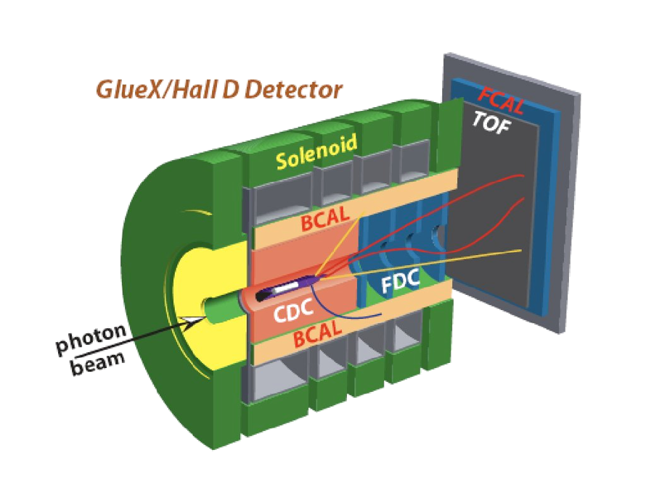
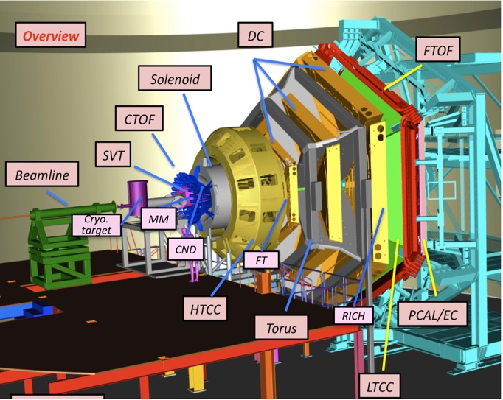
Data acquisition for big experiments
Detecting hardware is physically distributed within the detector so we need to:
Log where the data came from (and when).
Gather all of the data from one event together.
Experiments run for months or years so need :
Stability.
Control - to start and stop the whole system.
Monitor conditions under which data was taken.
GlueX/Hall D Detector
Clas12/Hall B Detector

Slide 6
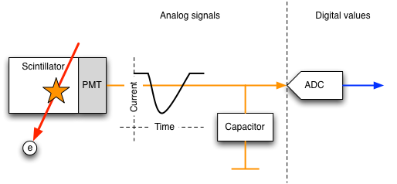
Detector example, a scintillator
A particle deposits energy in a scintillating material that converts it into light.
A Photo Multiplier Tube (PMT) converts the light into a pulse of electricity.
The charge is captured to generate a voltage.
An Analog to Digital Converter (ADC) measures the voltage as a digital value.

Slide 7
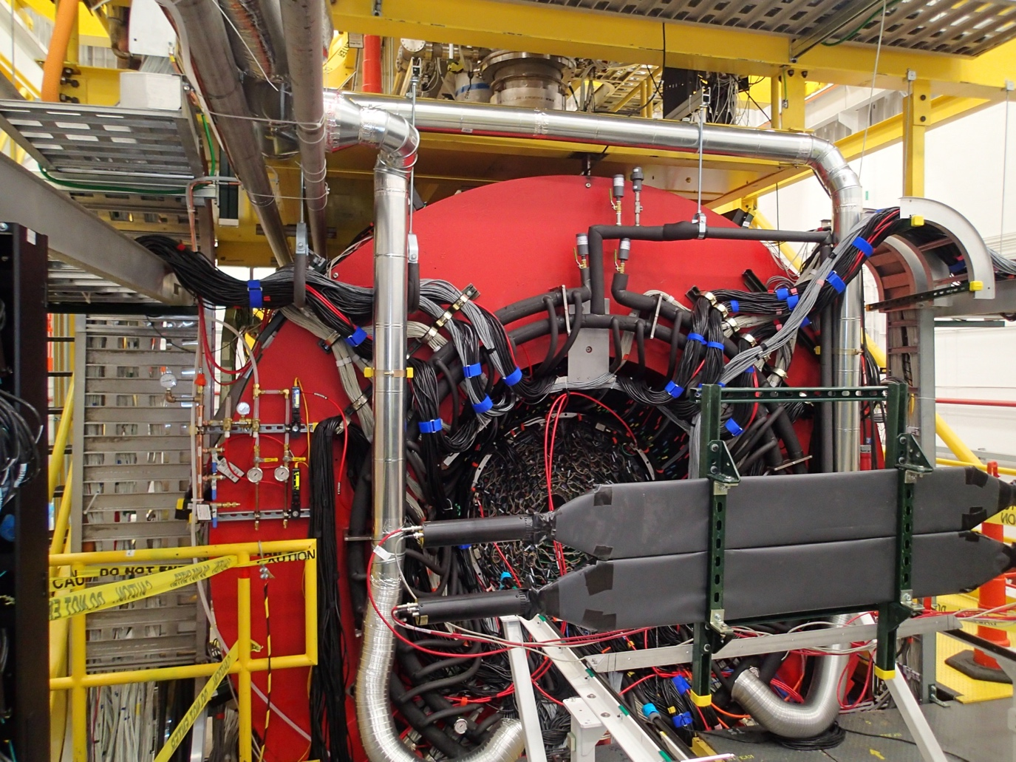
Picture of test scintillators in hall-D
Scintillator
Photomultiplier

Slide 8
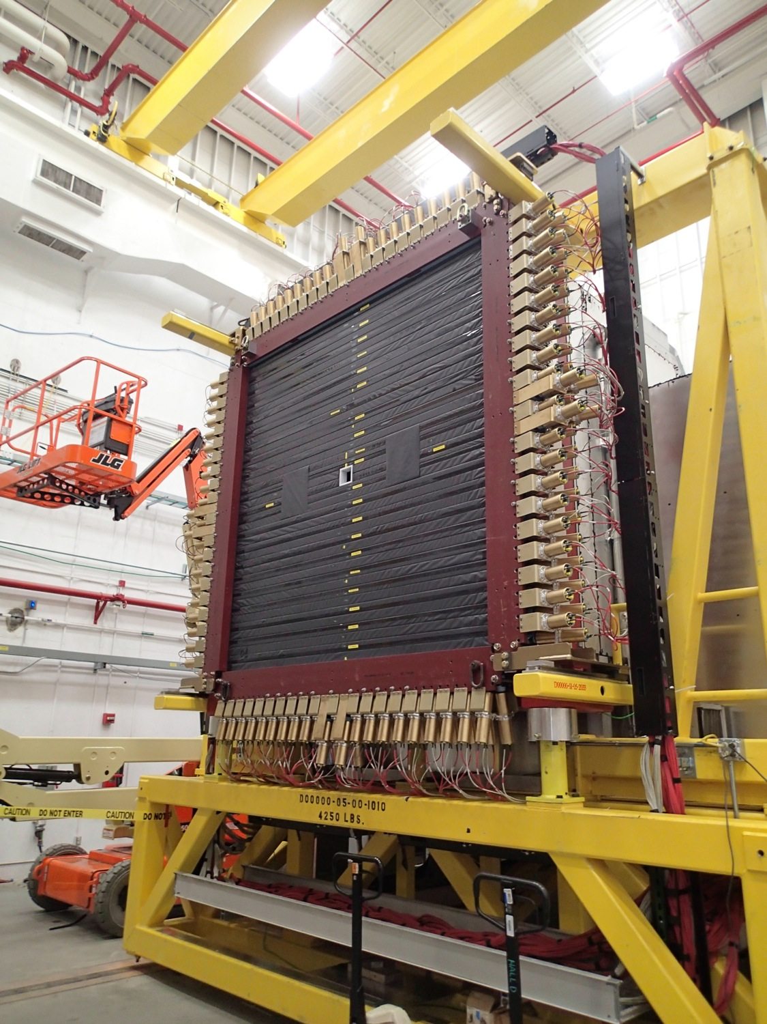
Array of scintillators

Slide 9
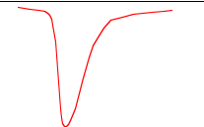

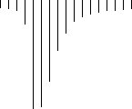
Sampling vs Integration
A traditional “integrating” ADC takes 6 to 10 µsec to digitize a pulse. A gate pulse, generated by other detectors marks the region of interest to electronics electronics that integrates the charge from the signal pulse.
This type of ADC generates a single measurement representing the charge sum during the gate.
A Flash ADC samples continuously at a fixed rate.
For example, a 250 MHz ADC samples every 4 nsec and generates ~10-15 measurements during the gate. These describe the pulse shape as well as charge.
Signal pulse
Gate pulse

Slide 10
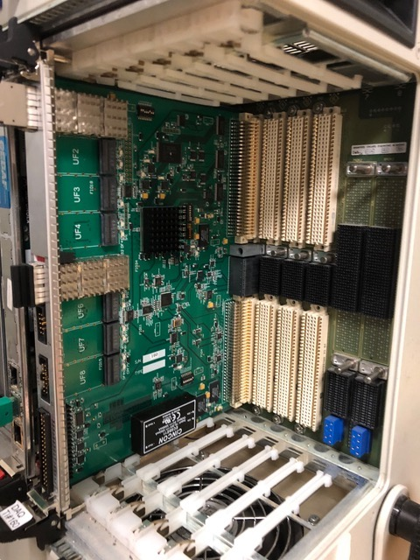
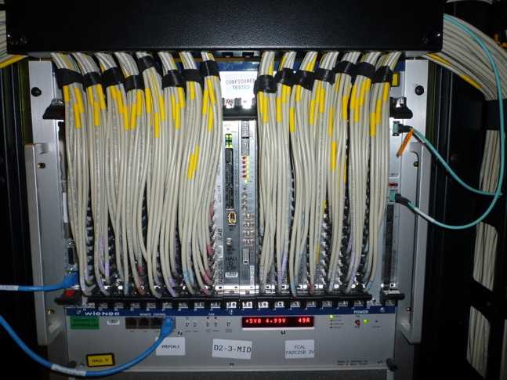
Putting together a system
In reality there are many data sources in a detector like GLUEX so we need many ADCs, TDCs and other electronics.
Devices are connected together using backplane buses and cables.
GlueX uses VXS, which is a variant of the VME standard for interconnecting electronics.
Boards slide into slots in a “crate” and plug into one or more backplanes that provide power and interconnect the boards.
Usually there is a single board computer in the left most slot to configure and read out the boards.
VXS has a third “backplane” that provides high speed point-to-point serial data links between boards and two switch slots in the center of the crate.

Slide 11
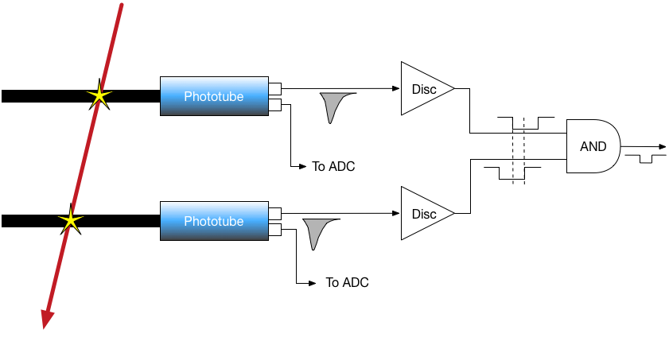
A Simple Trigger
How do we know the signal came from an event?
Fortunately we have more than one detector.
Combine data from different detectors to characterize events.
Determine which events are interesting.
Example - coincidence trigger – two detectors have data within a time window.

Slide 12
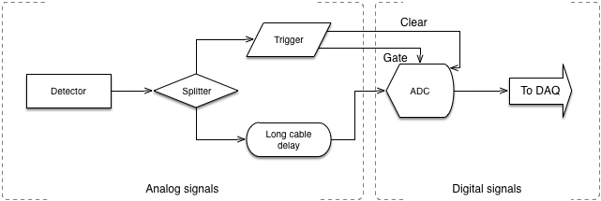
An analog trigger
It takes some time for the trigger logic to decide if a signal should be digitized.
The analog signal must be delayed so that the gate and signal arrive at the ADC at the same time. Typical coax cables ~1 ns/ft so you could simply delay the signals using long cables.
Matching cable lengths is very important.
The ADC cannot process a new signal until it is read or cleared.
This limits the trigger rate.

Slide 13
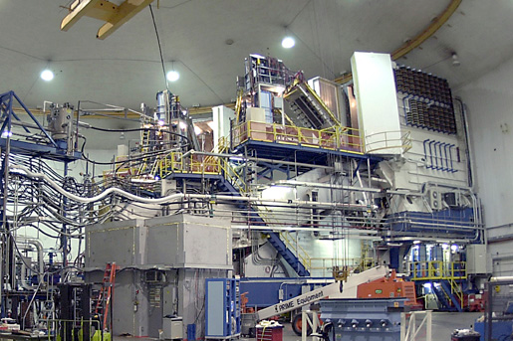
Here’s the long cable in Hall-A.
Detector hut
Delay cable

Slide 14
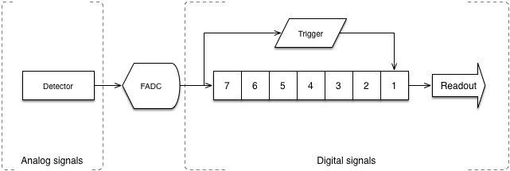
Pipeline trigger
Replace all that cable with digital memory.
In a pipelined system a Flash ADC digitizes at a constant rate and stores the values in a memory. Values are clocked into memory at the same rate as the Flash ADC clock which, in the case of GLUEX, is 250MHz (4 nS).
For example, if the trigger logic takes 28 nS we know that trigger corresponds to measurements 28/4 = 7 cells down the memory pipeline.
The readout software can read and clear the entire memory at once.
Read all the samples or read the integrated charge + time of arrival.

Slide 15
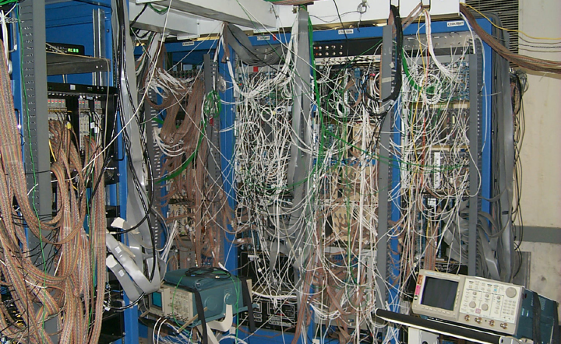
Trigger logic
Triggers used to use a lot of electronics wired together. We can’t do that now:
Propagation times down cables limit trigger rates.
Modern experiments require very complex trigger decisions.

Slide 16
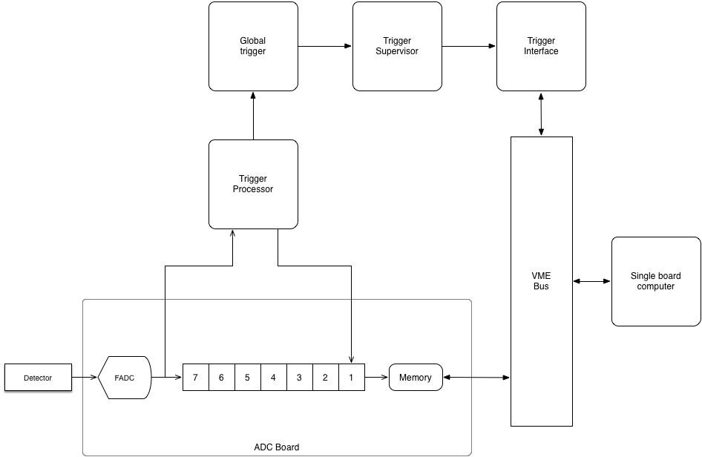
GLUEX trigger
Each ADC sends signals to a crate level trigger processor over VXS serial bus.
Trigger processor sends signal to global trigger for all crates over fiber optic cable.
Global trigger tells trigger supervisor (TS) which events are good.
TS tells Trigger Interface (TI) board in each crate.
TI signals single board computer to read out crate and provides information about which trigger the data belongs to.

Slide 17


GlueX trigger, starts at ADC crate
16 channels per board
15 boards = 240 channels per crate
Trigger interface
Intel CPU Read Out Controller
(ROC) running Linux
Boards are connected to CPU via VME bus.
ADC trigger data over VXS serial bus
CTP Board sending signals to trigger over fiber

Slide 18
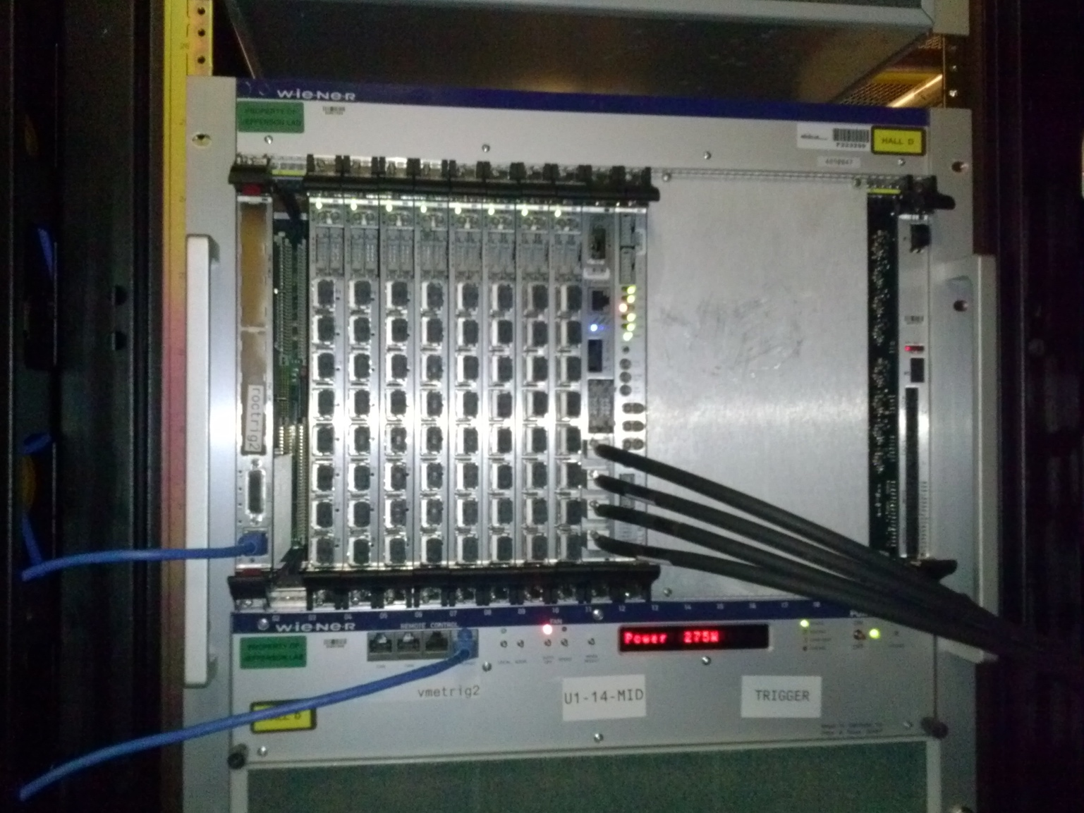

All crates connect to Global Trigger Crate
Intel CPU controller
Global trigger processor (GTP)
Sub-system processor board (SSP)
Outputs to trigger
supervisor
Eight boards with eight connectors each so up to 64 crates.

Slide 19
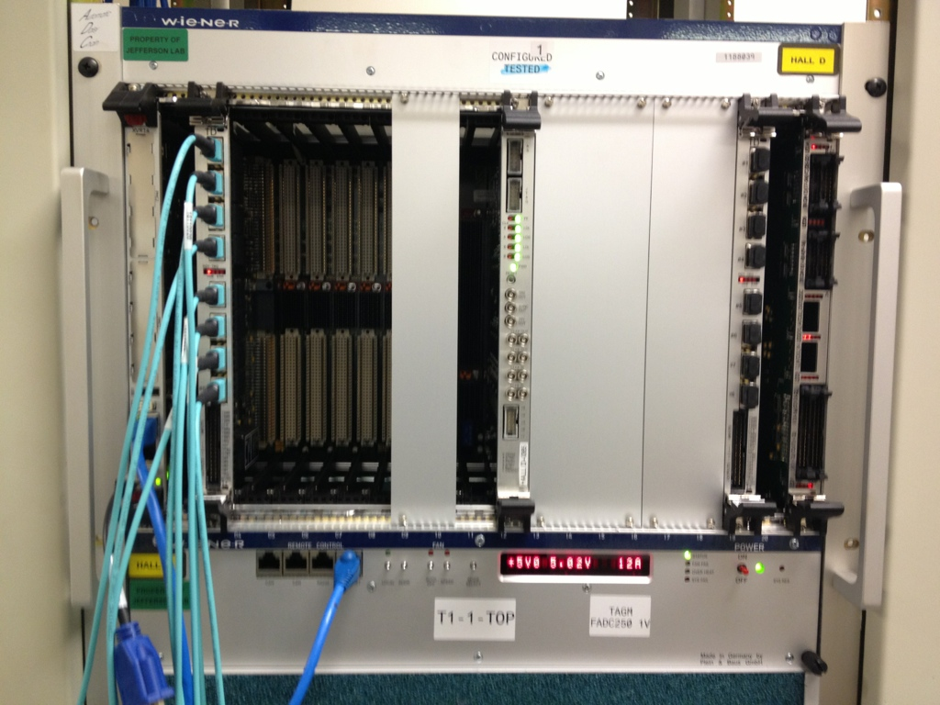
Final trigger goes to Trigger Supervisor crate
Signal Distribution board (SD)
Trigger Supervisor (TS)
Trigger Distribution
board (TD).
Intel CPU for control and configuration.
Optical trigger link back to crates.
VXS serial backplane

Slide 20
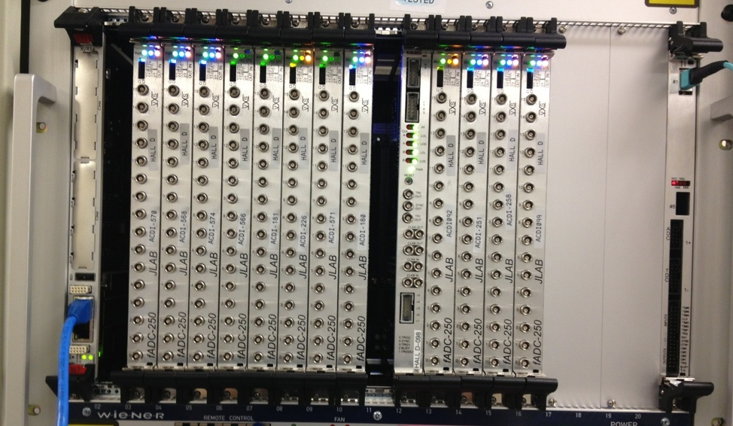
Then back to the start to trigger VME readout
Cable coming from trigger
Intel CPU ReadOut Controller or ROC.
Trigger Interface board (TI)
ADC payload board
Output via network link.
1 Gbit/s
The TI board gets from the trigger supervisor:
Signal to CPU to read the memory of the ADC boards.
TI is read to get data about which events the ADC data belong to.
The CPU:
Copies ADC and TI data into memory via VME backplane,
CPU encodes data in EVIO data format.
Sends the data over the network to the rest of the data acquisition system.

Slide 21
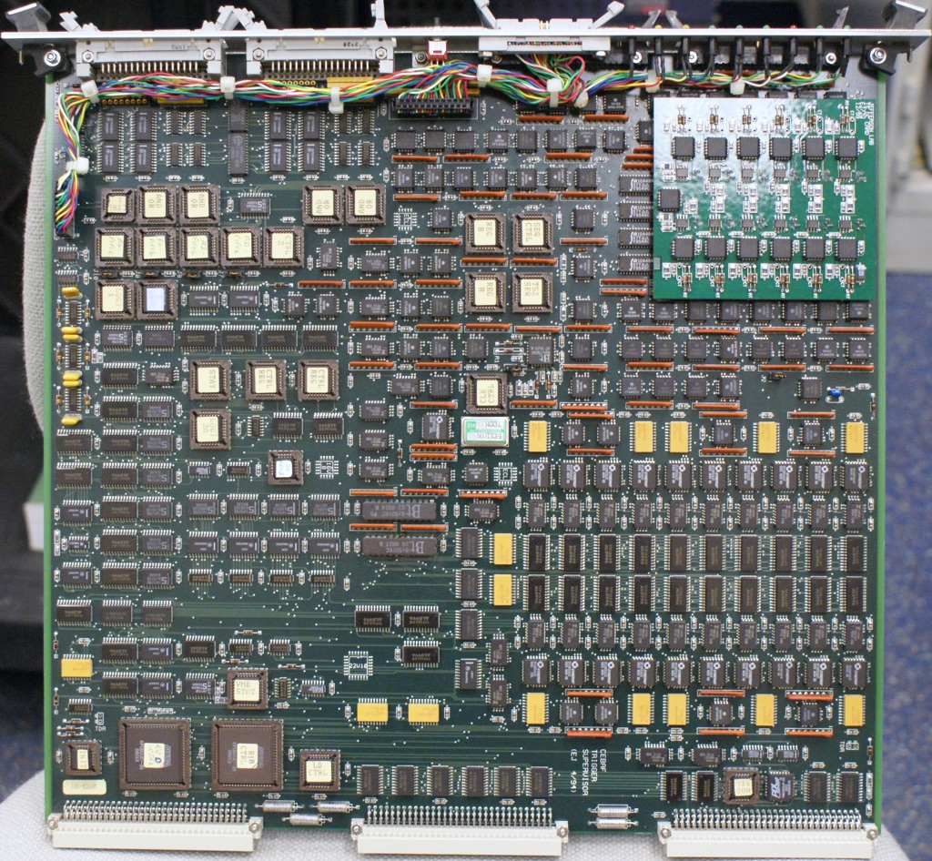
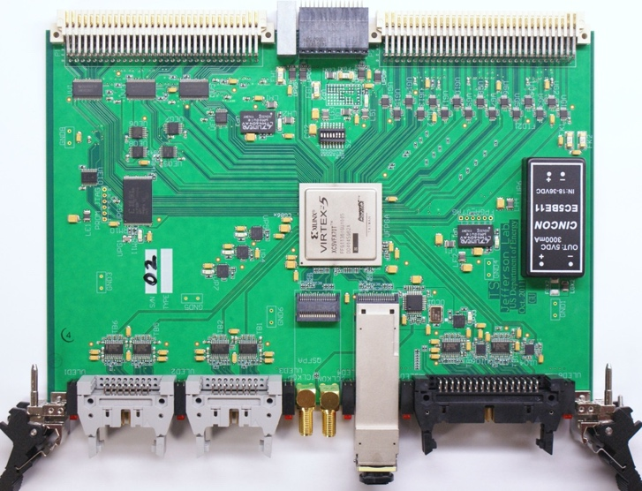
Complex electronics
We can now buy programmable logic arrays that allow us to implement complex algorithms in the firmware on a single chip.
The two pictures are of boards with similar functionality.
The one on the left designed in the early 1990’s.
The one below designed in 2011.

Slide 22
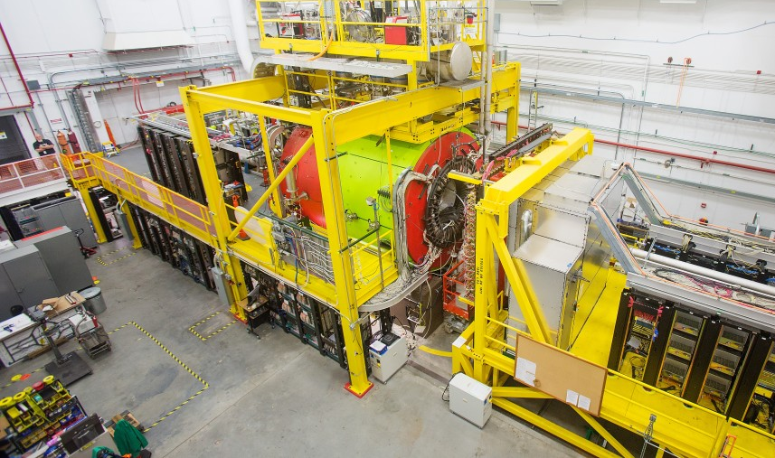
GLUEX DAQ electronics

Slide 23
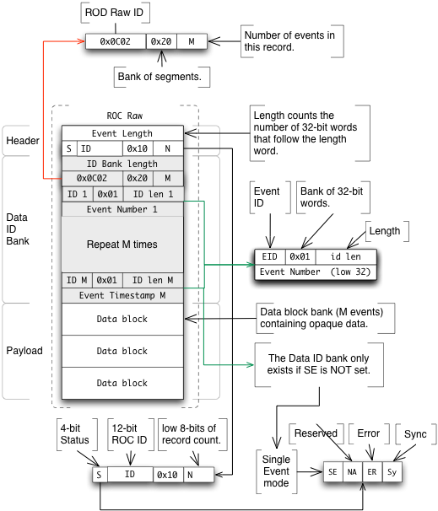
EVIO Data format, a real example
Bank - container for other data.
Each bank starts with a header.
Length.
Description of content.
The outer header tells us this bank contains banks.
The first bank is a list of trigger information for all the events in the block.
The following “payload banks” contain blocks of raw data read from ADCs or TDCs.

Slide 24
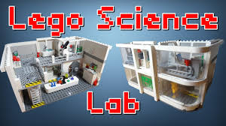
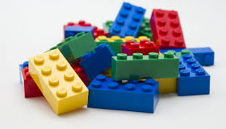
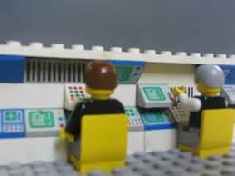
CODA
CEBAF Online Data Acquisition (see coda.jlab.org)
Kit for implementing data acquisition systems.
Electronics
Custom boards like trigger, TDCs and ADCs.
Support for commercial hardware.
Software to :
Interface with electronics.
Readout boards and format data.
Move data.
Merge data streams.
Give users access to data for monitoring.
Write data to files.
Control the data acquisition system
CODA is modular, solves big problems by splitting them into smaller ones.

Slide 25
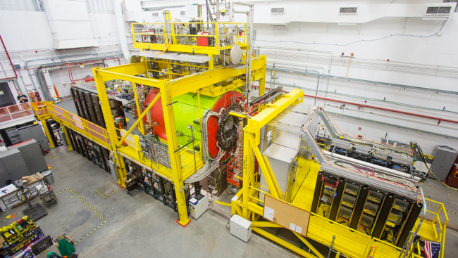
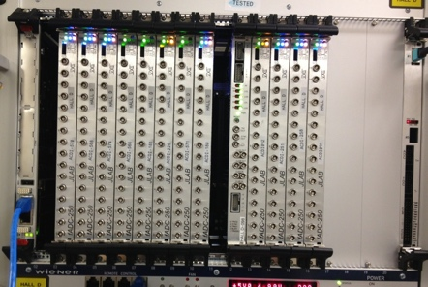
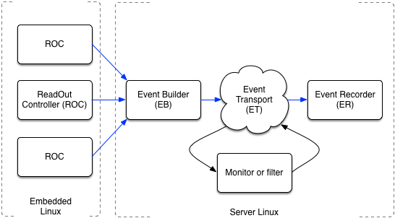
Network based data acquisition
The detectors are spread over a volume of space.
ROCS send data via a network.
Bits and pieces of events arrive at different times from different places but need to be collected together. This is done by the Event Builder.
Need to give the experimenter online data to monitor data taking.
Need to store the data.
A lot of pieces need to work together.

Slide 26
Event Building challenges
In 2018 GlueX event rate was 90 kHz and there are 50 crates.
The Event Builder has 11 µS to:
Find all 50 parts of an event.
Decode the incoming data headers.
Check for errors.
Generate new headers for the complete event.
Generate a trigger bank per event.
Copy all of the data into place.
The GLUEX goal data rate is 1.5 GByte/s.
30 MByte/s average per each of the 50 incoming links.
1.5 GByte/s through the EB, ET and ER.
Since data is copied several times the data rate inside machine running EB is several times 1.5 GByte/s.
That could be a lot for one machine to handle.
Solution: multi stage parallel event builder.

Slide 27
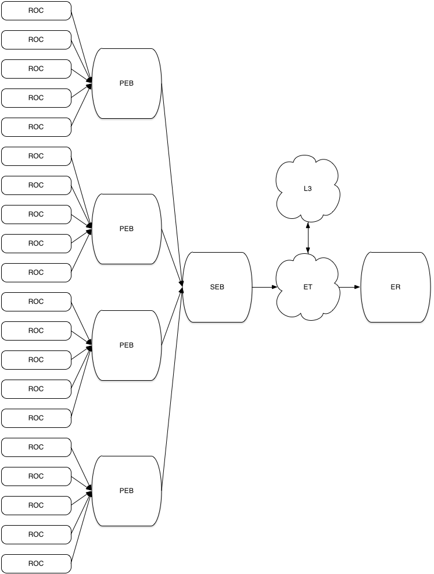
Staged Event Builder, 20 ROC example
Four Primary Event Builders (PEB) are connected to five ROCs each by 1 Gbit/s Ethernet links.
For each PEB this divides the formatting/checking work load and the data throughput for by four.
The four PEBs are connected to a single Secondary Event Builder (SEB) via 40 Gbit/s Infiniband links
The SEB has to handle the full rate but only has four incoming streams to handle.
If this is too much we can use two SEBs in parallel.
The SEB outputs to a system called ET which distributes the events to online data monitors.
A final program called the Event Recorder (ER) writes data files to disk.
Mon
SEB
ET
ER

Slide 28
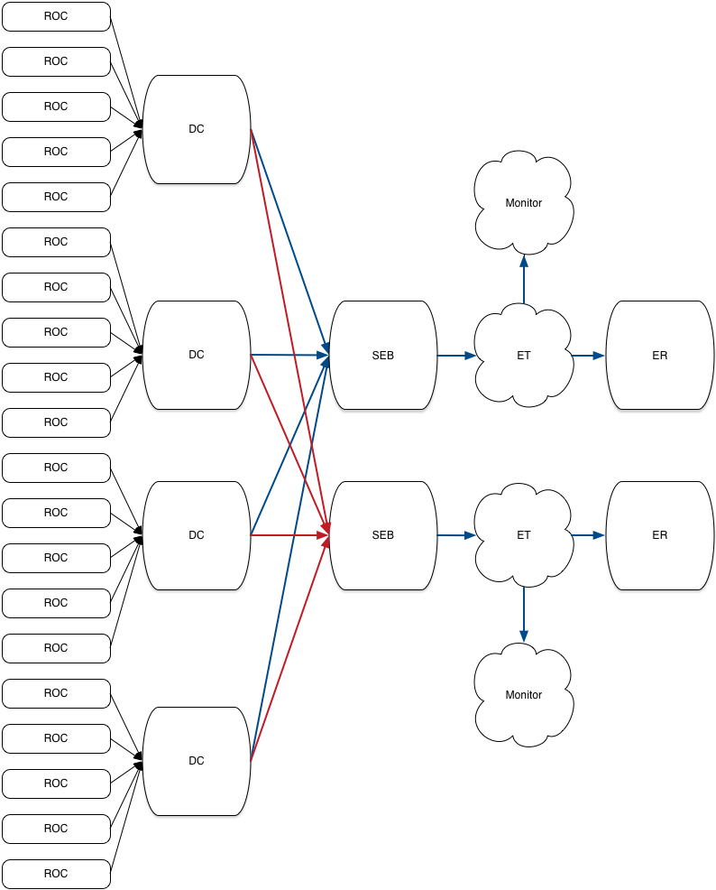
Multi stage and parallel

Slide 29
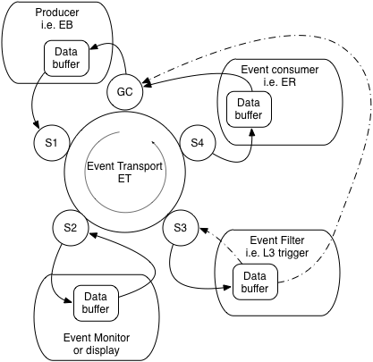
Event Transport, ET
Allocating and freeing buffers is time consuming.
The ET system gives programs access to data via preallocated shared buffers.
The system uses a railroad metaphor. Empty data buffers originate at Grand Central. They are filled by data producers and tagged to describe the content.
The buffers “move” around a circular track and at each station the tag is checked to see if the buffer should stop at the station.
An event monitor could set up station, S2, to take 1% of the events.
An event filter could set up S3 to take all events. Discarded events are sent back to GC good ones move on.
An event recorder takes all events and, after the data is written to a file sends the buffer back to GC.

Slide 30
Real World Performance
Even with a fast server and fast disk there is a limit to how quickly one program can write to a single file.
Solution – ER writes in parallel.
The ET system was designed for monitoring – it was never intended to run a single ET over 1 GB/s.
Solution move the ET out of the data path and give it a sample of events.

Slide 31
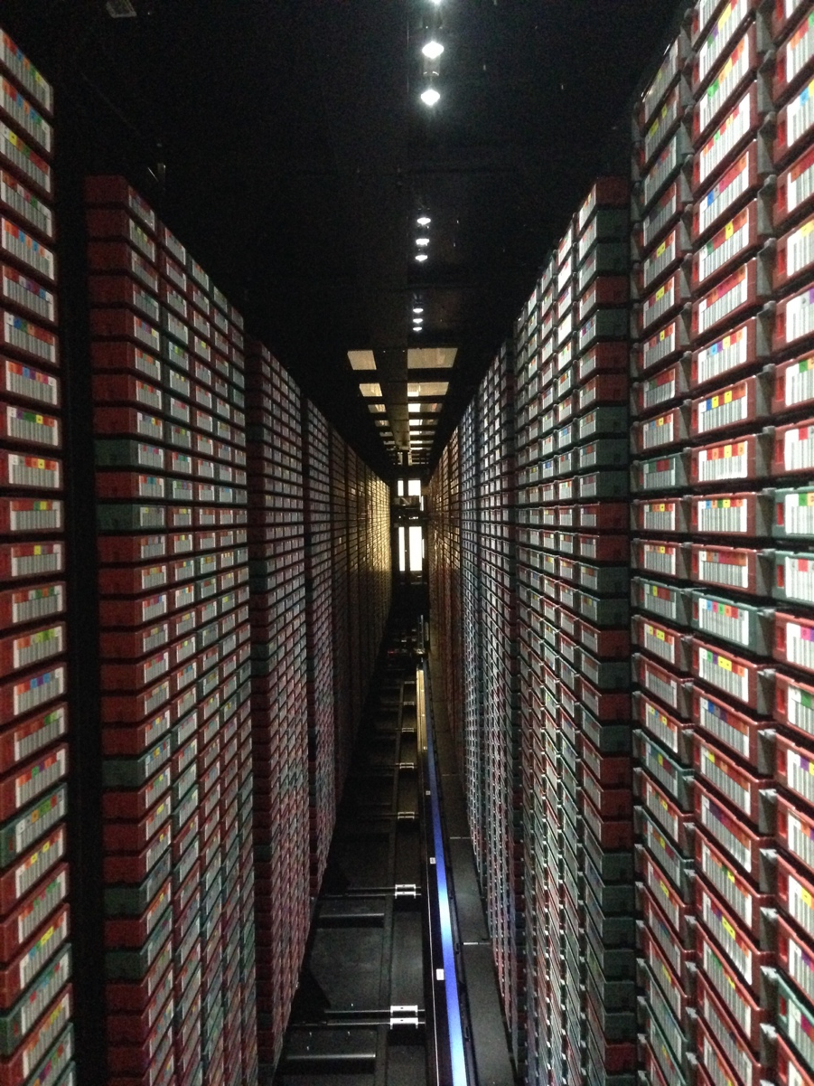
Data storage
6 GeV experiments ran at tens of MB/s.
12 GeV experiments, hundreds of MB/s.
Generate tens of petabytes per year.
Tape is cheap but disk is faster.
We write data to disk then copy from disk to tape later.
Tape speed only needs to handle average rate over a 24 hour period.
Tape drives and library robots are expensive and fragile. Writing to disk allows data taking to continue if the tape system breaks.
We typically have enough disk to hold three days of raw data.

Slide 32

Summary of SoA at JLab – pipeline mode
Data is split into trigger and DAQ paths.
Trigger data read over VXS serial backplane by Crate Trigger Processor and passed to global trigger.
Trigger formed in electronics
Blocks of data queued in “pipeline” while trigger is made.
Readout of the DAQ data by embedded CPU over VME.
Data sent over network to Event Builder
Pros:
Data stream is a stream of events containing data from detectors.
Trigger filters “unwanted data”.
Well understood way of doing things.
Cons
Have to delay prompt data until slowest data appears.
Relies on good understanding of trigger.
All parts of DAQ have to work.
One failure stops the pipeline.
Doesn’t work well when events overlap in time.
Obvious bottlenecks!

Slide 33
Looking forward
New experiments are being proposed
Detectors that do not play well together due to timing.
Traditional trigger and event builder strategies are not ideal.
Detectors with peculiar topologies.
Detectors split or segmented in a way that makes forming a trigger hard.
High event and/or data rates.
Particles from more than one event in a detector at the same time – need to disentangle.
The data acquisition from these experiments does not fit well with current techniques.

Slide 34
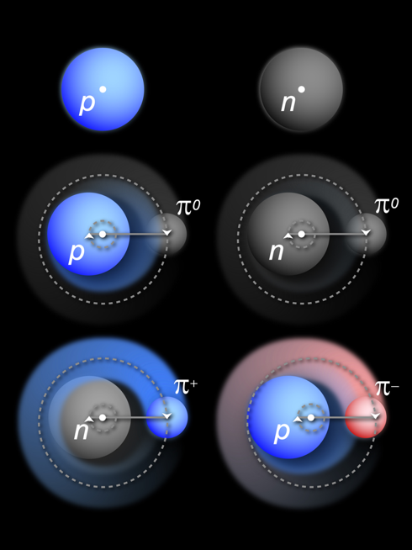
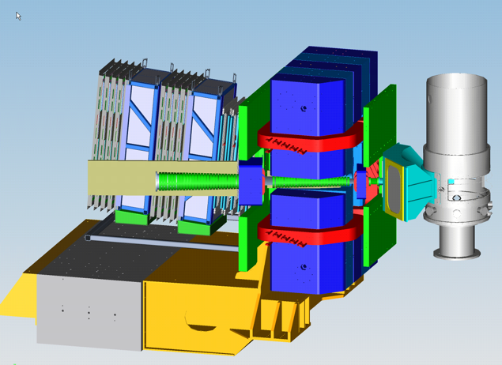
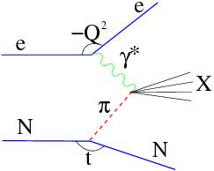
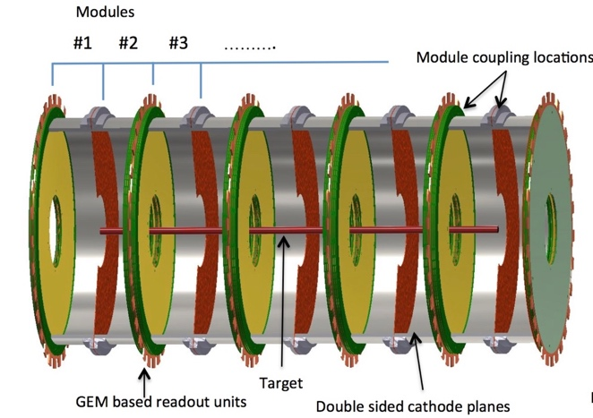
Tagged Deep Inelastic Scattering (TDIS)
TDIS Scientific Goal: Access Elusive Partonic Structure of Mesons by Using Mesons in Nucleons as “Target”
Scattered electrons detected in planned Hall-A Super Bigbite Spectrometer.
“Spectator” protons detected by radial Time Projection Chamber (rTPC).

Slide 35
TDIS - Challenges
It takes up to a microsecond for the proton track to trace itself out on the wall of the TPC.
Super Bigbite electron detectors are much faster – large timing mismatch.
Large flux of background electrons not associated with a proton.
Multiple protons in the TPC at the same time.
TPC has 25,000 pads, hit rate per pad ~800 kHz.
Data rate from TPC up to 4 Gbyte/s total.
How to read this out and match up the electrons with the protons?
Event building online at these rates is a bottleneck.

Slide 36
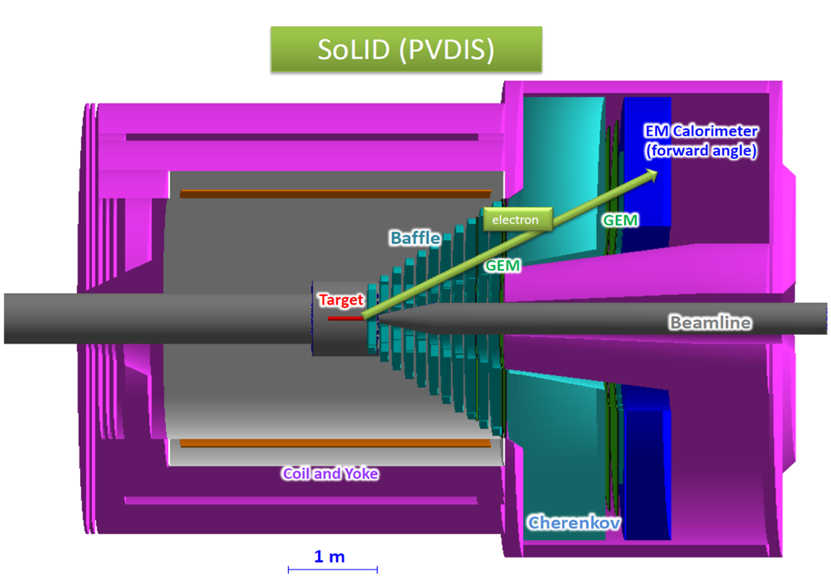
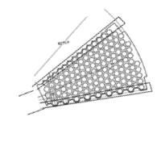
SoLID
SoLID is another experiment proposed for installation hall-A at JLab.
In the PVDIS configuration electrons are scattered of a fixed target at high luminosity.
Spiral baffles cut background.
The detector is split into radially 30 sectors, the single track event topology allows 30 DAQ systems to be run in parallel at rates of up to 1 Gbyte/s each 30 Gbyte/s total
Challenges :
How to handle 30 Gbyte/s affordably?
Hits at sector edges span two sectors?
How to integrate GEM with other detectors?
GEM detectors are segmented into 30 sectors.
Baffles constrain momentum

Slide 37

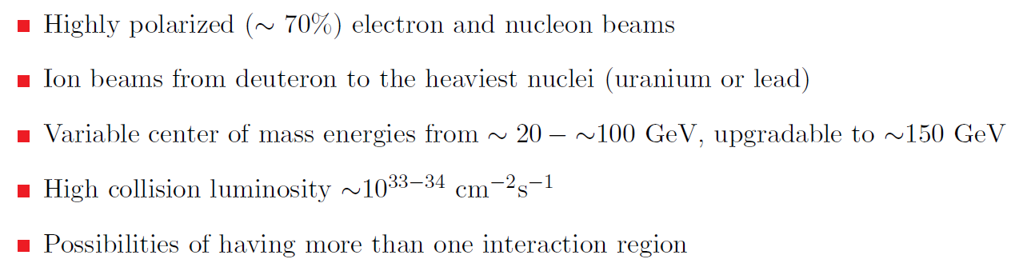
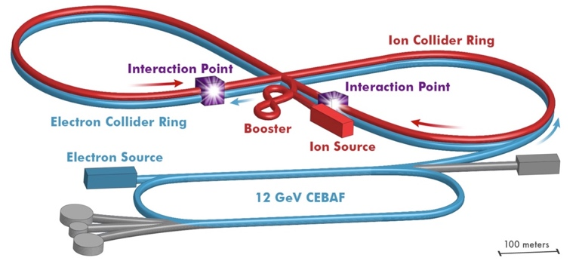
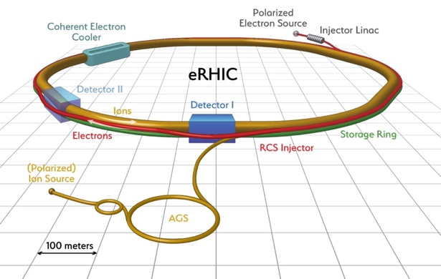
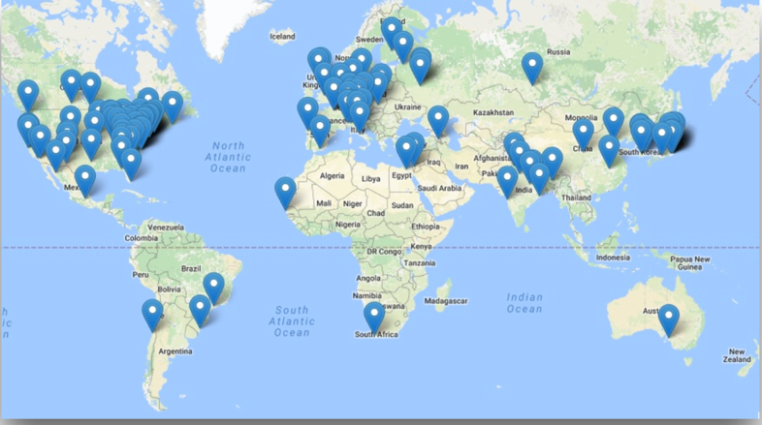

Electron-Ion Collider: The Next QCD Frontier
EIC Physics
Whitepaper
2013
Electron-Ion Collider (EIC) parameters
Realization Proposals
Jefferson Lab
Brookhaven Lab
EIC Users Group
~800 members
168 Institutions
29 Countries
NAS report on EIC science imminent
Next Step: DOE CD0 (2018 or 19?)

Slide 40
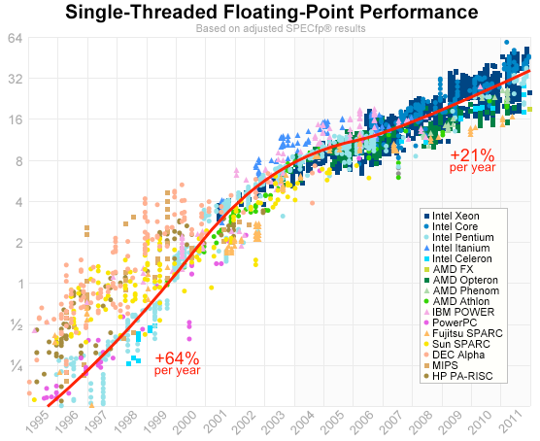
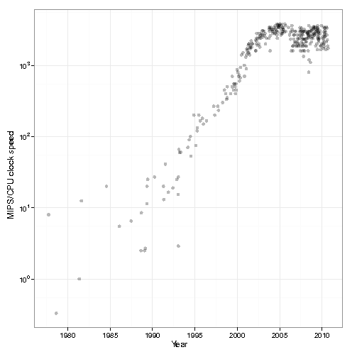
Trends - computing
Famous Moore’s law - transistor count doubles every two years.
In fact MIPS/clock speed plateaued in ~2005.
Matters because online we rely heavily on integer performance.
Remaining gains rely on a much slow growth in clock speed since ~2000.
Current advances by squeezing more cores per chip and improved architectures – vector processing units etc.
MIPS / clock speed

Slide 41
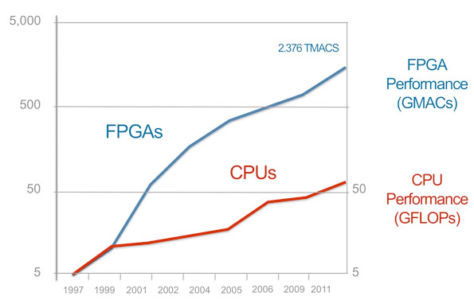

Trends - electronics
Already at JLab the number of channels per crate is limited by VMEbus bandwidth.
Move to other industry standards like MicroTCA?
Crateless serial fiber networks.
Current trend is to push some functionality currently performed in software running on embedded processors into firmware on custom electronics. Drivers are :
Slow increase in single thread CPU performance.
Availability of “large”, easily programmable, affordable components.
Delay between when technology is developed and when it becomes affordable for use in custom electronics means that there is room for growth over the next ten years.

Slide 42

Trends - data transport
What matters is not only what technology exists but also whether it marketable and affordable.

Slide 43
What would we expect to be happening?
If we extrapolate current trends:
CPUs are becoming more powerful but the performance that matters for online systems is achieved mainly through doing more in parallel rather than improvements in per-core performance.
FPGA performance, affordability and usability are still improving.
IO and serial network bandwidth still seem to be growing exponentially.
It is time to revisit the ideas that have dominated nuclear physics detector readout for the past twenty or thirty years.
Move things that we moved from hardware to software 25 years ago back into hardware (or at least firmware).
Reevaluate the use of busses – serial links may be more cost effective.
Reevaluate data flow.

Slide 44
Streaming mode
In traditional triggered readout:
Data is digitized into buffers and a trigger, per event, starts readout.
Parts of events are transported through the DAQ to an event builder where they are assembled into events.
At each stage the flow of data is controlled by “back pressure”.
Data is organized sequentially by event.
A variation increases bandwidth by moving blocks of events.
In a Streaming readout:
Data is read continuously from all channels.
Validation checks at source reject noise and suppress empty channels.
The data then flows unimpeded in parallel channels to storage or a local compute resource.
Data flow is controlled at source.
Data is organized in multiple dimensions by channel and time.

Slide 45
Streaming advantages
The lack of a trigger means that:
Potentially useful physics is not discarded.
Run groups of experiments in parallel.
The system is simplified.
Readout speed is independent of detector response time.
Flow control at data source not via backpressure.
Parallel timestamped streams mean:
System is robust against minor hardware or firmware glitches.
Can use different analysis techniques such as looking for hit patterns rather than reconstructing events.
Requires robust and accurate time stamp generation and distribution.
Is still a simpler task than an online trigger.

Slide 46
What does streaming readout solve?
TDIS
High data rate from TPC handled as parallel streams – no one stream handles the full rate.
Electron data is it’s own stream and is matched up with proton candidates offline – removes high rate event building issue.
SoLID
High rates from GEMs handled in parallel – no event building.
Sector edge effects and correlation with other detectors is handled in software offline.
EIC
All of the above.
New data analysis modes – for example looking statistically at hit distributions instead of event-by-event analysis.
Analogy – crystallography looks at diffraction patterns rather than ray tracing every x-ray through a crystal.

Slide 47
State of the art – sPHENIX

Slide 48
State of the art – sPHENIX

Slide 49
State of the art - LHCb

Slide 50
Generic stream based readout
Rad hard detector interfaces convert detector signals into serial stream.
Stream processor – “smart” FPGA and maybe CPU equipped electronics processes the raw stream to reduce data rate.
Stream aggregator - since there will be many streams need to reduce the number of cables
Note : this is NOT event building, this is pushing more than one stream down a single fiber.
Modularity allows growth from small to large systems.
If the fiber protocol is a network standard like Ethernet we connect directly to a switch.
If not then we will provide a PCI card to put in the storage node(s).

Slide 51
Concept- hardware
Raw data from the detector is continuously streamed
A very basic trigger is be used to reject time periods unassociated with events.
The SP can reject noise and “zero suppress”.
Data packets are packed into an efficient standard format and sent over a standard hardware interface.
If all components use the same hardware interface and format we have a “plug and play” system!!
Individual components should be cheap!
One of out VXS crates with support boards such as CPU and trigger cards costs ~$90k!
Stream via a CoTS standard like Ethernet?

Slide 52
Concept - software
Packets containing data are stored indexed by time and channel.
How to store and process data in this form? We are used to 1D files of events, this is a 2D structure indexed by detector and time.
Reconstruction software requests data for a particular channel based on a time window where the data associated with an interaction is likely to be found.
In this example triggers 2 and 3 close together.
The request for trigger 3 gets part of trigger 2 data from detector 3.
In this case it is resolved because that data appears too early in the region of interest to be from the trigger 3 event.
Note that this does not represent a layout in storage. Areas where there is no data would be compressed.

Slide 53

Integrated readout and detector design
In many experiments someone builds a detector and someone else has to figure out how to read it out and integrate it into the DAQ.
With a streaming system each detector generates one, or more independent data streams in a standard format – plug and play.
Avoid generating data that is costly to process:
Tracking in weird magnetic fields.
Data packed in a convoluted way.
Segmented detectors that have a lot of overlap between sectors.
Detectors where the bulk of the data is generated by a few high bandwidth streams
Here tracking is done outside the field to reduce processing cost.

Slide 54
Where do we go from here
JLab has several proposals, TDIS and SoLID are examples, that would benefit from streaming mode readout.
The technology, both hardware and software is available and affordable to allow us to move to this mode.
Proven by LHC readout and adopted at other labs.
Simpler and more robust than the current readout mode.
Other advantages over pipeline readout already mentioned.
We will develop a test stand to investigate techniques and technologies.
We will develop a way to integrate legacy hardware – CLAS12?
The goal is to use this mode for TDIS.
If pilot system is successful:
Investigate moving CLAS12 and GlueX to this mode.
Use for SoLID and future JLab experiments.
I hope we may see new or modified proposals based on this.
Use for EIC?

Slide 55

JLab TDIS TPC test stand using SAMPA
Fast Track test stand– use as many components of the ALICE TPC readout/control chain as possible
Validate use of SAMPA for TDIS
Experience reading a detector in streaming mode
Guide future R&D effort in this area
Rad. hardened
FEC – Front End Card
CRU – Common Readout Unit
DCS – Detector Control System
LTU – Local Trigger Unit

Slide 56

JLab – DAQ and Electronics R&D
The VTP board is able to read 250 MHz fADC via the VXS serial backplane and stream the data out over the front panel transceivers.
Read a crate in this mode.
Zero suppression logic
Flow control
What comes out on the front panel fiber?
How to interface with DAQ?
Read out some detectors in streaming mode!
Integrate with TDIS test-stand.
Can we replace the CRU etc?
Can we repackage to remove need for expensive VXS crates etc.
Cheap system for university groups!

Slide 57
Summary
Data acquisition is constantly challenging.
Technology changes all the time.
Physicists think up experiments with tougher requirements.
The boundary between hardware and software is fluid and depends on what is available when a system is implemented.
There is always some R&D time to discover new algorithms and techniques.
To be honest, we do it because it’s fun and we get to play with all of the cool toys!

Slide 58

Expect the unexpected
Engineer: I told the Captain I'd have this analysis done in an hour.
Scotty: How long will it really take?
Engineer: An hour!
Scotty: Och, you didn't tell him how long it would *really* take, did ya?
Engineer: Well, of course I did.
Scotty: Och, laddie. You've got a lot to learn if you want people to think of you as a miracle worker.

