Slide 1
The evolution of JLab DAQ towards streaming readout
Graham Heyes
Jefferson Lab

Slide 2
Agenda
Workshop goals:
Enough talks to stimulate discussion.
Leave plenty of room in the agenda for discussion.
Leave second day with a list of things to do.
Monday January 29th
09:15 - Jan Bernauer (MIT) - Intro and food for thought.
09:45 - Jose Repond (ANL) - TOPSIDE- Concept of an EIC detector.
10:15 - Martin Purschke (BNL) -Streaming TPC Readout in the sPHENIX Experiment at the Relativistic Heavy Ion Collider,
11:00 - Graham Heyes (JLAB) - The Evolution of JLAB DAQ toward streaming readout,
11:30 - Alexandre Camsonne (JLAB) - JLAB SOLID experiment DAQ overview.
13:30 - Ryan Herbst (SLAC) - SLAC data acquisition efforts.
14:00 - Chris Cuevas (JLab) - Streaming Readout Electronics for the 12GeV Experiment Program @JLAB.
14:30 - Shaorui Li(BNL) - Developing Front-End ASICs and Redout Electronics at BNL Instrumentation.
15:00 - Esko Mikkola (Alphacore) - Alphacore
Tuesday, January 30
09:00 - Mike Williams (MIT) - LHCB and Machine Learning
09:30 - Markus Diefenthaler (JLab) - Streaming readout and the EIC.

Slide 8
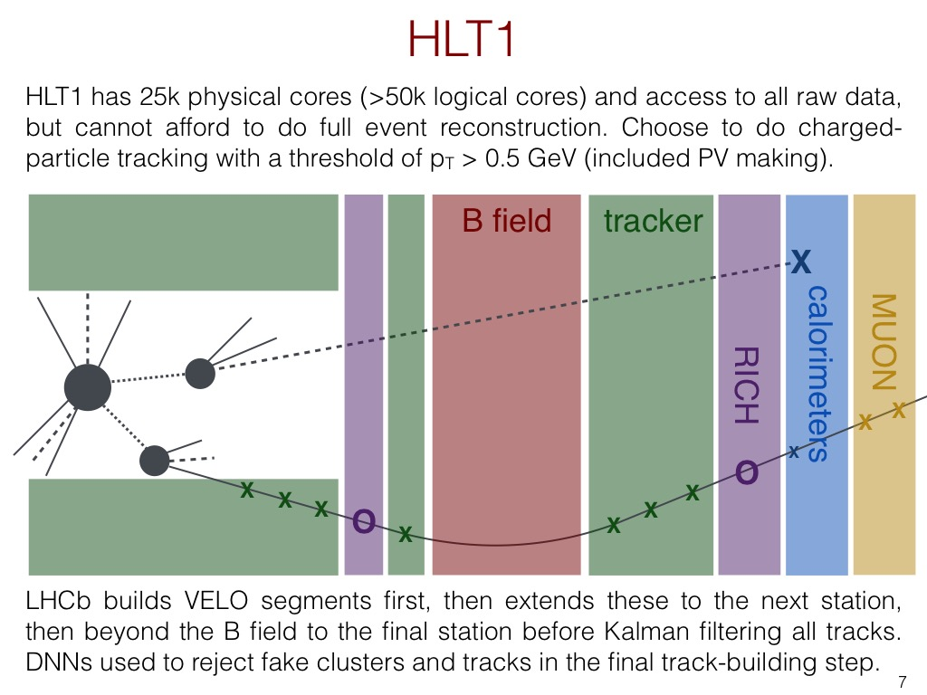

Slide 10
Summary of current approach
Data is split into trigger and DAQ paths.
Trigger formed in electronics and fed back to control readout of the DAQ path.
Pros:
Data stream is a stream of events.
Events are self contained blocks containing data from detectors.
Trigger filters “unwanted data”.
Well understood way of doing things.
Cons:
Trigger rate is limited by slowest detector.
Relies on good understanding of trigger
Doesn’t work well when events overlap in time.
Major bottlenecks – worked around via parallel multi-stage event builder.
Network configuration and management.
There are other network users…

Slide 11
Why do anything different?
New experiments are being proposed at JLab
Detectors that do not play well together due to timing.
Traditional trigger and event builder systems not ideal.
Detectors with peculiar topologies.
Detectors split or segmented in a way that makes forming a trigger hard.
High event and/or data rates.
Particles from more than one event in a detector at the same time – need to disentangle.
The data acquisition from these experiments does not fit well with current techniques
Technology advances are making alternatives possible.
Continuously clocked a single 250 MHz fADC channel generates 16 Gbytes/s of data.
Data processing at this rate was difficult when technologies for CLAS12 and GlueX were chosen.

Slide 12
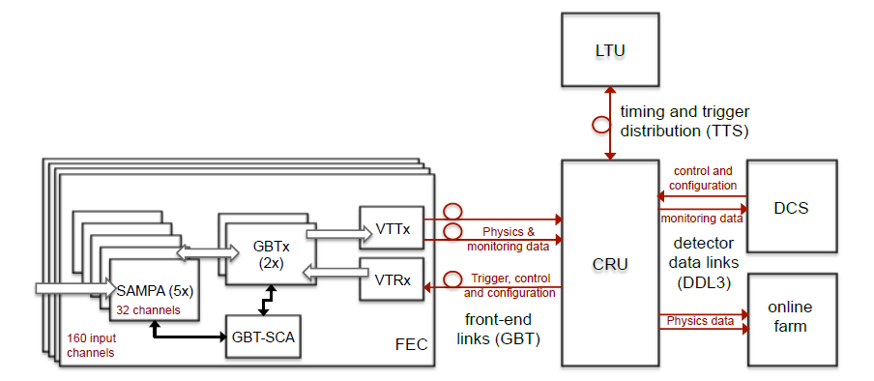
TDIS TPC test stand using SAMPA
Fast Track test stand– start with components of the ALICE TPC readout/control chain as technology demo.
FEC – Front End Card
CRU – Common Readout Unit
DCS – Detector Control System
LTU – Local Trigger Unit

Slide 13
Generic stream based readout
Rad hard detector interfaces convert detector signals into serial stream.
Stream processor – “smart” FPGA and maybe CPU equipped electronics processes the raw stream to reduce data rate.
See CRU in earlier slide
Stream aggregator - since there may be many stream processors an optional SA aggregates streams to reduce the number of cables
Note : this is NOT event building, this is pushing more than one stream down a single fiber.
SA’s can be cascaded in a large system.
If the fiber protocol is a network standard like Ethernet we connect directly to a switch.
If not then we will provide a PCI card to put in the storage node(s).

Slide 14
Moving forward
JLab has several proposals, TDIS and SoLID are examples, that would benefit from streaming mode readout.
The technology, both hardware and software is available and affordable to allow us to move to this mode.
Proven by LHC readout and adopted at other labs.
Simpler and more robust than the current readout mode.
Other advantages over pipeline readout already mentioned.
We will develop a test stand to investigate techniques and technologies.
We will develop a way to integrate legacy hardware.
The goal is to use this mode for TDIS.
If pilot system is successful:
Investigate moving CLAS and GlueX to this mode.
Use for SoLID and future JLab experiments.
I hope we may see new or modified proposals based on this.
Use for EIC?

Slide 15
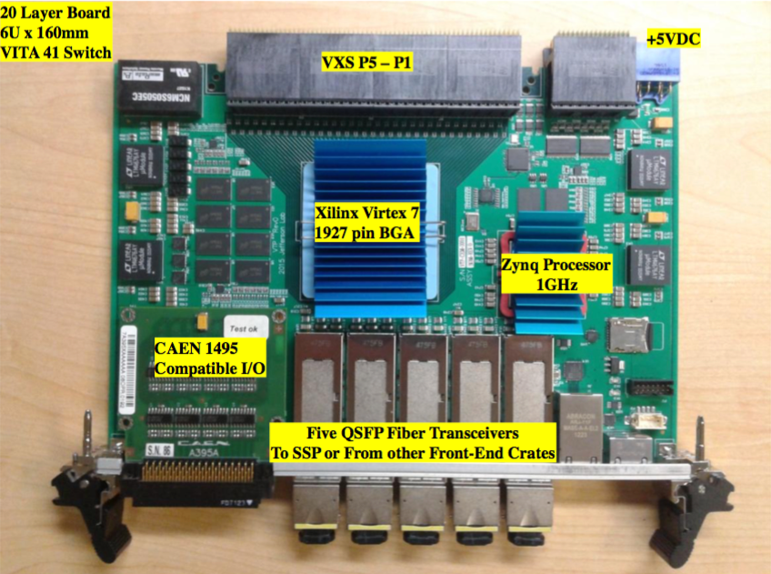
JLab – DAQ and Electronics R&D
The VTP board is able to read 250 MHz fADC via the VXS serial lines.
Read a crate in this mode.
Zero suppression logic
Flow control
What comes out on the front panel fiber?
How to interface with CODA?
Read out some detectors in streaming mode!
Integrate with TDIS test-stand.
Can we replace the CRU etc?
How to repackage to remove need for expensive VXS crates etc.

Slide 16
What we will do – EIC group
There will be a follow up BlueJeans meeting at the end of this month.
Will meet regularly and also discuss via a mailing list :
https://mailman.mit.edu/mailman/listinfo/eic_streaming_readout
Subgroups looking at :
Pilot projects.
Electronics
Software
Protocols
Detectors

