Slide 1
Streaming Readout, the JLab perspective
Graham Heyes
Data Acquisition Support Group
Jefferson Lab

Slide 2
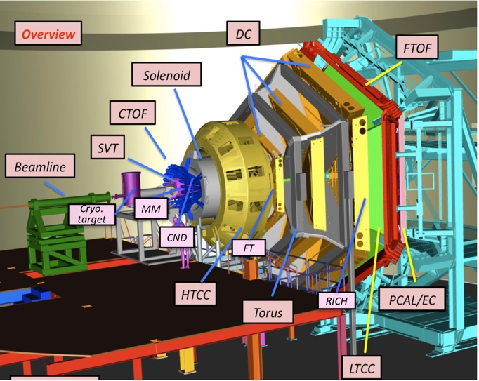
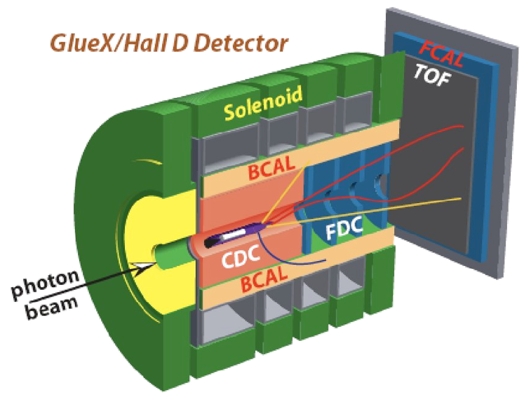
Introduction
After the 12 GeV accelerator upgrade all four halls took production data in Spring of this year.
The two large detectors, CLAS12 in hall-B and GlueX in hall-D are using very similar DAQ and trigger systems.
We expect both DAQ system to evolve over the coming years.
Other detectors are proposed for installation in hall-A over the next five years.
This presentation will show :
  The current state of the art at JLab.
  Projects that we have planned for existing hardware.
  Projects related to the proposed experiments.
  Direction of future research and development.
Clas12/Hall B Detector

Slide 3
Data Acquisition at Jefferson Lab
Custom and commercial electronics in VME format.
We use ANSI/VITA 41 – VXS, a variant of VME.
  Switched serial backplane.
Crate Trigger Processor (CTP) in VXS switch slot generates crate level trigger decision.
  Blocks of data queued in “pipeline” while trigger is made.
  Trigger passed to global trigger via fiber.
Global Trigger Processor (GTP) makes global trigger.
Trigger Supervisor (TS) queues triggers, assigns event types, and distributes trigger back to crates.
Readout the data over VME bus by Read Out Controller (ROC) on embedded CPU.
Blocks of events sent over network to software Event Builder on Linux server.
Buffer manager allows L3 software trigger and data quality monitoring.
Event Recorder writes event blocks to disk.

Slide 4
Why do anything different?
Pros:
  Data stream is a stream of events containing data from detectors.
  Use of CTP and GTP allows complex triggers in firmware.
  Trigger filters “unwanted data”.
  Software event builder is scalable – buy faster machines – parallel topologies.
  Data transport over network hardware – easy upgrade path.
  Well understood way of doing things.
Cons
  Trigger pipeline and event building require strict online synchronization.
    Have to delay prompt data until slowest data appears.
    All parts of DAQ have to work. One failure stops the pipeline.
  Relies on good understanding of trigger.
  Doesn’t work well when events overlap in time.
  Obvious bottlenecks!
  Difficult to partition large detectors into independent systems – debugging, commissioning or some types of experiment.
  Systems using “high end” crate based readout such as VXS are very expensive.
    Buy-in problem for university collaborators

Slide 5
Future needs
New experiments are being proposed
  Detectors that do not play well together due to timing.
    Traditional trigger and event builder strategies are not ideal.
  Detectors with peculiar topologies.
    Detectors split or segmented in a way that makes forming a trigger hard.
  High event and/or data rates.
    Particles from more than one event in a detector at the same time – need to disentangle.
The data acquisition requirements of these experiments does not fit well with current techniques.

Slide 6
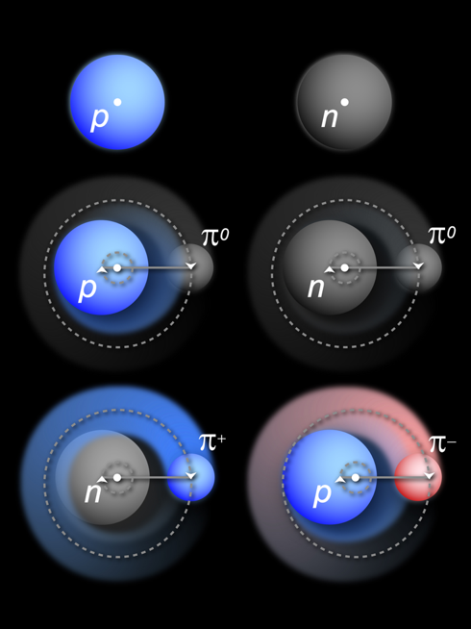
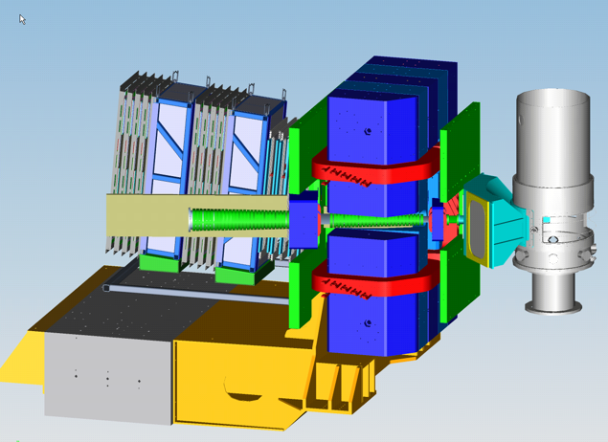
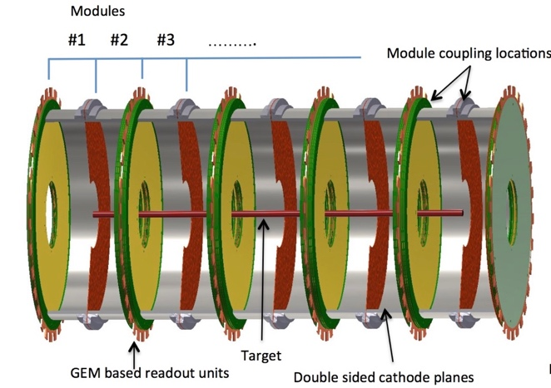
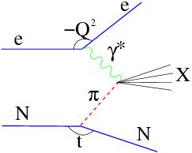
Tagged Deep Inelastic Scattering (TDIS)
TDIS Scientific Goal: Access Elusive Partonic Structure of Mesons by Using Mesons in Nucleons as “Target”
Scattered electrons detected in planned Hall-A Super Bigbite Spectrometer.
“Spectator” protons detected by radial Time Projection Chamber (rTPC) with 25,000 pads.
  Hit rate per pad ~800 kHz.
  Up to 4 Gbyte/s total.
How to read this out and match up the electrons with the protons?
Event building online at these rates is a bottleneck.

Slide 7
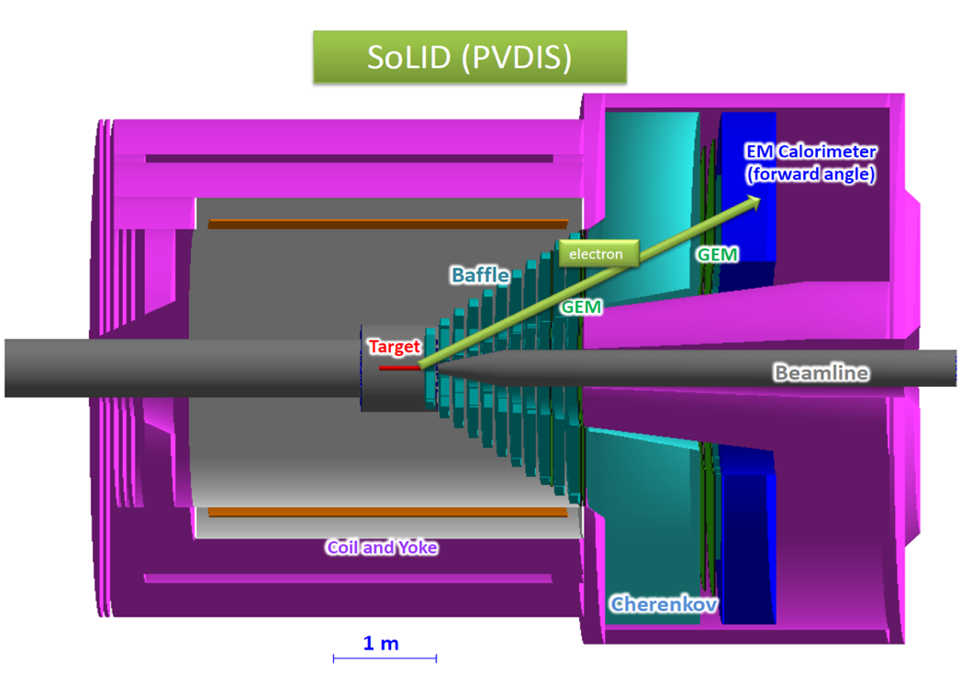
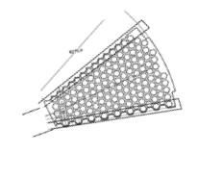
SoLID
SoLID is another experiment proposed for installation hall-A at JLab.
In the PVDIS configuration electrons are scattered of a fixed target at high luminosity.
Spiral baffles cut background.
The detector is split into radially 30 sectors, the single track event topology allows 30 DAQ systems to be run in parallel at rates of up to 1 Gbyte/s each 30 Gbyte/s total
Challenges :
  How to handle 30 Gbyte/s affordably?
  Hits at sector edges span two sectors?
  How to integrate GEM with other detectors?
GEM detectors are segmented into 30 sectors.
Baffles constrain momentum

Slide 8
Streaming readout as a solution.
High data rate detectors are handled as parallel streams.
  No one stream handles all data from the whole detector.
Data synchronization happens offline.
  Removes high rate event building issue.
  Detector edge effects dealt with offline.
  Prompt data does not have to wait for slower detectors.
Little or no online trigger.
  Potentially useful physics is not discarded.
  Groups of simultaneous experiments.
  Complex trigger electronics eliminated – simpler system
  Zero and noise suppression is still a requirement.

Slide 9
Projects
We are starting to work on several pilot projects to gain experience with streaming mode readout and to put it in use in some experiments.

Slide 10
CLAS12 - RICH
CLAS12 is a general purpose detector with a lot of subdetectors.
RICH detector is read out via fiber to Sub-System Processor (SSP) boards in VXS crates.
Same setup is used by GlueX DIRC.

Slide 11
SSP Closeup
Front panel has 32 x 2.5 Gb/s fiber links.
VXS connector links to serial lines on backplane (~20 Gb/s).
VME interface (~1.6 Gb/s).
Rely on low occupancy, buffering and data processing to match rates.
DIRC readout – data comes in on fiber and is read out over VME.
Per-crate data density is limited by VME backplane bandwidth.
Sub System Processor (SSP)
VXS Backplane

Slide 12
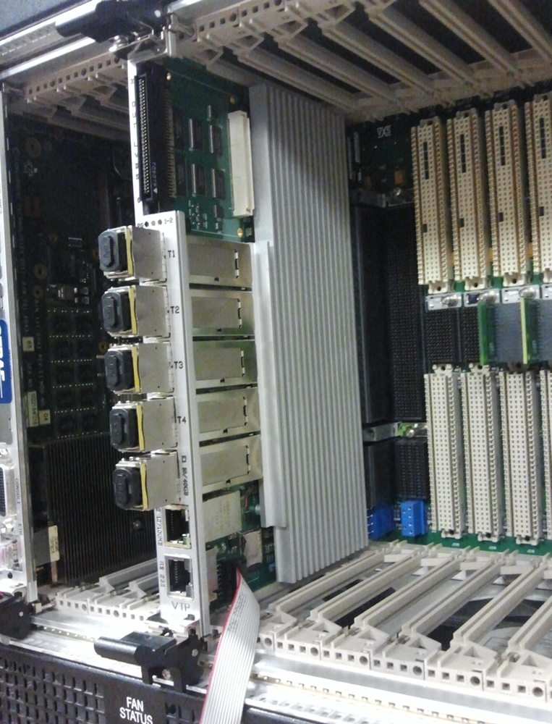
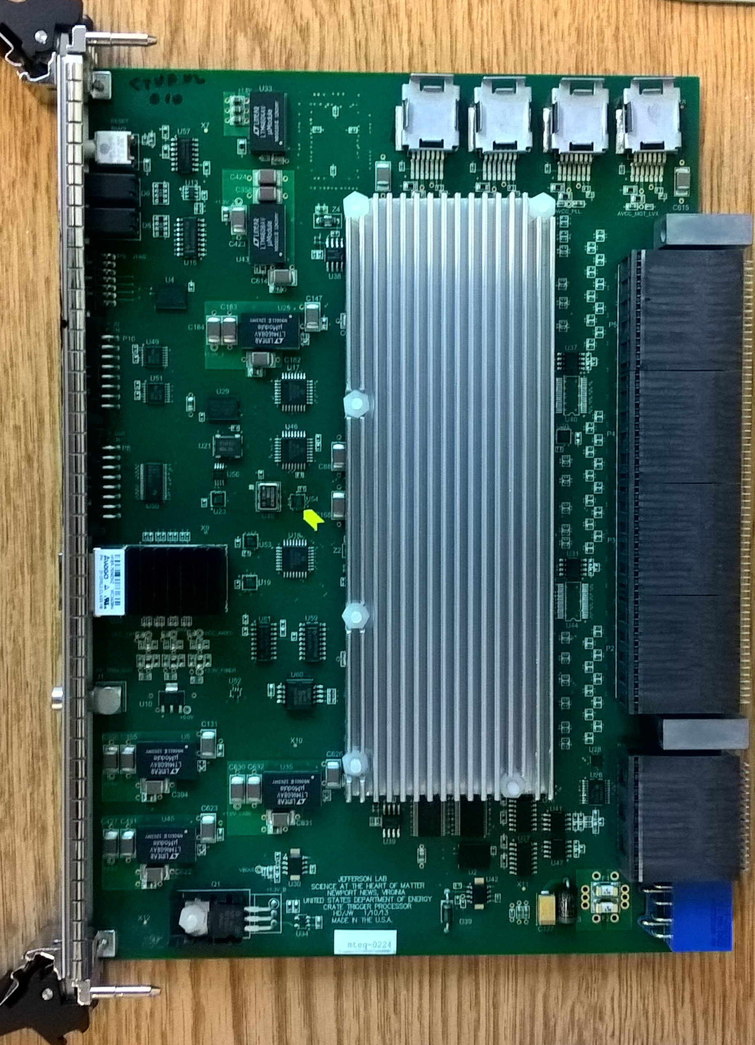
CLAS12 – RICH and GlueX DIRC
A new generation of CTP, the VTP, can read out a crate over VXS ~10x faster than VME.
Project : Read out RICH using VTP.
  Data from front end over fiber to SSP –> 32 x 2.5 Gb/s = possible 80 Gb/s per SSP
  SSP to VTP over VXS backplane –> 20 Gb/s –> need to reduce by factor of 4 in SSP.
  VTP output over fiber on front panel – bottom of the five fibers is 40 Gb/s -> reduce by 5 in VTP.
CTP
VTP
VTP in VXS
switch slot.

Slide 13
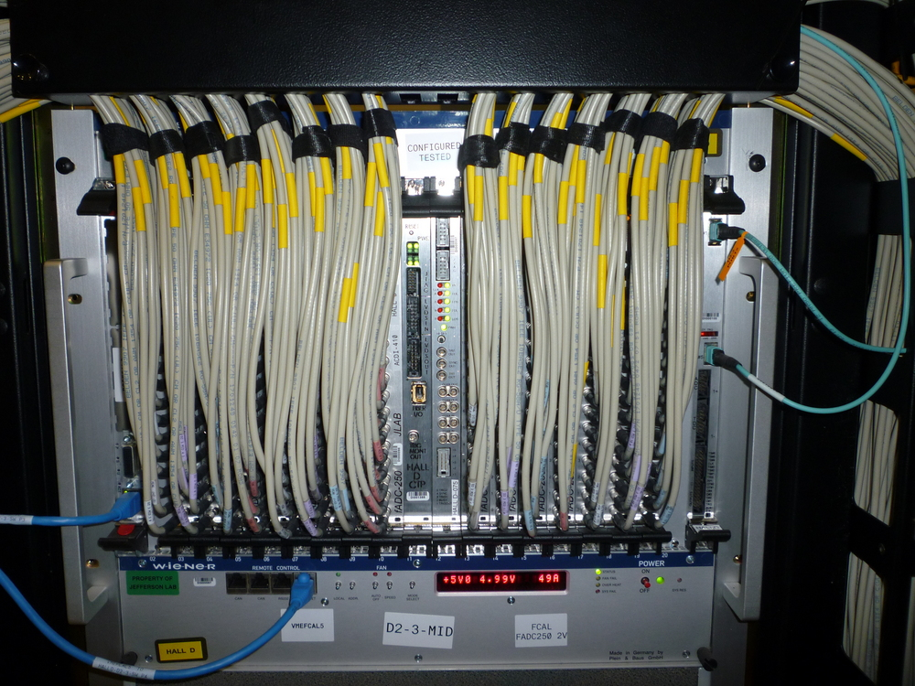
fADC readout
CLAS12 and GlueX are instrumented with 250 MHz fADCs in VXS.
  Read over VME.
  CTP only used for trigger.
Project : Swap the CTP for a VTP.
  Read fADC to VTP over VXS serial.
  Send data from VTP over front panel fiber.
fADCs with
CTP

Slide 14
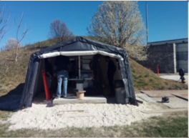
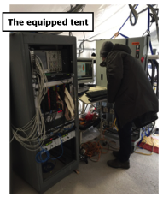
INFN – low cost ADC board
12-channel board
Configurable:
  12-bit 65 MHz to
  14-bit 250 MHz.
Application - BDX at JLab.
Project: Reprogram Zynq7030 to match protocol expected by SSP front panel fiber inputs.
SiPM front
end
Zynq7030
mezzanine
SFP
GBE
Slow Control M4 ARM
JLab
Hall-T

Slide 15
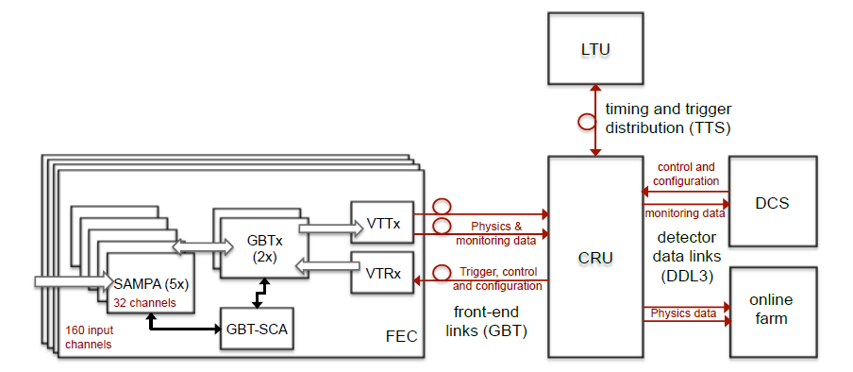
JLab TDIS TPC test stand using SAMPA
Fast Track test stand– use as many components of the ALICE TPC readout/control chain as possible
Target test stand operational July 1st 2018
  Validate use of SAMPA for TDIS
  Experience reading a detector in streaming mode
  Guide future R&D effort in this area
Project : Redesign FEC to work with SSP.
Rad. hardened
FEC – Front End Card
CRU – Common Readout Unit
DCS – Detector Control System
LTU – Local Trigger Unit
Goal – common system architecturefor TDIS and SoLID.

Slide 16
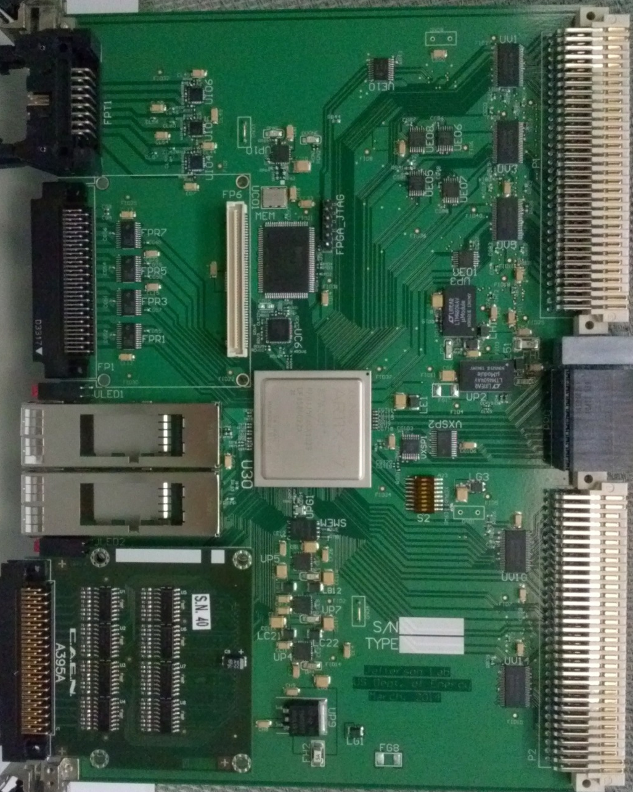
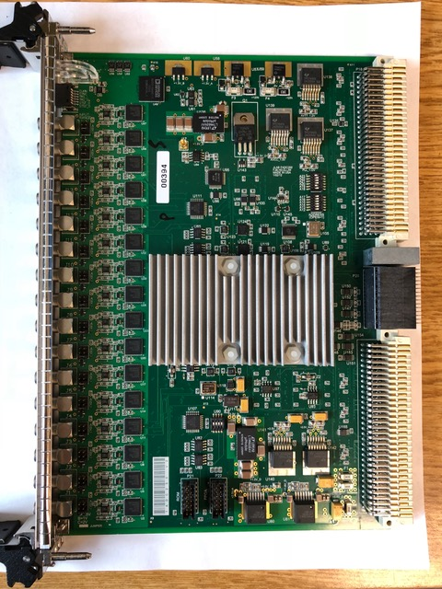
Where to go next - hardware
Currently we have several hardware components that are suitable for use in a streaming system.
In this mode we have a system where the VME bus is no longer used for data.
Data output is to a fiber based network
If we can also configure via the fiber network then..
We no longer need a bus at all…

Slide 17
All streaming DAQ
The projects in the previous few slides are hardware solutions that can operate in either traditional or streaming mode.
We intend to use these projects to gain insight that will be used to:
  Refine the hardware, firmware and software.
  Aid detector design.
  Suggest future directions.
In an “all streaming DAQ” detectors have detector specific interfaces which stream data on a fiber with a well defined protocol.
Devices similar to the VTP and SSP take the data streams and :
  Merge streams to reduce number of fibers.
  Provide buffering to take advantage of occupancy.
  Reformat or compress to reduce rate.
  Zero and noise suppress.
  Provide online monitoring and calibration.
  Not necessary in all situations.
If all devices use the same protocol on the fiber then we have a plug and play kit of parts each of which is relatively inexpensive.

Slide 18
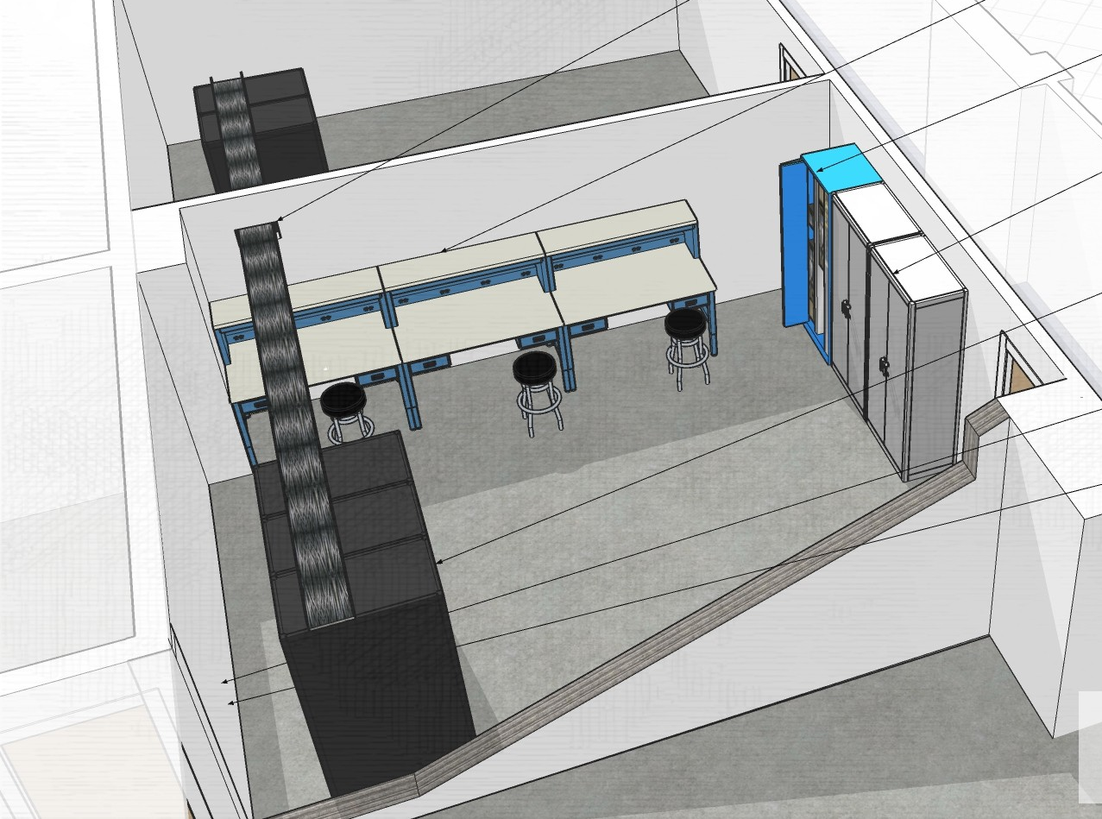
Facility for Innovation in Nuclear Data Readout and Analysis (INDRA)
Having a bunch of interesting projects is all well and good but progress would be speeded by having a dedicated facility for R&D.
  Semi-permanent test stands without having to borrow hardware.
  Proximity to existing data acquisition lab.
  Proximity to JLab datacenter.
Have acquired space and modifications for power etc. are underway.
Procurement of hardware will start
  soon.

Slide 19
Summary
Jefferson lab has electronics that were designed for use in traditional triggered readout.
With firmware modification these boards could be used in a streaming mode.
Several projects will enhance the triggered mode readout to the point where it can be flipped into streaming mode.
Operating in this mode we can find out what the critical parameters are for the design of the next generation of electronics.
We have several customers lined up to use this.
The goal is to increase flexibility and reduce cost – in particular for university collaborators.
Our experience should be very useful to the EIC detector readout community.

