Slide 1
The evolution of JLab DAQ towards streaming readout
Graham Heyes
Jefferson Lab

Slide 2
Outline
Current state of the art at JLab
Why change?
Example experiments
Streaming ideas
What next?

Slide 3
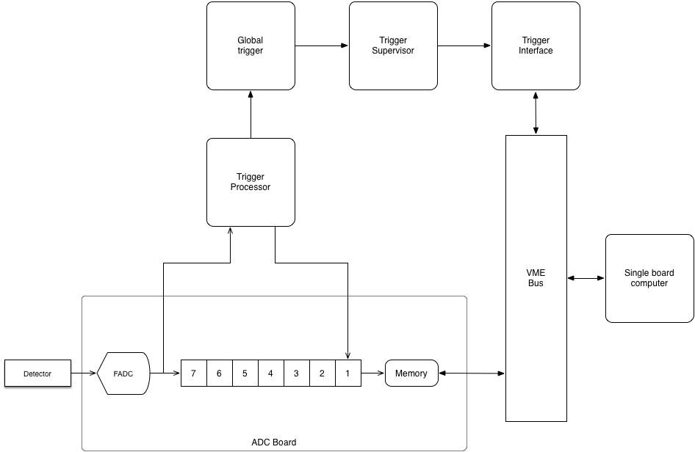
Current SoA - pipelined readout
Trigger data is sent to crate trigger processor via the backplane.
Raw data enters a pipeline memory.
Crate trigger processor sends data to global trigger for all crates over optical fiber.
Global trigger tells trigger supervisor (TS) which events are good.
TS tags trigger with an event type and timestamp.
TS forwards this to a Trigger Interface (TI) in each crate.
TI signals SBC to read out crate.

Slide 4

Front end VXS crate
Intel CPU Read Out Controller
(ROC) running Linux
16 channels per board
17 boards = 272 channels per crate
Trigger interface
Boards are connected to CPU via a VME backplane and trigger via VXS serial bus.
Crate trigger processor

Slide 5
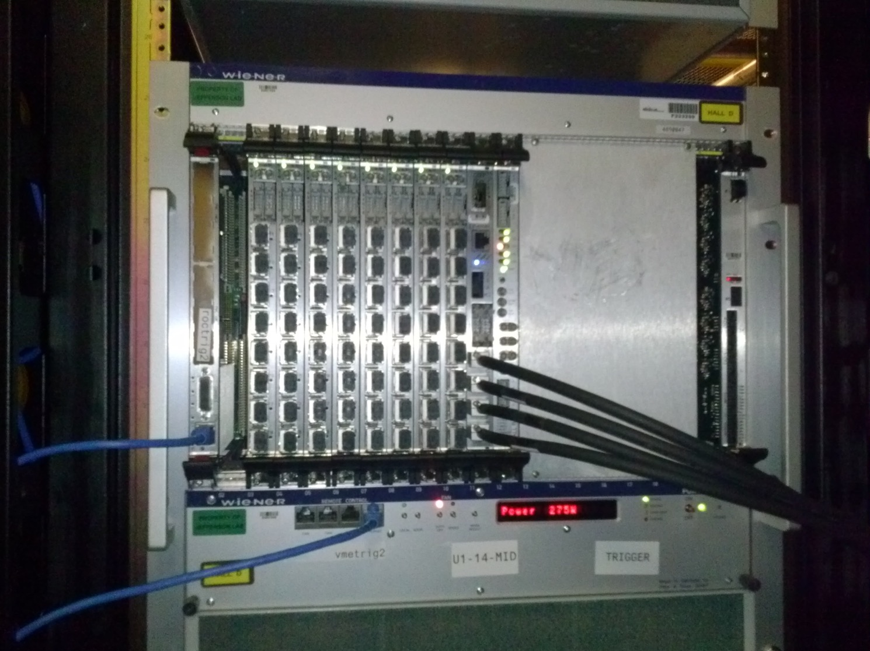

Global trigger crate
Intel CPU controller
Global trigger processor (GTP)
Sub-system processor board (SSP)
Outputs to trigger
supervisor
Eight boards with eight connectors each so up to 64 crates.

Slide 6
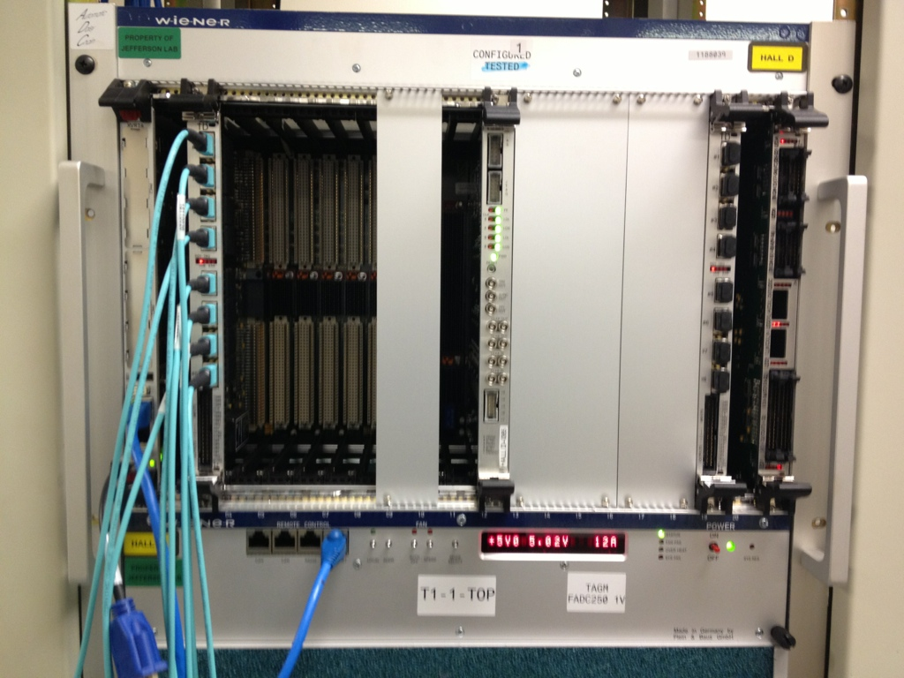
Trigger supervisor crate
Signal Distribution board (SD)
Trigger Supervisor (TS)
Trigger Distribution
board (TD).
Intel CPU for control and configuration.
Optical trigger link back to crates.
VXS serial backplane

Slide 7
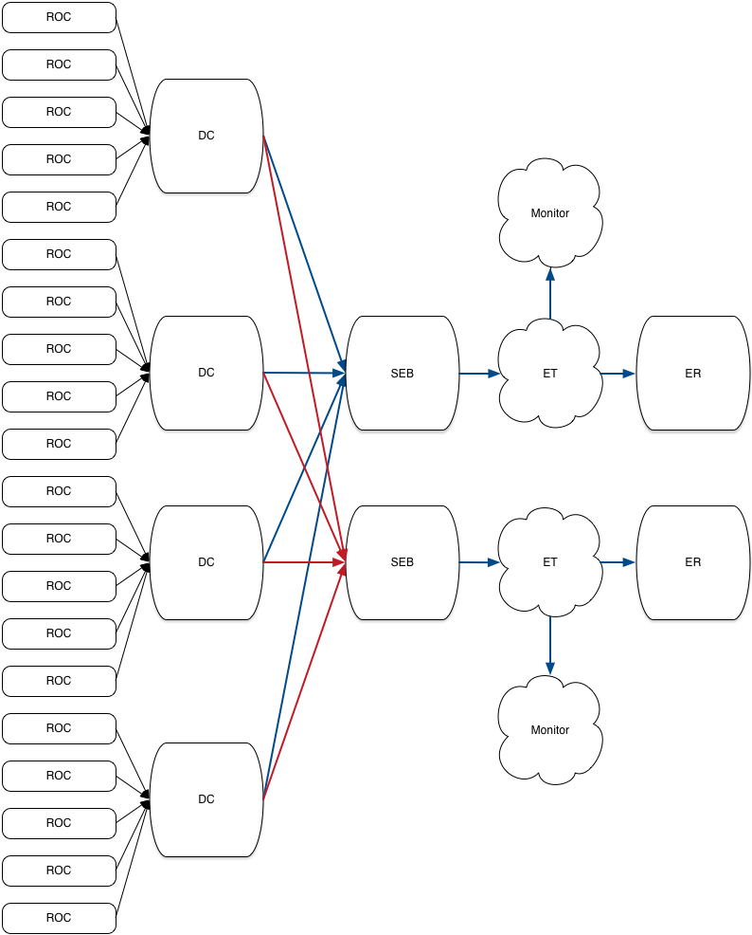
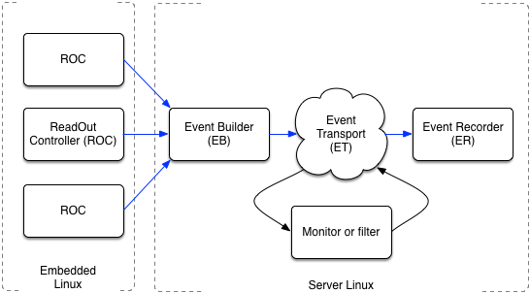
Network based data acquisition
ROCS buffer multiple events and periodically send data via a network to software Event Builder.
  Decoupled from trigger.
Software EB builds events.
The ET system allows us to filter or monitor the data stream.
The Event recorder writes to disk.
Event building is a bottleneck – dealt with by distributed multi-stage EB

Slide 8
Summary of current approach
Data is split into trigger and DAQ paths.
Trigger formed in electronics and fed back to control readout of the DAQ path.
Pros:
  Data stream is a stream of events.
    Events are self contained blocks containing data from detectors.
  Trigger filters “unwanted data”.
  Well understood way of doing things.
Cons:
  Trigger rate is limited by slowest detector.
  Relies on good understanding of trigger
  Doesn’t work well when events overlap in time.
  Major bottlenecks – worked around via parallel multi-stage event builder.
  Network configuration and management.
    There are other network users…

Slide 9
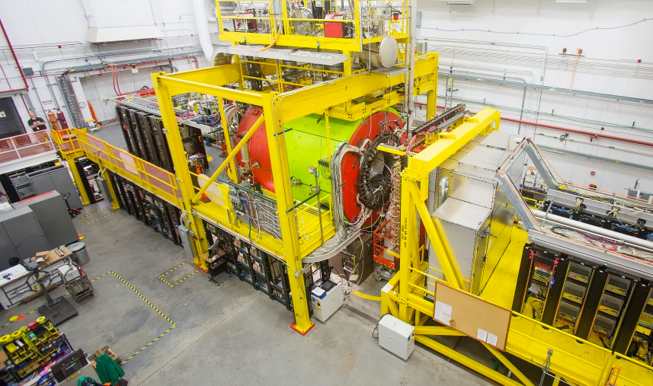
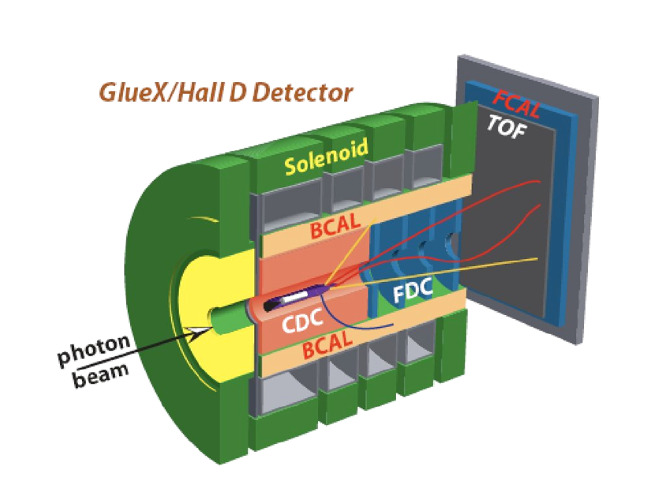
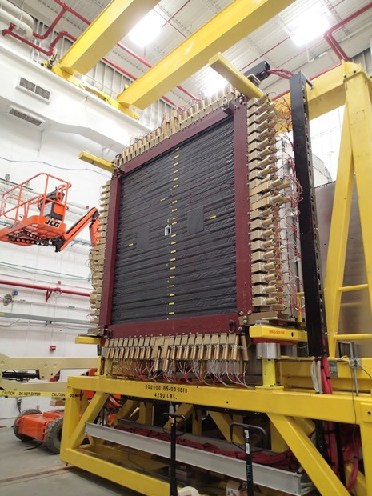
Example - GlueX detector at JLab
Electron beam converted into photon beam.
Physics event size 17 kBytes, rate 90 kHz.
Rate to storage is ~1.5 Gbyte/s
Background reduced by a trigger implemented in custom electronics.
Data is spread over 50+ VXS systems.

Slide 10
Why do anything different?
New experiments are being proposed at JLab
  Detectors that do not play well together due to timing.
    Traditional trigger and event builder systems not ideal.
  Detectors with peculiar topologies.
    Detectors split or segmented in a way that makes forming a trigger hard.
  High event and/or data rates.
    Particles from more than one event in a detector at the same time – need to disentangle.
The data acquisition from these experiments does not fit well with current techniques
Technology advances are making alternatives possible.
  Continuously clocked a single 250 MHz fADC channel generates 16 Gbytes/s of data.
  Data processing at this rate was difficult when technologies for CLAS12 and GlueX were chosen.

Slide 11
TDIS

Slide 12
TDIS - Challenges
It takes up to a microsecond for the proton track to trace itself out on the wall of the TPC.
It takes nanoseconds for the electron to hit the electron detector in the conventional spectrometer arm.
  Timing mismatch makes matching an electron to it’s proton hard.
Multiple protons in the TPC at the same time.
TPC has 25,000 pads, hit rate per pad ~800 kHz.
Data rate from TPC up to 4 Gbyte/s total
  Conventional software based event building expensive at this rate.

Slide 13
Proposed TPC readout
Use the SAMPA ASIC developed for the ALICE TPC and Muon Chamber (MCH) upgrades
Chosen for TPC readout by sPHENIX and STAR upgrade at RHIC (Hi Martin).
Design effort led by University of São Paulo, Brazil.
  “SAMPA” - nickname for the city of São Paulo, Brazil
ALICE alone > 50,000 chips (1.5 M channels)
  JLab should be able to get hold of some.
All plan to use a streaming readout mode for their TPCs
  JLab gets a running start.

Slide 14
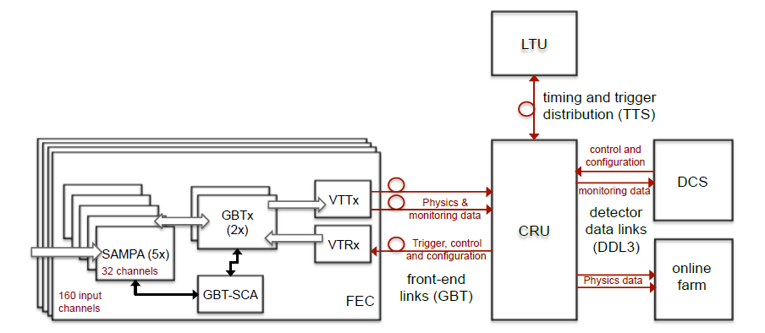
TDIS TPC test stand using SAMPA
Fast Track test stand– start with components of the ALICE TPC readout/control chain as technology demo.
FEC – Front End Card
CRU – Common Readout Unit
DCS – Detector Control System
LTU – Local Trigger Unit

Slide 15
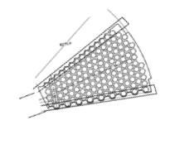
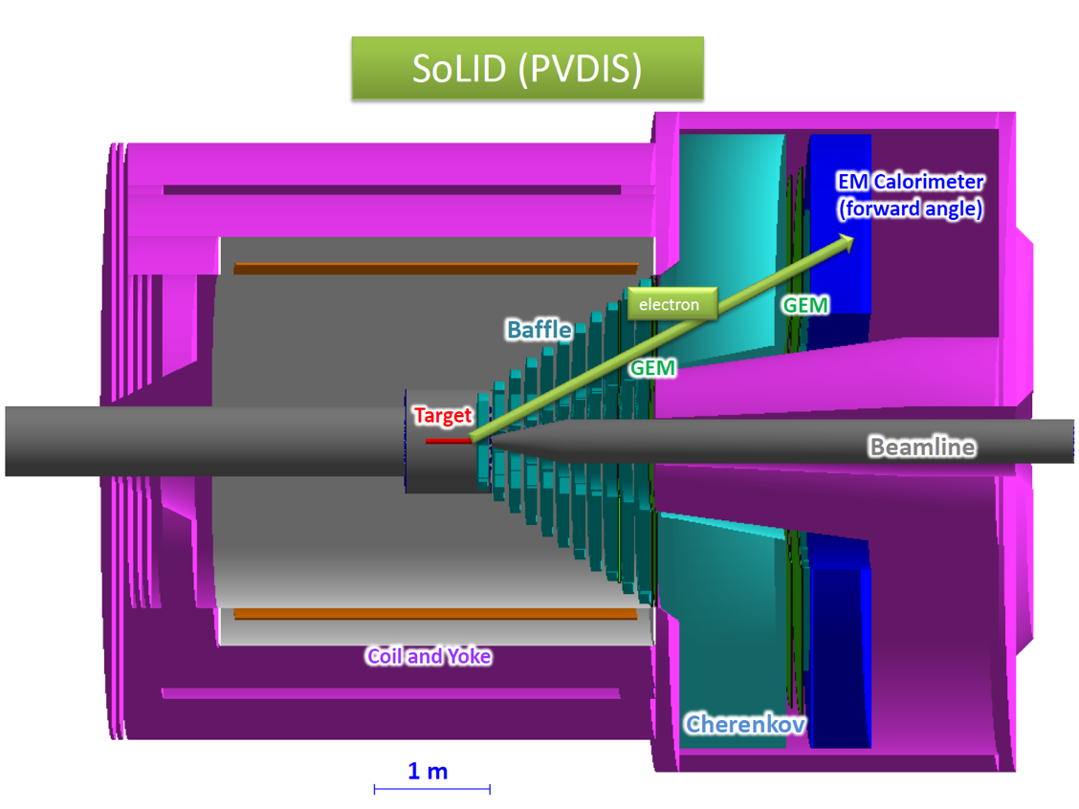
SoLID
SoLID is another experiment proposed for installation hall-A at JLab.
In the PVDIS configuration electrons are scattered of a fixed target at high luminosity – single electron event.
The detector is split into radially 30 sectors each would generate data at rates of up to 1 Gbyte/s for a 30 Gbyte/s detector total.
Challenges :
  How to handle 30 Gbyte/s affordably?
  How to deal with hits at edges that span two sectors?
  How to integrate GEM with other detectors?
Good candidate for streaming SAMPA like
  GEM readout.
  Each sector can stream separately.
  Deal with edge effects offline.
Use TDIS as technology stepping stone.
See Alex’s talk

Slide 16
Generic stream based readout
Rad hard detector interfaces convert detector signals into serial stream.
Stream processor – “smart” FPGA and maybe CPU equipped electronics processes the raw stream to reduce data rate.
  See CRU in earlier slide
Stream aggregator - since there may be many stream processors an optional SA aggregates streams to reduce the number of cables
  Note : this is NOT event building, this is pushing more than one stream down a single fiber.
  SA’s can be cascaded in a large system.
  If the fiber protocol is a network standard like Ethernet we connect directly to a switch.
  If not then we will provide a PCI card to put in the storage node(s).

Slide 17
Thoughts - electronics
Separating the detector interface (DI) from stream processing reduces the amount of electronics in a high radiation environment.
Stream Processor (SP) can be used with different detector types.
  Firmware tracking, pattern finding, zero suppression etc.
The Stream Aggregator (SA) reduces the number of long distance physical connections.
  Firmware tracking, pattern finding
  Small setups would not need an SA. For small setups it will reduce cost if a CotS standard like Ethernet is used as the SP-SA and SA-SA serial protocol.
  Ethernet will have a performance impact. It may be better to use a lighter weight serial protocol with a low cost serial protocol transceiver (SPT) in a PCI format.
  Some minimal Ethernet interface will be very useful for debugging, monitoring etc.
Although there will be several flavors of detector interface the rest of the system is composed of only three boards SP, SA and SPT.
  Important for JLab where detector configurations change between experiments.
  A VME master carrier board for an SP could be developed that would allow readout of legacy VME based electronics.

Slide 18
Closer look at hardware
Raw data from the detector is continuously streamed from the DI to the SP.
An optional very basic trigger can be used by the SP to reject data from time periods likely to be unassociated with events.
The SP maintains a timestamp generator, set and synced via the serial interface and clocked via a system wide clock (if required) (SBIR).
ASIC on SP performs noise and zero suppression etc. outputs data tagged with source and timestamp.
  Raw stream may be Gbyte/s.
  SP aggregates several raw streams and reduces rate using algorithms in the ASIC.
Data packets are packed into a “time frame” which represents a fixed period of real time.
  Internal timestamps are relative to the frame start.
Frames stream to one or more servers where data is stored indexed by detector and time.
Concept is to have a common plug-and-play protocol on the green fibers.

Slide 19
Streaming data
Packets containing data are stored indexed by time and channel.
How to store and process data in this form? We are used to 1D files of events, this is a 2D structure indexed by detector and time.
Reconstruction software requests data for a particular channel based on a time window where the data associated with an interaction is likely to be found.
In this example time windows 2 and 3 overlap.
  The request for window 2 includes data from detector 4 belonging to interactions 2 and 3.
  The request for window 3 includes data from detector 3 belonging to interactions 2 and 3.
  Software needs be able to resolve these cases.
Note that this does not represent a layout in storage. Areas where there is no data would be compressed.
In a sparsely occupied detector there could be considerable time periods where there is no data from a detector.

Slide 20
Moving forward
JLab has several proposals, TDIS and SoLID are examples, that would benefit from streaming mode readout.
The technology, both hardware and software is available and affordable to allow us to move to this mode.
  Proven by LHC readout and adopted at other labs.
  Simpler and more robust than the current readout mode.
  Other advantages over pipeline readout already mentioned.
We will develop a test stand to investigate techniques and technologies.
We will develop a way to integrate legacy hardware.
The goal is to use this mode for TDIS.
If pilot system is successful:
  Investigate moving CLAS and GlueX to this mode.
  Use for SoLID and future JLab experiments.
    I hope we may see new or modified proposals based on this.
  Use for EIC?

