Slide 1
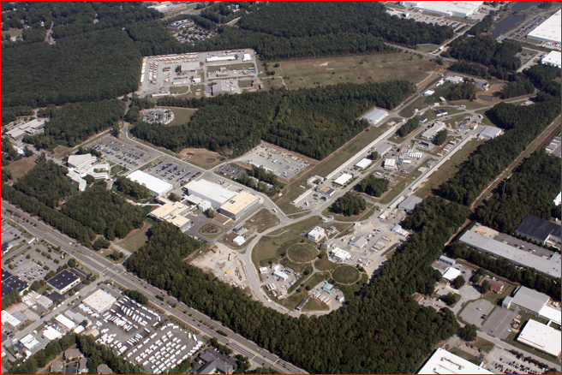
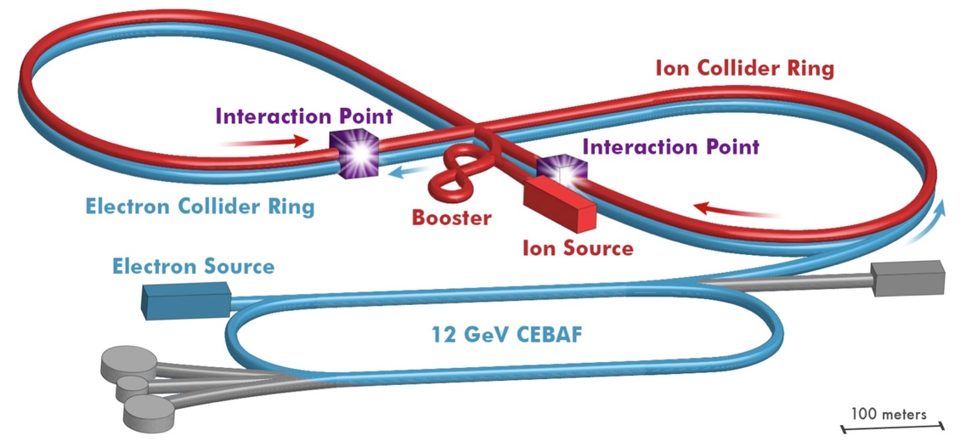
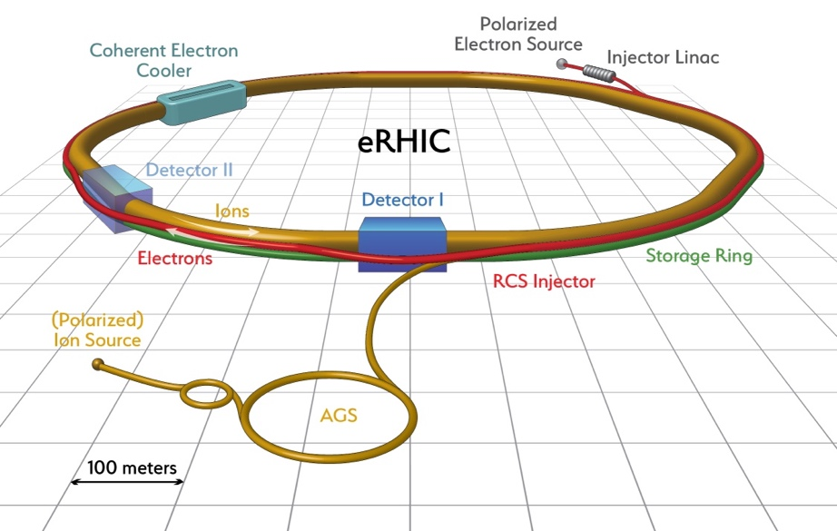
Streaming readout for a 12 GeV CEBAF and a future EIC.
CEBAF at Jefferson Lab
EIC at Jefferson Lab
EIC at Brookhaven Lab
Graham Heyes

Slide 2
Introduction
About Jefferson Lab.
Current State Of The Art
Looking forward:
JLab 12 GeV experiments.
An Electron Ion Collider.
Trends in computing and electronics.
What is Streaming Readout?
Contemporary examples
Ideas for the future
Where do we go from here

Slide 3
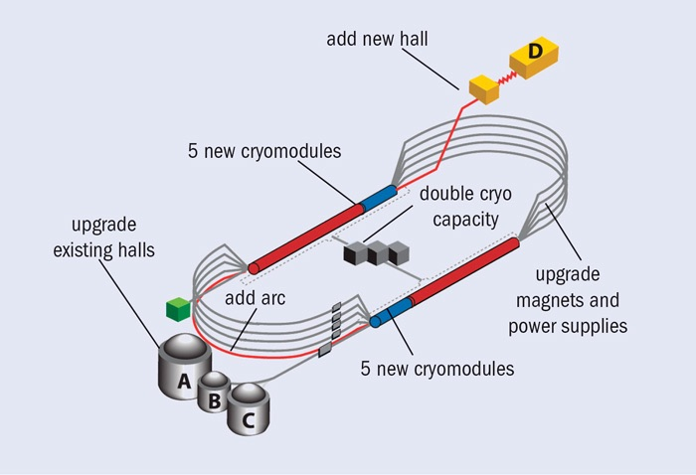
Jefferson Lab
The principle goal of Jefferson lab is nuclear physics research using the CEBAF electron accelerator.
Two superconducting LINACs with recirculating arcs.
Simultaneous beam to multiple halls.
Each hall has equipment designed to study different, but complementary, aspects of matter in the nucleus.
Recently we completed an upgrade of the accelerator from 6 GeV to 12 GeV, complemented by upgraded detectors and a new experiment, GLUEX, in a fourth hall.
D
NL
SL
A
B
C

Slide 4
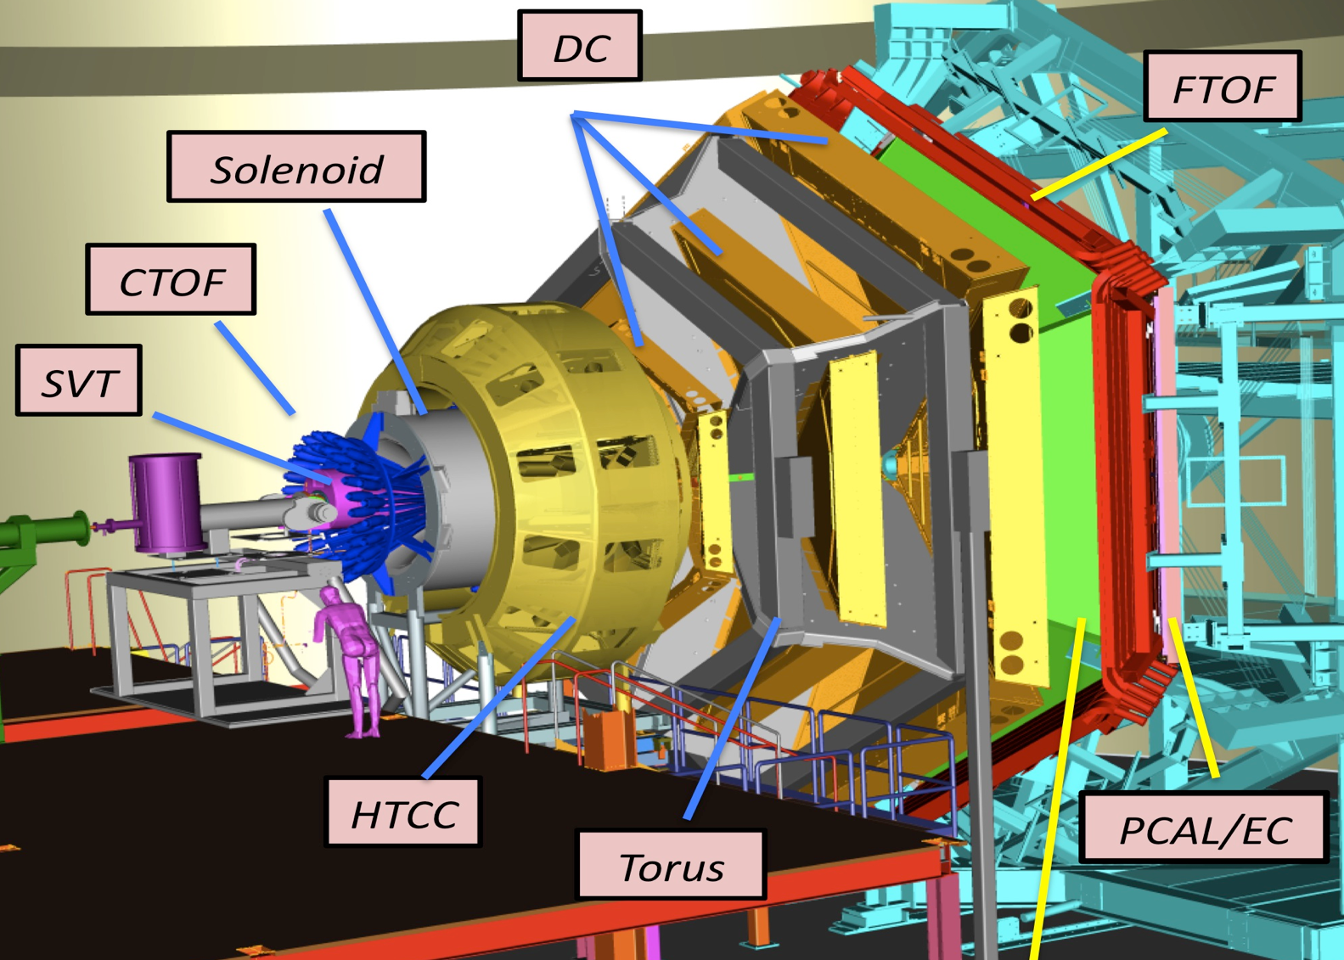
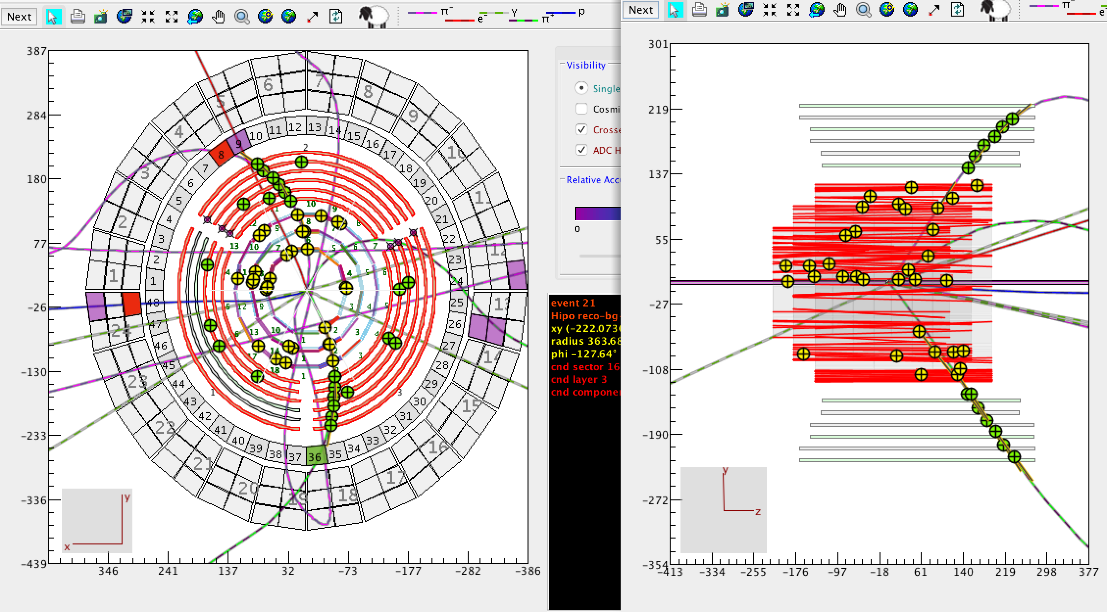
Hall-B CLAS12 – Large Acceptance Spectrometer
Large number of individual detectors.
“Run Groups” of experiments with shared beam and target requirements share data.
Event rate 12 kHz.
Event size 50 kB.
Working to lower this.
Over 100 embedded processors.
LTCC

Slide 5
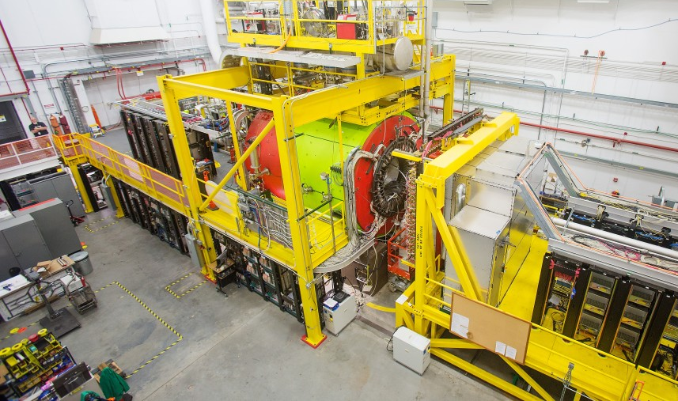
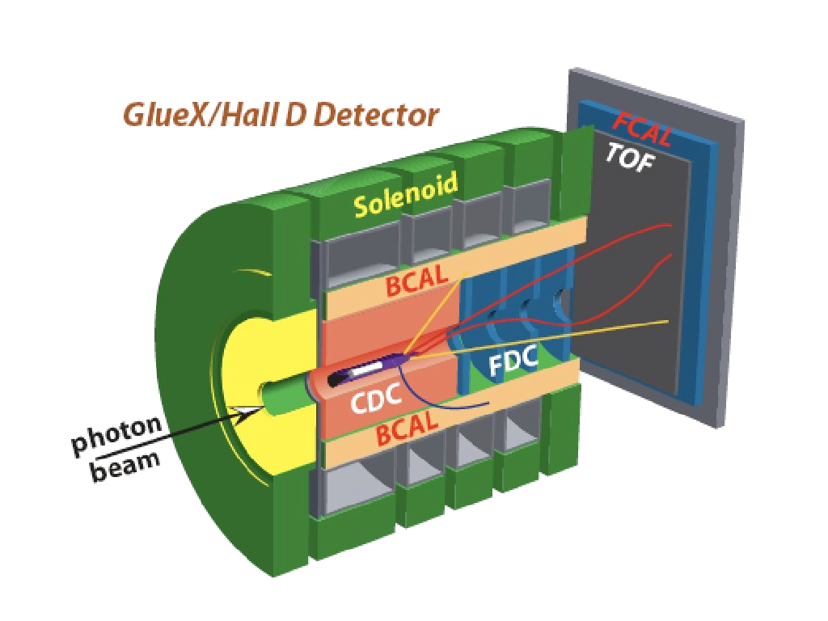
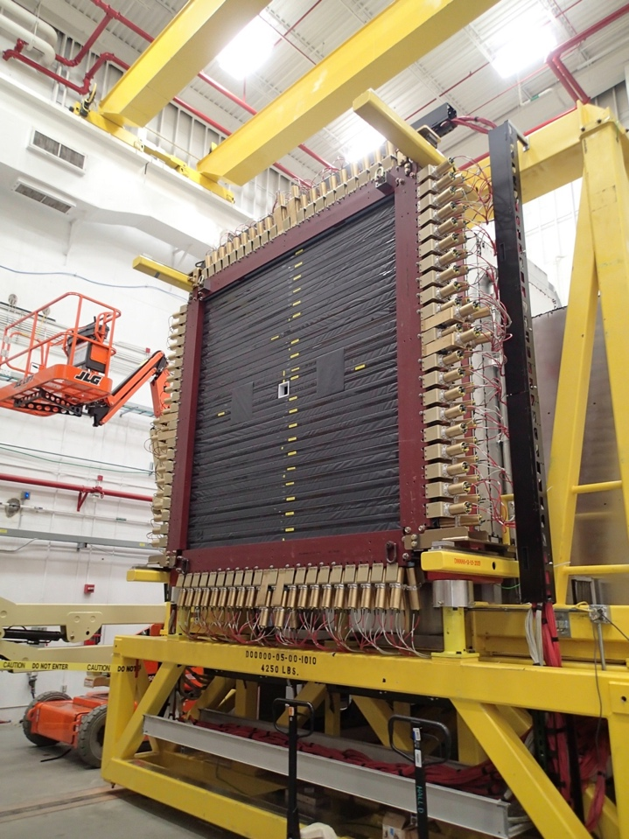
Hall-D GLUEX detector
Electron beam converted into photon beam.
Event size 17 kB.
Event rate 90 kHz.
Data rate ~1.5 GB/s
Data is spread over 50+ VME systems.
“Pipeline mode” readout.

Slide 6

Summary of SoA at JLab – pipeline mode
Data is split into trigger and DAQ paths.
Trigger data read over VXS serial backplane by Crate Trigger Processor and passed to global trigger.
Trigger formed in electronics
Blocks of data queued in “pipeline” while trigger is made.
Readout of the DAQ data by embedded CPU over VME.
Data sent over network to Event Builder
Pros:
Data stream is a stream of events containing data from detectors.
Trigger filters “unwanted data”.
Well understood way of doing things.
Cons:
Have to delay prompt data until slowest data appears.
Relies on good understanding of trigger.
All parts of DAQ have to work.
One failure stops the pipeline.
Doesn’t work well when events overlap in time.
Major bottlenecks – worked around via parallel multi-stage event builder.

Slide 7
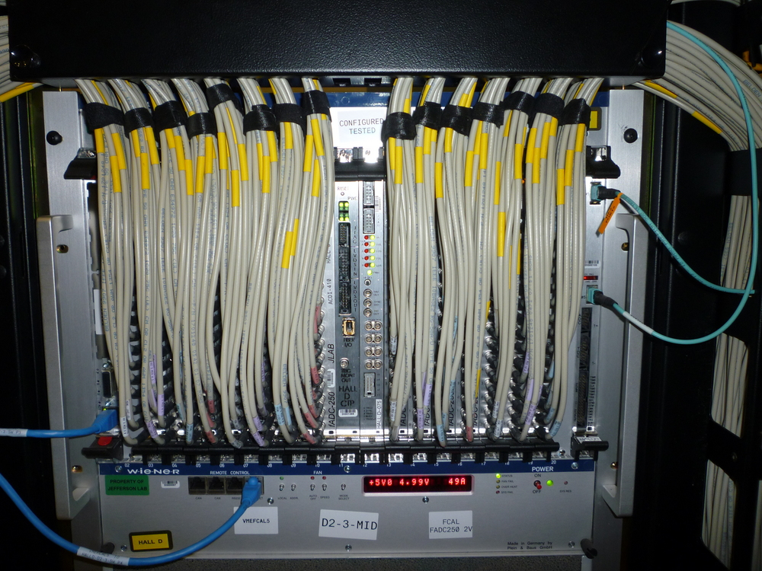
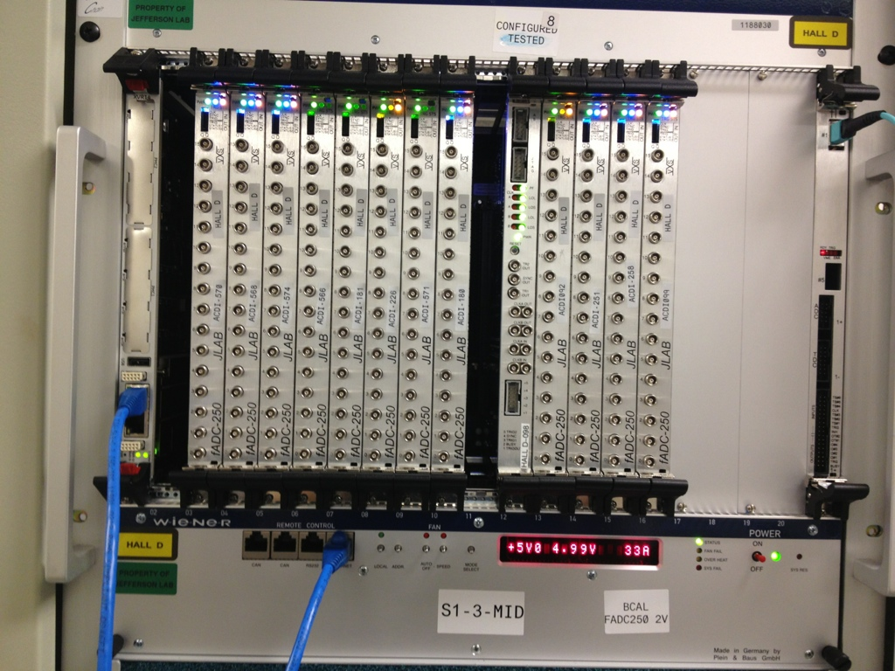
Real world example
Individual ADC channel
16 channels per board
Intel CPU Read Out Controller
(ROC) running Linux
17 boards = 272 channels per crate
Not cheap.
VXS crate +
ADCs +
CPU +
Trigger interface +
Crate trigger processor +
Trigger Signal Distribution
~$90k
Trigger interface
Boards are connected to CPU via a VME backplane and trigger via VXS serial bus.
Crate trigger processor

Slide 8
Looking forward
New experiments are being proposed
Detectors that do not play well together due to timing.
Traditional trigger and event builder strategies are not ideal.
Detectors with peculiar topologies.
Detectors split or segmented in a way that makes forming a trigger hard.
High event and/or data rates.
Particles from more than one event in a detector at the same time – need to disentangle.
The data acquisition from these experiments does not fit well with current techniques.

Slide 9
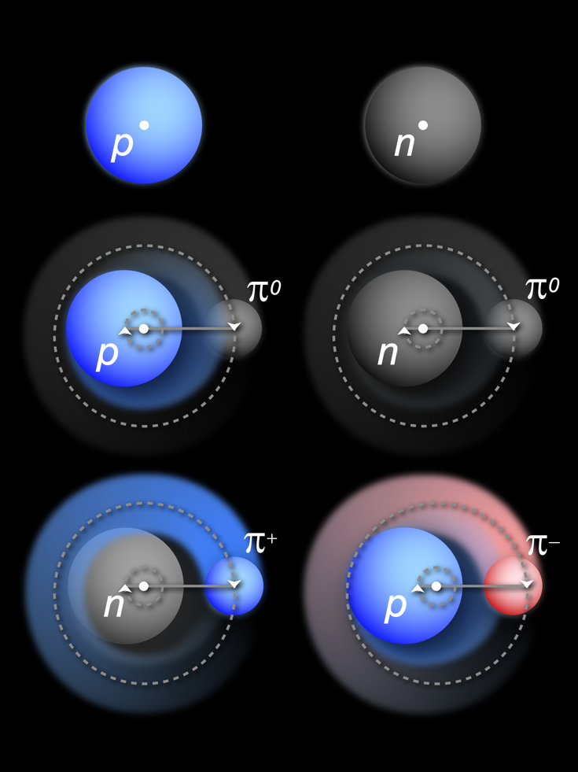
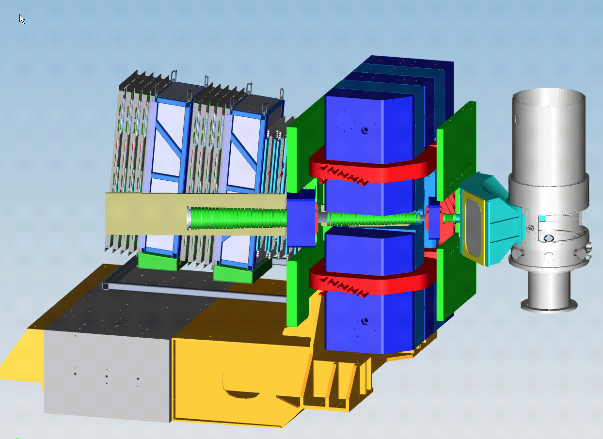
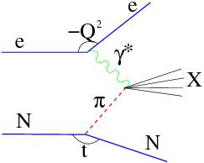
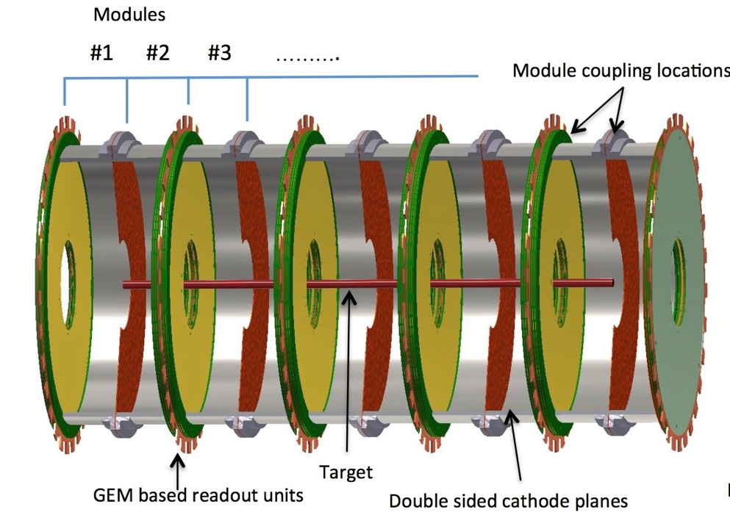
Tagged Deep Inelastic Scattering (TDIS): Probing the Mesonic Structure in the Nucleon
TDIS Scientific Goal: Access Elusive Partonic Structure of Mesons by Using Mesons in Nucleons as “Target”
Scattered electrons detected in planned Hall-A Super Bigbite Spectrometer.
“Spectator” protons detected by radial Time Projection Chamber (rTPC).

Slide 10
TDIS - Challenges
It takes up to a microsecond for the proton track to trace itself out on the wall of the TPC.
Super Bigbite electron detectors are much faster – large timing mismatch.
Large flux of background electrons not associated with a proton.
Multiple protons in the TPC at the same time.
TPC has 25,000 pads, hit rate per pad ~800 kHz.
Data rate from TPC up to 4 Gbyte/s total.
How to read this out and match up the electrons with the protons?
Event building online at these rates is a bottleneck.

Slide 11
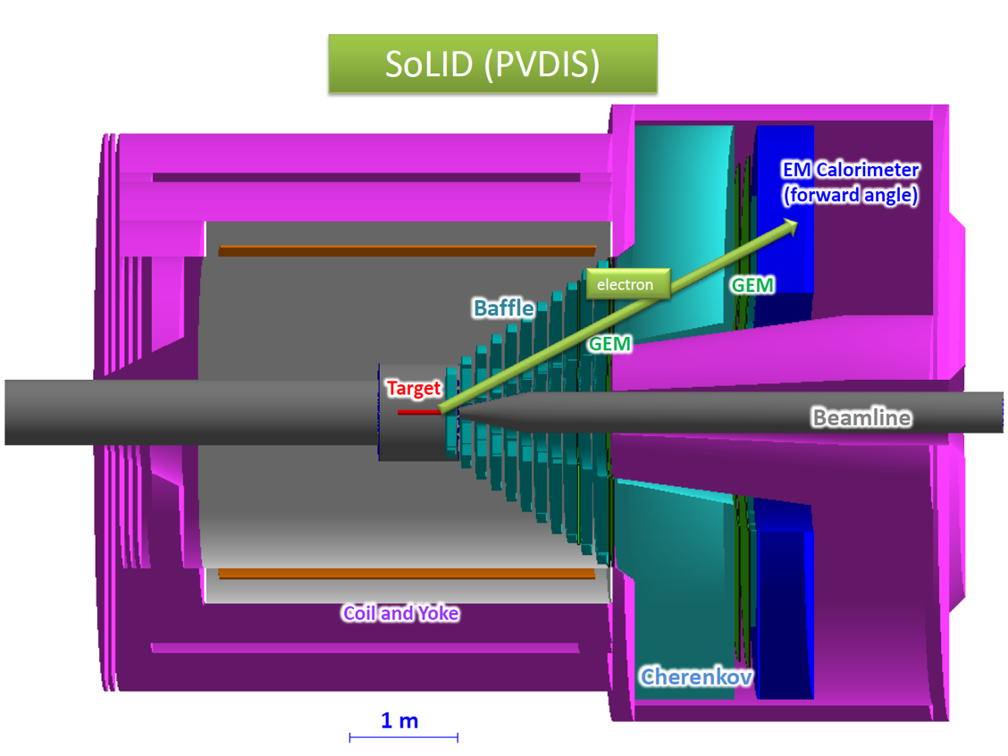
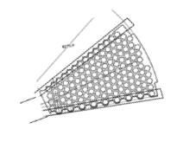
SoLID
SoLID is another experiment proposed for installation hall-A at JLab.
In the PVDIS configuration electrons are scattered of a fixed target at high luminosity.
Spiral baffles cut background.
The detector is split into radially 30 sectors, the single track event topology allows 30 DAQ systems to be run in parallel at rates of up to 1 Gbyte/s each 30 Gbyte/s total
Challenges :
How to handle 30 Gbyte/s affordably?
Hits at sector edges span two sectors?
How to integrate GEM with other detectors?
GEM detectors are segmented into 30 sectors.
Baffles constrain momentum

Slide 12

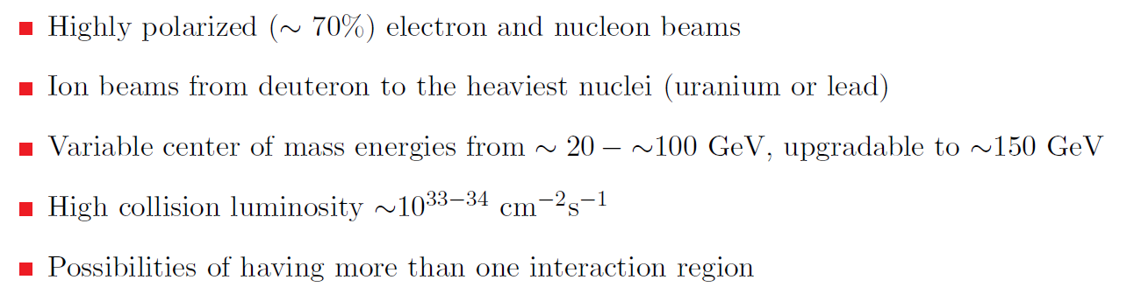
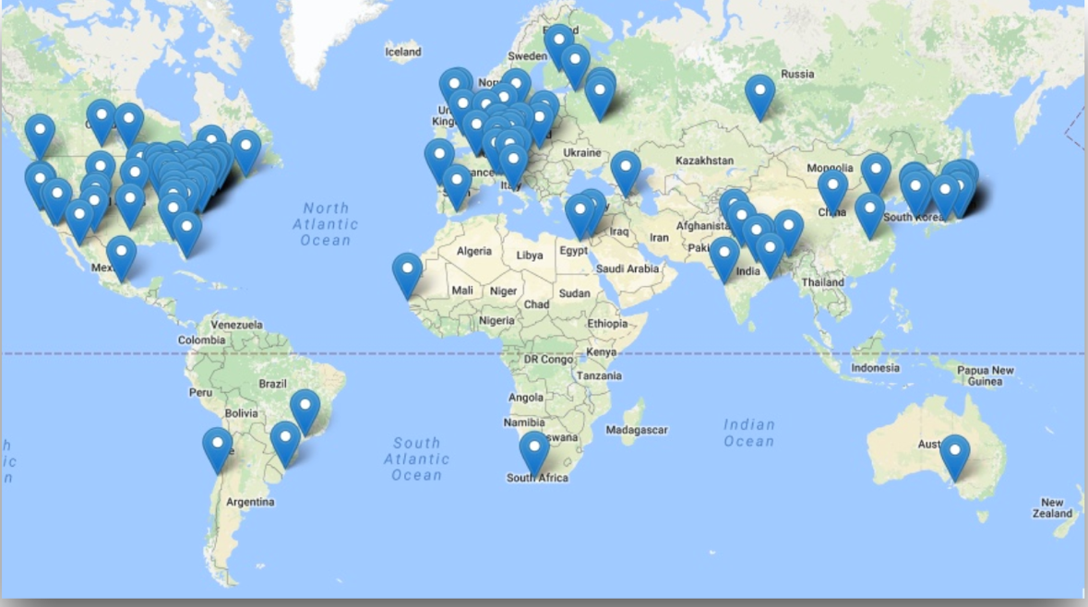

Electron-Ion Collider: The Next QCD Frontier
EIC Physics
Whitepaper
2013
Electron-Ion Collider (EIC) parameters
Realization Proposals
Jefferson Lab
Brookhaven Lab
EIC Users Group
~800 members
168 Institutions
29 Countries
NAS report on EIC science imminent
Next Step: DOE CD0 (2018 or 19?)

Slide 15
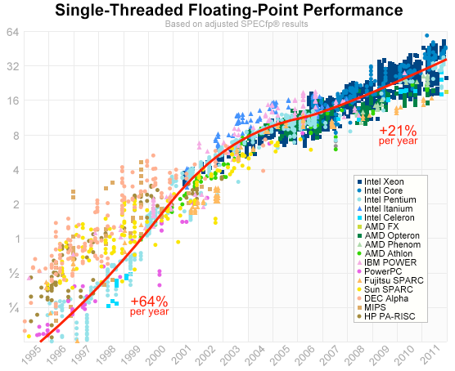
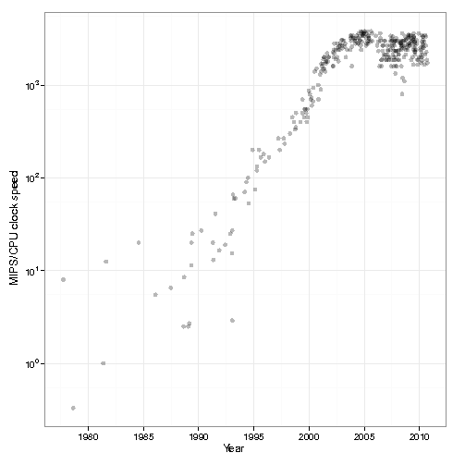
Trends - computing
Famous Moore’s law - transistor count doubles every two years.
In fact MIPS/clock speed plateaued in ~2005.
Matters because online we rely heavily on integer performance.
Remaining gains rely on a much slow growth in clock speed since ~2000.
Current advances by squeezing more cores per chip and improved architectures – vector processing units etc.
MIPS / clock speed

Slide 16
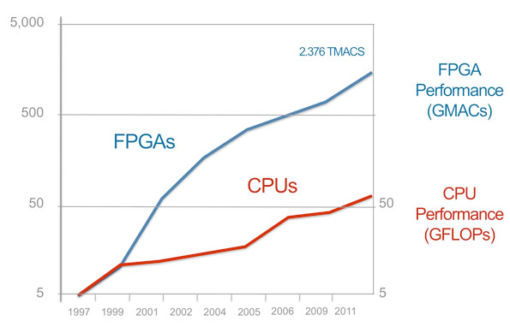
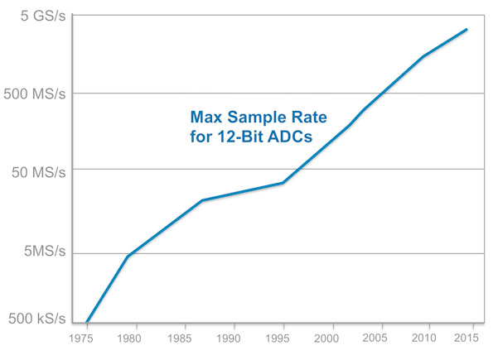
Trends - electronics
Already at JLab the number of channels per crate is limited by VMEbus bandwidth.
Move to other industry standards like MicroTCA?
Crateless serial fiber networks.
Current trend is to push some functionality currently performed in software running on embedded processors into firmware on custom electronics. Drivers are :
Slow increase in single thread CPU performance.
Availability of “large”, easily programmable, affordable components.
Delay between when technology is developed and when it becomes affordable for use in custom electronics means that there is room for growth over the next ten years.

Slide 17
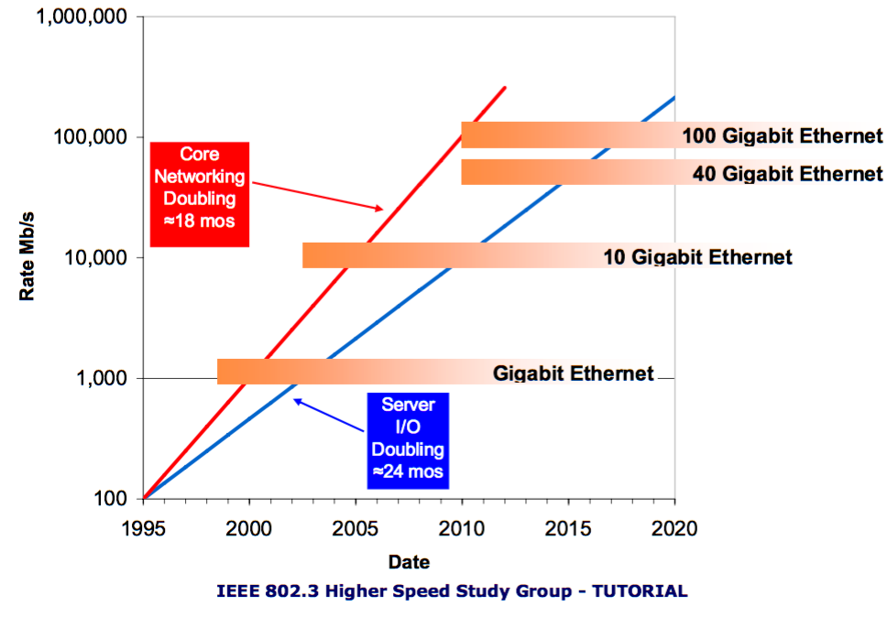
Trends - data transport
What matters is not only what technology exists but also whether it marketable and affordable.

Slide 18
What would we expect to be happening?
If we extrapolate current trends:
CPUs are becoming more powerful but the performance that matters for online systems is achieved mainly through doing more in parallel rather than improvements in per-core performance.
FPGA performance, affordability and usability are still improving.
IO and serial network bandwidth still seem to be growing exponentially.
It is time to revisit the ideas that have dominated nuclear physics detector readout for the past twenty or thirty years.
Move things that we moved from hardware to software 25 years ago back into hardware (or at least firmware).
Reevaluate the use of busses – serial links may be more cost effective.
Reevaluate data flow.

Slide 19
Streaming mode
In traditional triggered readout:
Data is digitized into buffers and a trigger, per event, starts readout.
Parts of events are transported through the DAQ to an event builder where they are assembled into events.
At each stage the flow of data is controlled by “back pressure”.
Data is organized sequentially by event.
A variation increases bandwidth by moving blocks of events.
In a Streaming readout:
Data is read continuously from all channels.
Validation checks at source reject noise and suppress empty channels.
The data then flows unimpeded in parallel channels to storage or a local compute resource.
Data flow is controlled at source.
Data is organized in multiple dimensions by channel and time.

Slide 20
Streaming advantages
The lack of a trigger means that:
Potentially useful physics is not discarded.
Run groups of experiments in parallel.
The system is simplified.
Readout speed is independent of detector response time.
Flow control at data source not via backpressure.
Parallel timestamped streams mean:
System is robust against minor hardware or firmware glitches.
Can use different analysis techniques such as looking for hit patterns rather than reconstructing events.
Requires robust and accurate time stamp generation and distribution.
Is still a simpler task than an online trigger.

Slide 21
What does streaming readout solve?
TDIS
High data rate from TPC handled as parallel streams – no one stream handles the full rate.
Electron data is it’s own stream and is matched up with proton candidates offline – removes high rate event building issue.
SoLID
High rates from GEMs handled in parallel – no event building.
Sector edge effects and correlation with other detectors is handled in software offline.
EIC
All of the above.
New data analysis modes – for example looking statistically at hit distributions instead of event-by-event analysis.
Analogy – crystallography looks at diffraction patterns rather than ray tracing every x-ray through a crystal.

Slide 22
State of the art – sPHENIX (Hi Martin)

Slide 23
State of the art – sPHENIX (Hi Martin)

Slide 24
State of the art - LHCb

Slide 25
Generic stream based readout
Rad hard detector interfaces convert detector signals into serial stream.
Stream processor – “smart” FPGA and maybe CPU equipped electronics processes the raw stream to reduce data rate.
Stream aggregator - since there will be many streams need to reduce the number of cables
Note : this is NOT event building, this is pushing more than one stream down a single fiber.
Modularity allows growth from small to large systems.
If the fiber protocol is a network standard like Ethernet we connect directly to a switch.
If not then we will provide a PCI card to put in the storage node(s).

Slide 26
Concept- hardware
Raw data from the detector is continuously streamed
A very basic trigger is be used to reject time periods unassociated with events.
The SP can reject noise and “zero suppress”.
Data packets are packed into an efficient standard format and sent over a standard hardware interface.
If all components use the same hardware interface and format we have a “plug and play” system!!
Individual components should be cheap!
One of out VXS crates with support boards such as CPU and trigger cards costs ~$90k!
Stream via a CoTS standard like Ethernet?

Slide 27
Concept - software
Packets containing data are stored indexed by time and channel.
How to store and process data in this form? We are used to 1D files of events, this is a 2D structure indexed by detector and time.
Reconstruction software requests data for a particular channel based on a time window where the data associated with an interaction is likely to be found.
In this example triggers 2 and 3 close together.
The request for trigger 3 gets part of trigger 2 data from detector 3.
In this case it is resolved because that data appears too early in the region of interest to be from the trigger 3 event.
Note that this does not represent a layout in storage. Areas where there is no data would be compressed.

Slide 28
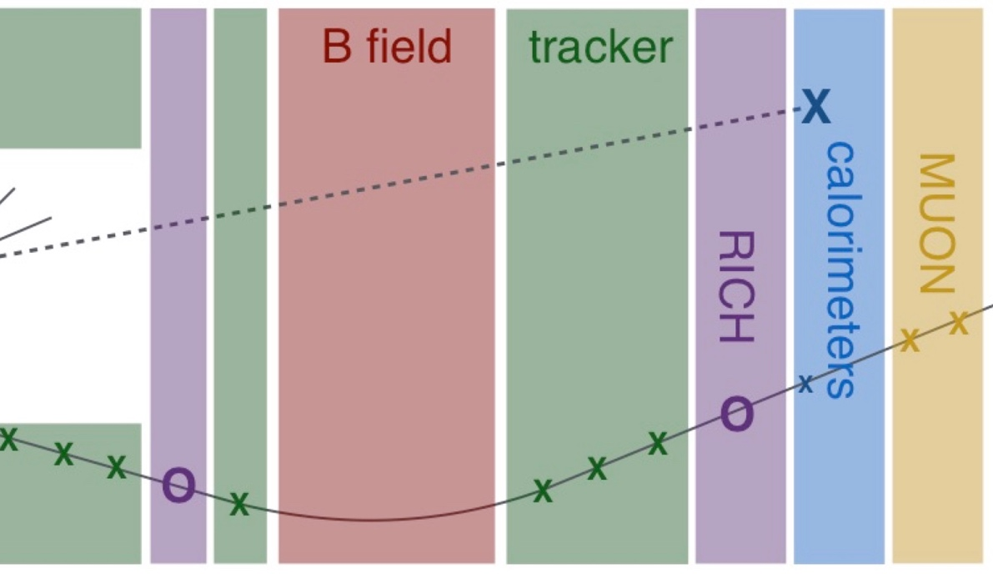
Integrated readout and detector design
In many experiments someone builds a detector and someone else has to figure out how to read it out and integrate it into the DAQ.
With a streaming system this is, in principle, simpler because each detector generates one, or more independent data streams in a standard format – plug and play.
It is still easy to fall into the trap of adding bottlenecks by having many parallel streams but the bulk of the data generated in only a few very high bandwidth streams.
Avoid generating data that is costly to process:
Tracking in weird magnetic fields.
Data packed in a convoluted way.
Segmented detectors that have a lot of overlap between sectors.
Here tracking is done outside the field to reduce processing cost.

Slide 29
Where do we go from here
JLab has several proposals, TDIS and SoLID are examples, that would benefit from streaming mode readout.
The technology, both hardware and software is available and affordable to allow us to move to this mode.
Proven by LHC readout and adopted at other labs.
Simpler and more robust than the current readout mode.
Other advantages over pipeline readout already mentioned.
We will develop a test stand to investigate techniques and technologies.
We will develop a way to integrate legacy hardware – CLAS12?
The goal is to use this mode for TDIS.
If pilot system is successful:
Investigate moving CLAS12 and GlueX to this mode.
Use for SoLID and future JLab experiments.
I hope we may see new or modified proposals based on this.
Use for EIC?

Slide 30
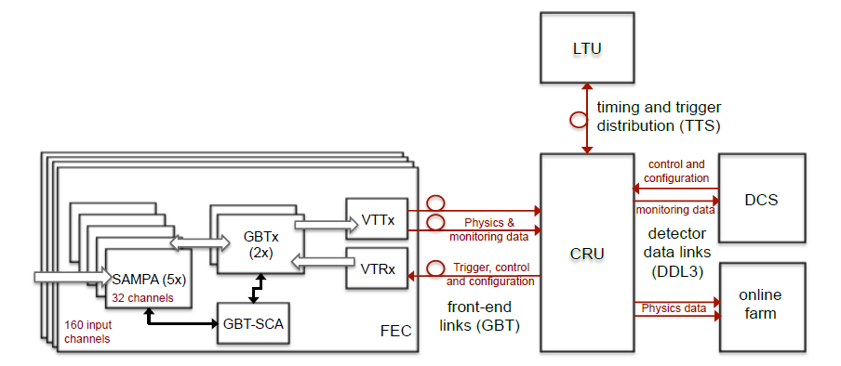
JLab TDIS TPC test stand using SAMPA
Fast Track test stand– use as many components of the ALICE TPC readout/control chain as possible
Target test stand operational July 1st 2018
Validate use of SAMPA for TDIS
Experience reading a detector in streaming mode
Guide future R&D effort in this area
Rad. hardened
FEC – Front End Card
CRU – Common Readout Unit
DCS – Detector Control System
LTU – Local Trigger Unit

Slide 31
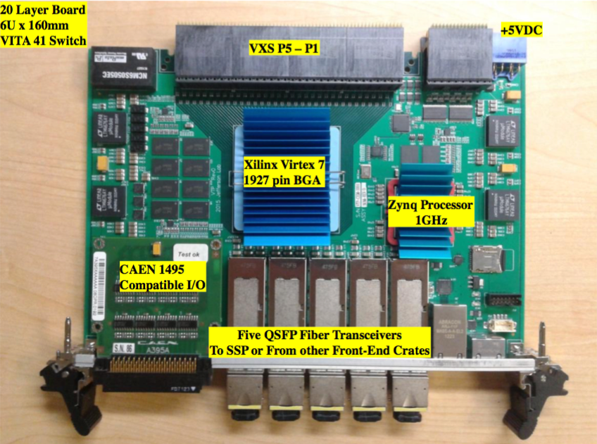
JLab – DAQ and Electronics R&D
The VTP board is able to read 250 MHz fADC via the VXS serial lines and stream the data out over the front panel transceivers.
Read a crate in this mode.
Zero suppression logic
Flow control
What comes out on the front panel fiber?
How to interface with DAQ?
Read out some detectors in streaming mode!
Integrate with TDIS test-stand.
Can we replace the CRU etc?
Can we repackage to remove need for expensive VXS crates etc.
Cheap system for university groups!

Slide 32
EIC focus group
Two streaming readout workshops, last one January 2018
Virtual meetings regularly and also discuss via a mailing list :
https://mailman.mit.edu/mailman/listinfo/eic_streaming_readout
Subgroups looking at :
Pilot projects
Electronics
Software
Protocols
Detectors

Slide 33
EIC Streaming Readout Consortium
Catholic University of America - S. Ali, V. Berdnikov, T. Horn, I. Pegg, R. Trotta
INFN - M. Battaglieri (Co-PI), A. Celentano
MIT - J.C. Bernauer* (Co-PI), D.K. Hasell, R. Milner
* Also Stony Brook University, Stony Brook, NY
Jefferson Lab - C. Cuevas, M. Diefenthaler, R. Ent, G. Heyes, B. Raydo, R. Yoshida
Proposal for streaming readout R&D targeted at EIC
Deliverable is a document/publication containing:
Reports on the relevant aspects of the performance of the prototypes studied.
A list and definition of streaming-readout parameters relevant to the EIC.
Initial estimates of some of the parameters with current technology as well as extrapolations to the time period of EIC detector construction phase.
A list and definitions of relevant parameters for detector technologies (e.g. TPC, Crystal Calorimeter..etc.) when considering streaming readout.
Initial estimates of some of these parameters.
Projects
TPC in streaming-readout at JLab
Crateless-Streaming at JLab
FEE and Circuit Designs for Streaming Readout at MIT
Streaming readout for an EIC Calorimeter at INFN Genoa and CUA
Multilayered Architecture for Streaming Readout at Stony Brook
Growing list…

Slide 34
Summary
There are clear advantages to be gained by transitioning to a streaming mode of readout for 12 GeV CEBAF era detectors at Jefferson Lab.
Our plan is to begin with hardware already installed for detectors such as CLAS12 and gain experience.
In parallel we are looking forward to:
Proposals such as TDIS and SoLID that we can instrument for streaming mode readout from the start.
EIC focused R&D and collaborations to generate standards for such systems and provide input for EIC detector design.
We hope that by forward looking design we can influence new physics proposals by expanding the view of what is possible and enabling different techniques for data analysis.

